Slide 1
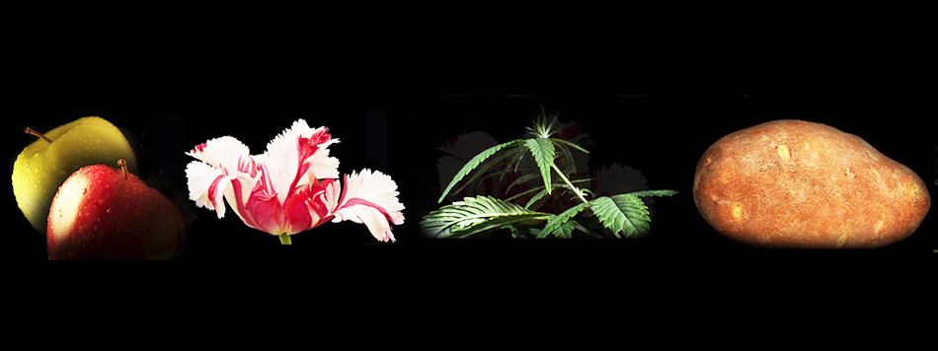
Assignment due March 30
The Botany of Desire, Michael Pollan
Watch online
BB link under “Videos”
Have a Netflix streaming account? Watch instantly
or
Watch closed caption DVD in Media Resources (library basement)
Complete quiz 8 by March 30 at midnight

Slide 2
Exam 2: April 3, 2014
Will cover material from Chapter 6 (fruits and seeds) through Chapter 19 (medicinal plants)
As before, focus on material covered in class.
Format: 50 multiple choice questions
Let me know if you plan to take the exam at the Exam Proctoring Center
My office hours are Tuesday, 4-5:30 p.m.
Kelly will hold a review session on Weds. evening from 7-9 p.m., location TBD.

Slide 3
Plant Secondary Compounds & Stimulating Beverages Chapter 16, pp. 263 - 278
Lecture Outline:
Plant secondary metabolites - a focus on alkaloids
Caffeine, a plant alkaloid
The biology, history, and processing of...
Coffee (Coffea arabica)
Chocolate (Theobroma cacao)
Tea (Camellia sinensis)

Slide 4
Secondary Compounds
What are plant secondary compounds,
a.k.a. secondary metabolites?
Q. First, what are primary metabolites?
A. Primary metabolites are major products of plant metabolism. They are necessary to the life of the cell and play a critical role in plant growth and function. Examples?

Slide 5
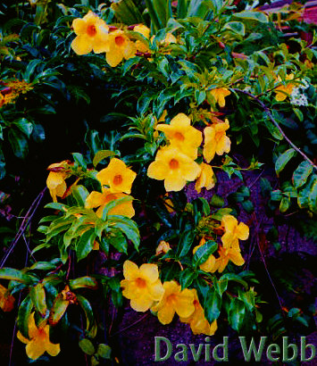
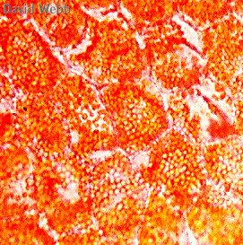
OK, then what are secondary metabolites?
Secondary metabolites are those that occur
usually only in special, differentiated cells and are
not necessary for the cells themselves but may be
useful for the plant as a whole. Examples
include pigments, scents, and defense compounds.
chromoplasts,
pigment-rich
organelles in
petal cells
orange flowers
of Allamanda

Slide 6
Q. What do secondary compounds do in the life of the plant?
A. Their role appears to be ecological: they serve as pollinator attractants, herbivore deterrents, etc.
“Plants can’t run away... But they are wonderful chemists” Ilya Raskin

Slide 7
These are the compounds that provide humans with:
Stimulants
Medicines
Poisons
Hallucinogens
Herbs, spices, and perfumes
and a host of others

Slide 8
Classes of Plant Secondary Compounds:
Terpenoids/Essential Oils
Phenolics
Glycosides
Alkaloids
and others

Slide 9
Classes of Plant Secondary Compounds:
Terpenoids/Essential Oils
Phenolics
Glycosides
Alkaloids
and others

Slide 10
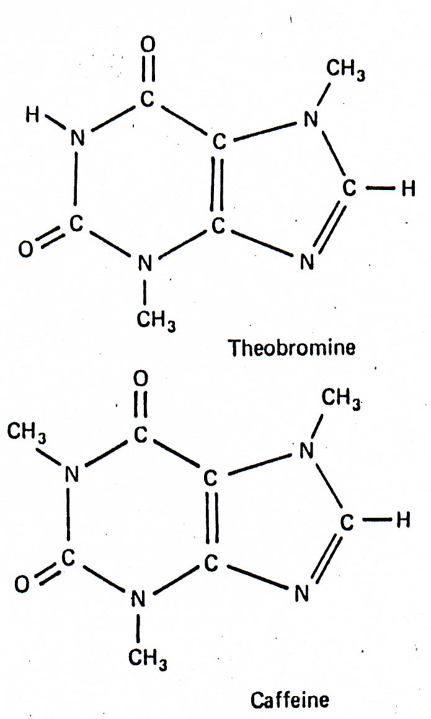
Alkaloids:
- ring compounds in which a nitrogen is included
- alkaline (pH > 7)
- bitter-tasting
- derived from amino acids

Slide 11
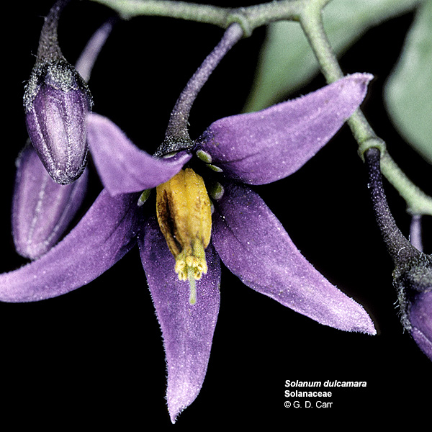
Alkaloids are present in more than 300 families of flowering plants
Families Rich in Alkaloids:
Nightshade family (Solanaceae)
Pea family (Fabaceae)
Coffee family (Rubiaceae)
Poppy family (Papaveraceae)

Slide 12
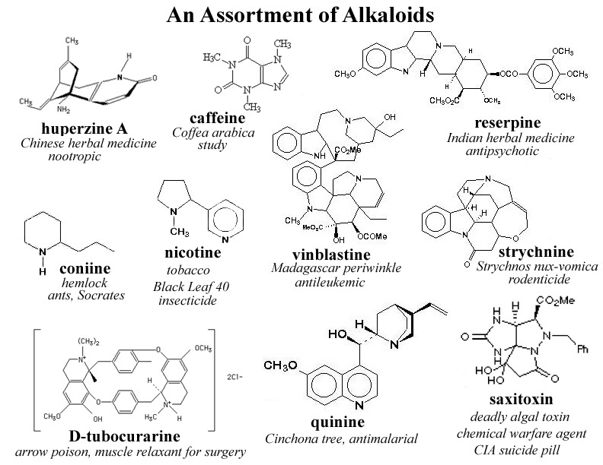

Slide 13
Notes:
Often added to aspirin: because headaches are often caused by dilated blood vessels in the brain, caffeine’s ability to constrict them enhances the effects of the pain-reliever.
Interestingly, according to the results of a recent study (of over 800 Japanese-American men in Hawaii), regular coffee drinkers have a significantly lower incidence of Parkinson’s disease, a neurological disorder in which dopamine-producing cells in the brain are destroyed over time.

Slide 14
So what is caffeine doing in the plant?
The Botany of Desire, Michael Pollan
According to Michael Pollan (The Botany of Desire),
caffeine “unhinges an insect’s nervous system and
kills its appetite.”

Slide 15
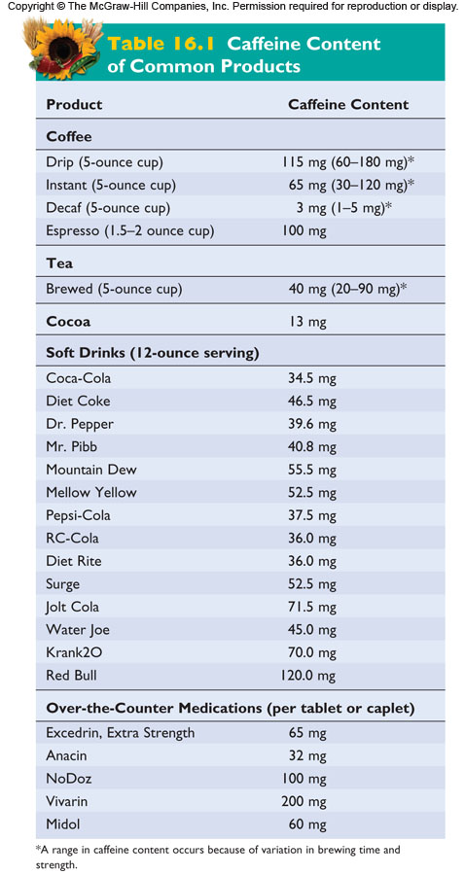
coffee
tea
cocoa
Red Bull

Slide 16
Concept Test ....................
Caffeine is considered an alkaloid because it:
is an herbivore deterrent.
has a stimulating effect on humans.
affects the central nervous system.
is a secondary metabolite produced by plants.
is an organic compound containing nitrogen in a ring structure.

Slide 17
Concept Test ....................
Caffeine is considered an alkaloid because it:
is an herbivore deterrent.
has a stimulating effect on humans.
affects the central nervous system.
is a secondary metabolite produced by plants.
is an organic compound containing nitrogen in a ring structure.

Slide 18
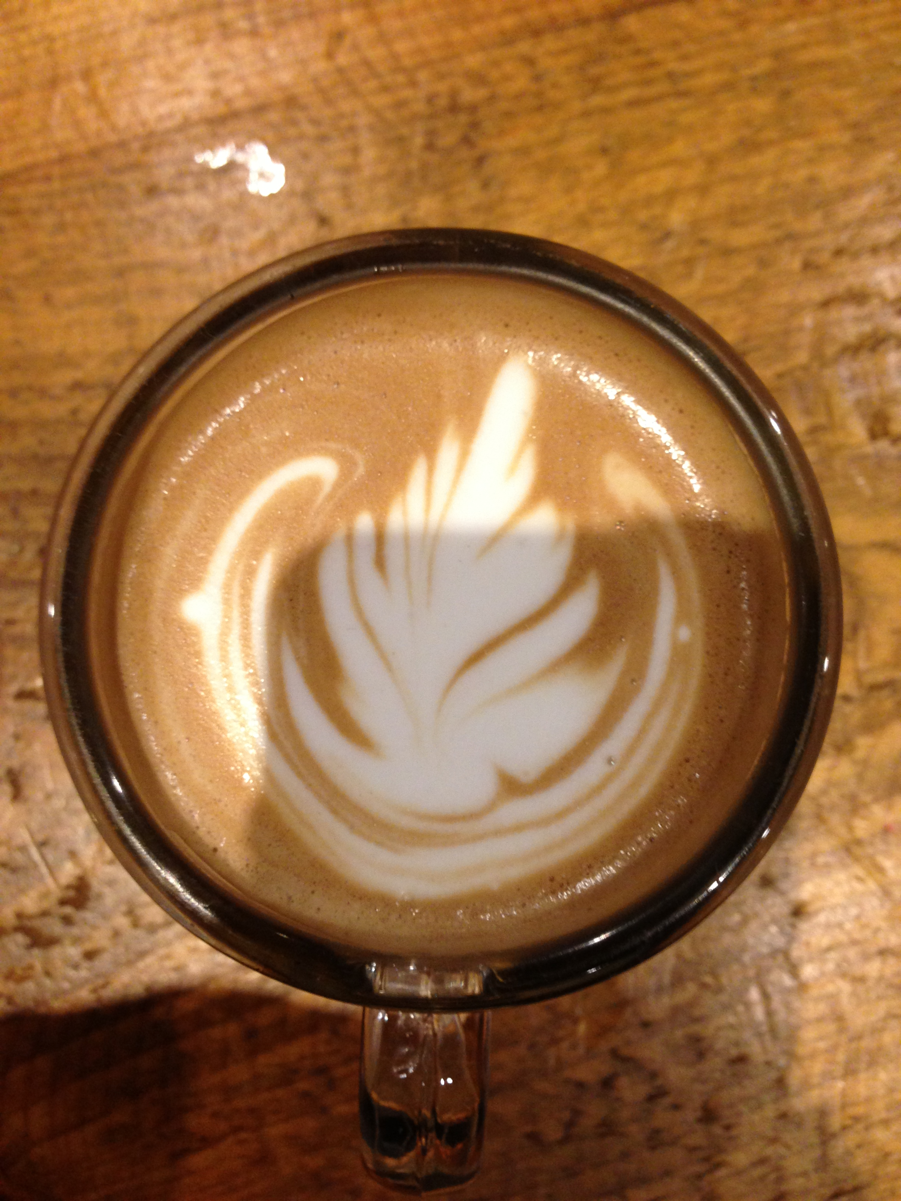
Stimulating Beverages:
Coffee, Tea, and Chocolate

Slide 19
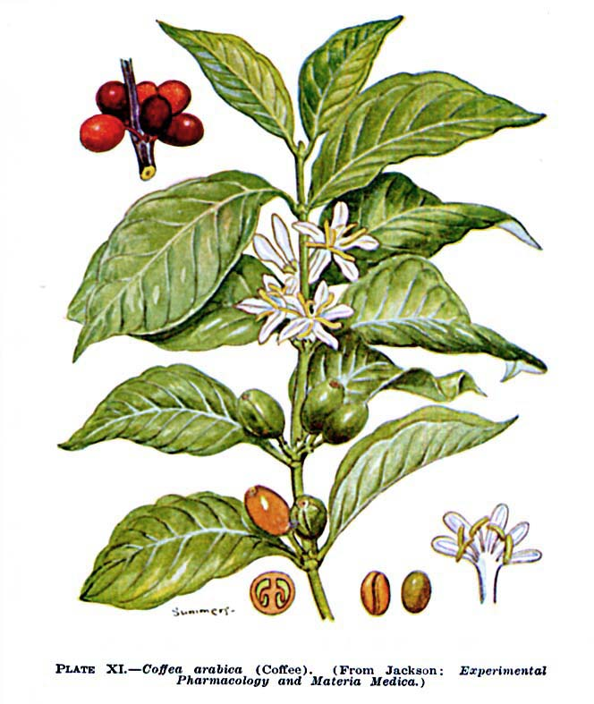
Coffee
(Coffea arabica)
Rubiaceae - the
Coffee Family

Slide 20
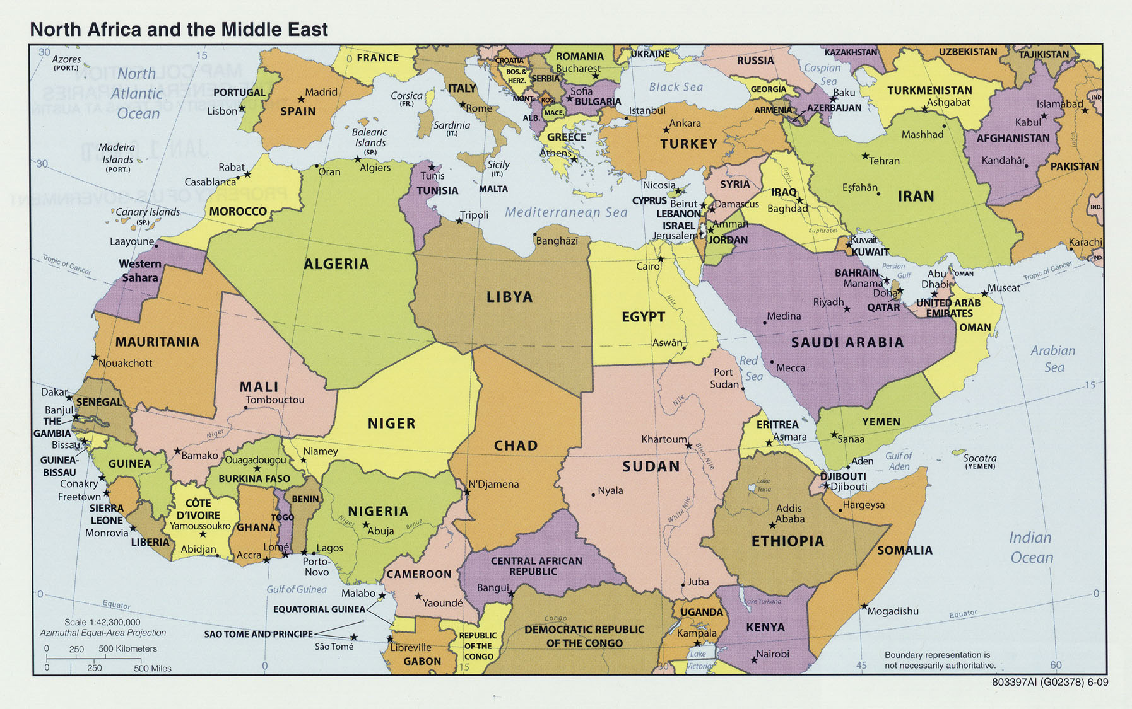
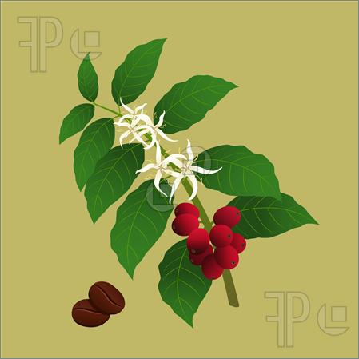
Notes:
Contrary to what the specific epithet implies, the plant is actually native to the plateaus of central Ethiopia, not Arabia.

Slide 21
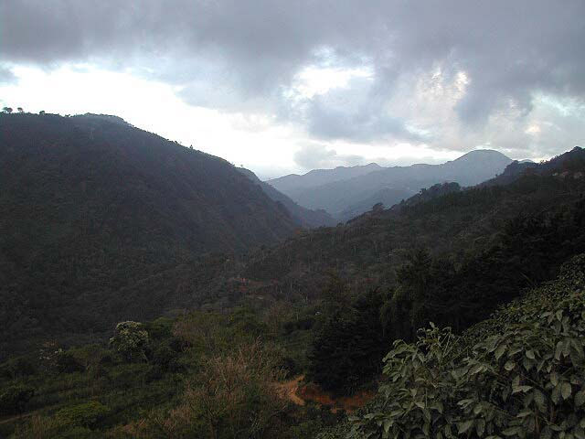
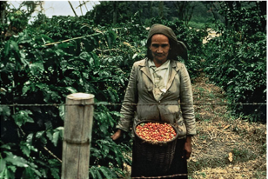
Coffee plants thrive at higher elevations, especially on volcanic slopes such as one finds in Hawaii and Costa Rica
Notes:
Species distribution is tropical or subtropical. Grow best in cool highlands; require 60-100 inches of rain per year. Intolerant of frost.
Coffee plants thrive at higher elevations, especially on volcanic slopes such as one finds in Hawaii and Costa Rica.
Coffee trees thrive where the soil is deep, hard, permeable, well-irrigated, with well-drained subsoil. The best lands are the hilly ones, those cut into a mountainside, of volcanic nature.

Slide 22
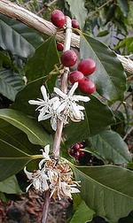
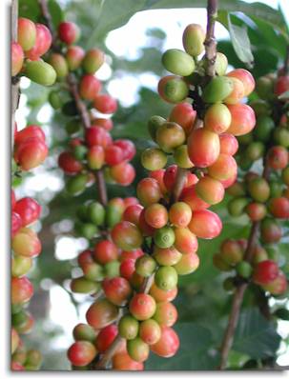
Coffee leaves are shiny, simple, and opposite.
Coffee flowers are small, white, and fragrant, in axillary clusters.

Slide 23
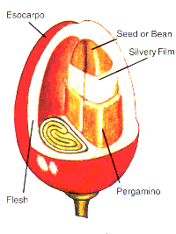
Coffee Fruit
exocarp
coffee bean (= seed)
endocarp
mesocarp

Slide 24
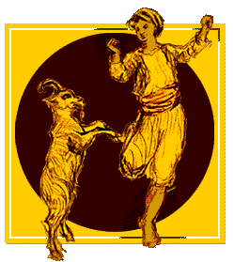
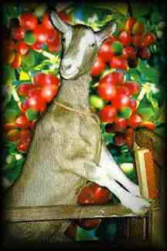
Coffee History
According to legend, coffee drinking began almost 12 centuries ago, when an
Ethiopian goat herd named Khalid noticed the antics of his frisky herd of goats …
Notes:
According to legend, coffee-drinking began almost 12 centuries ago (850 A.D.) when an Ethiopian goat herder named Khalid noticed that while the afternoon sun made him drowsy, his flock frolicked and skipped about after nibbling at some berries.

Slide 25
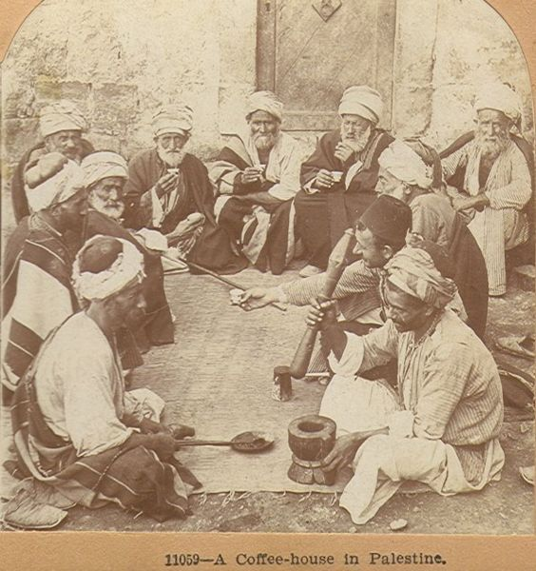
Notes:
Arab traders got the beans from Ethiopia across the Red Sea to Yemen around the 6th Century A.D. By 1500 A.D., coffee trees were widely cultivated in Yemen and coffee drinking had spread throughout the Arabian world. Coffeehouses established – places where men gathered to discuss politics, business, the affairs of the day.

Slide 26
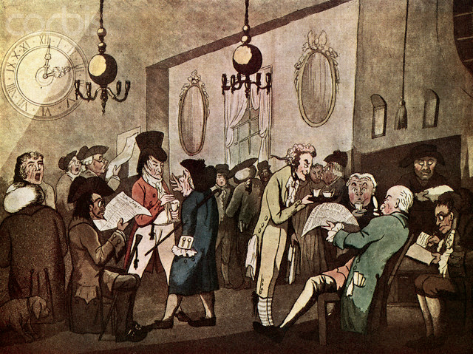
By the start of the 18th c., coffeehouses were well established in England as well.
Notes:
Venetian traders introduced coffee to Europe. By the start of the 18th c., coffeehouses were well established in England as well. The site of intellectual debate on many topics, they were sometimes called penny universities, that being the price of a cup of coffee! The famous company that insures ships, Lloyd’s of London, began as a coffee house.

Slide 27
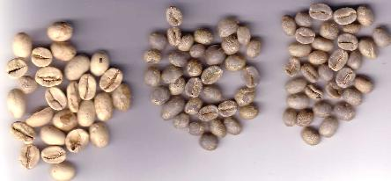
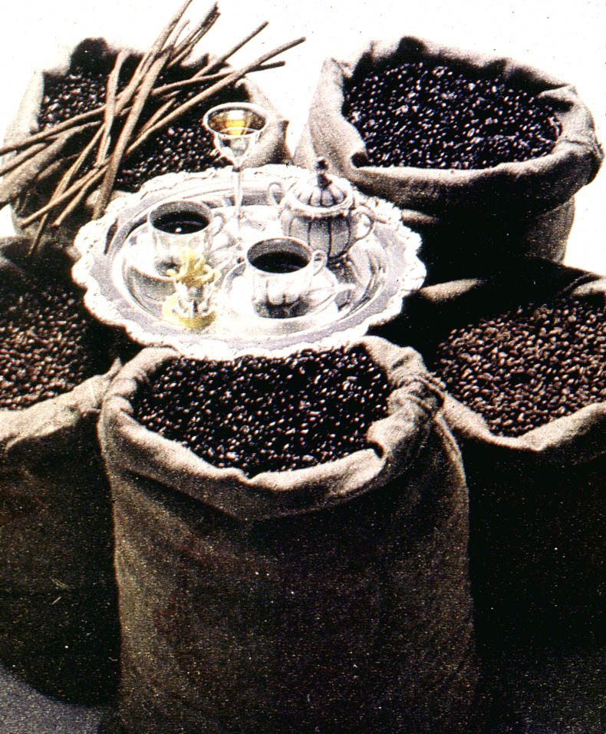
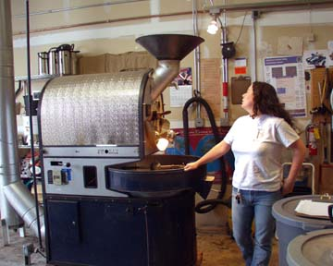
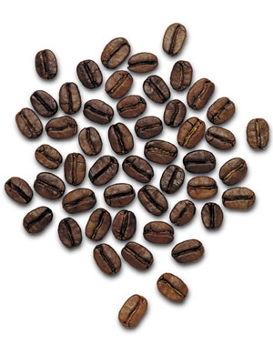
Roasting
Roasting is done in cylinders that
simultaneously heat and tumble the seeds.
Notes:
- Roasting – After a number of preliminary processing steps, beans are roasted, typically in the country where the coffee is to be consumed.
- Roasting is done in cylinders that simultaneously heat and tumble the seeds.

Slide 28
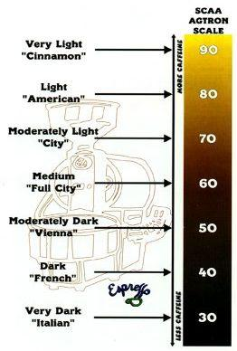
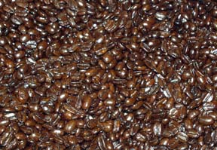
Coffee beans are roasted
at temperatures of about 400°- 480° F. for
about 10-15 minutes.
Notes:
- Beans are roasted at temps of about 400-450 degrees F. for 10-15 minutes. The kind of roast is determined by how long the beans are roasted and at what temp.
- Though dark roasts have more intense flavor that lighter roasts, they are not stronger. They feel oily because the roasting causes some of the aromatic oils to come to the surface.

Slide 29
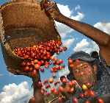
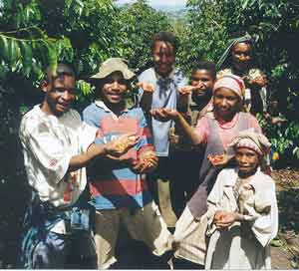
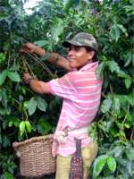
Coffee Economics
Coffee is the world’s second-most heavily traded commodity.
Unfortunately, the grower sees little of the profit.
Notes:
Millions of cups are consumed each day; some 20 million people around the world depend on coffee production for their income.

Slide 30
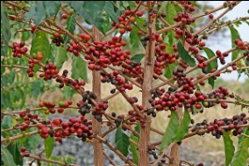
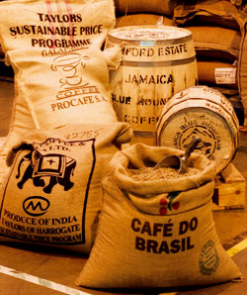
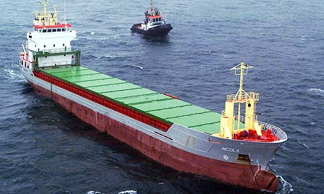
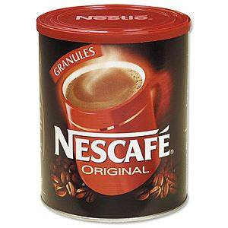
Coffee Commodity Chain
Farmer
Exporter
Shipper
Roaster
im.edirectory.co.uk
Retailer
Notes:
Although coffee is the second biggest commodity traded on the world market (after oil), farmers who grow coffee see very little profit. Consumers in importing countries spend roughly 40 billions US dollars annually, and yet, the average coffee farming family nets only $200-$300 in annual income. How is that possible? Most profits go to the middle men, especially the coffee roasters (eg. Kraft, Nestle). Coffee is grown mainly by families on small farms. Coffee ‘cherries’ are usually hand-picked, because they don’t all ripen at the same time.
The exporter sorts the beans into different sizes and packs them into bags. The bags are taken to the port for export.
The shipper transports the bags of coffee beans to countries where the beans will be roasted and blended.
The roasting industry is dominated by coffee companies such as Kraft and Nestle. This is where tremendous value is added to the product and profits sky-rocket.
The retailers include grocery stores, coffee shops, and restaurants where we buy coffee.
30

Slide 31
What percentage of the $4.00 that you might pay for a cup of premium coffee goes to the farmer that grew it?
$3.50
$2.00
$1.25
$0.50
$0.05
?
Notes:
31

Slide 32
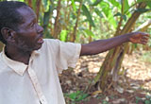
A Coffee Farmer’s Story
Lawrence Segunda, Uganda
'I have three acres of coffee with bananas. About one in eight of the bushes is affected by wilt, but it’s the price that has brought us down. I can’t maintain the farm. I’ve abandoned it. I just pick the little that’s left, but even that’s not worth doing. I can’t employ any labour because there’s no money from the coffee. Everyone is abandoning their coffee… We can’t afford anything. We have no cash. We can’t send children to hospital. We can’t buy sugar, salt, rice, oil, soap, paraffin. We can only eat the food we grow, maize, beans, cassava, sweet potatoes. ..’ (from interview with Oxfam)
Notes:
Coffee prices have been declining since the 1970s, and the farmers have been hit hardest, because their crops are worth less and less, and they have no control over pricing.
Unfortunately, coffee is a very unstable source of income, as prices fluctuate on the world market, and are right now at historic lows. Small producers in Central America and elsewhere earn as little as 40 cents a pound for their efforts. This will net an average family $200-$300 per year in income.
32

Slide 33
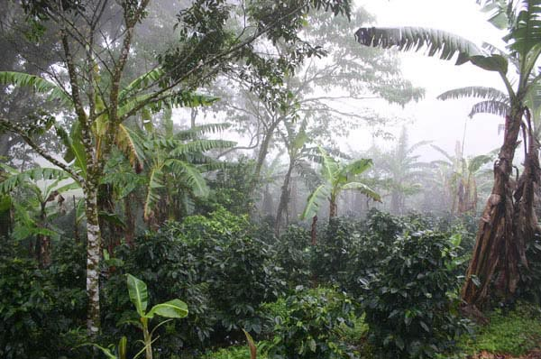
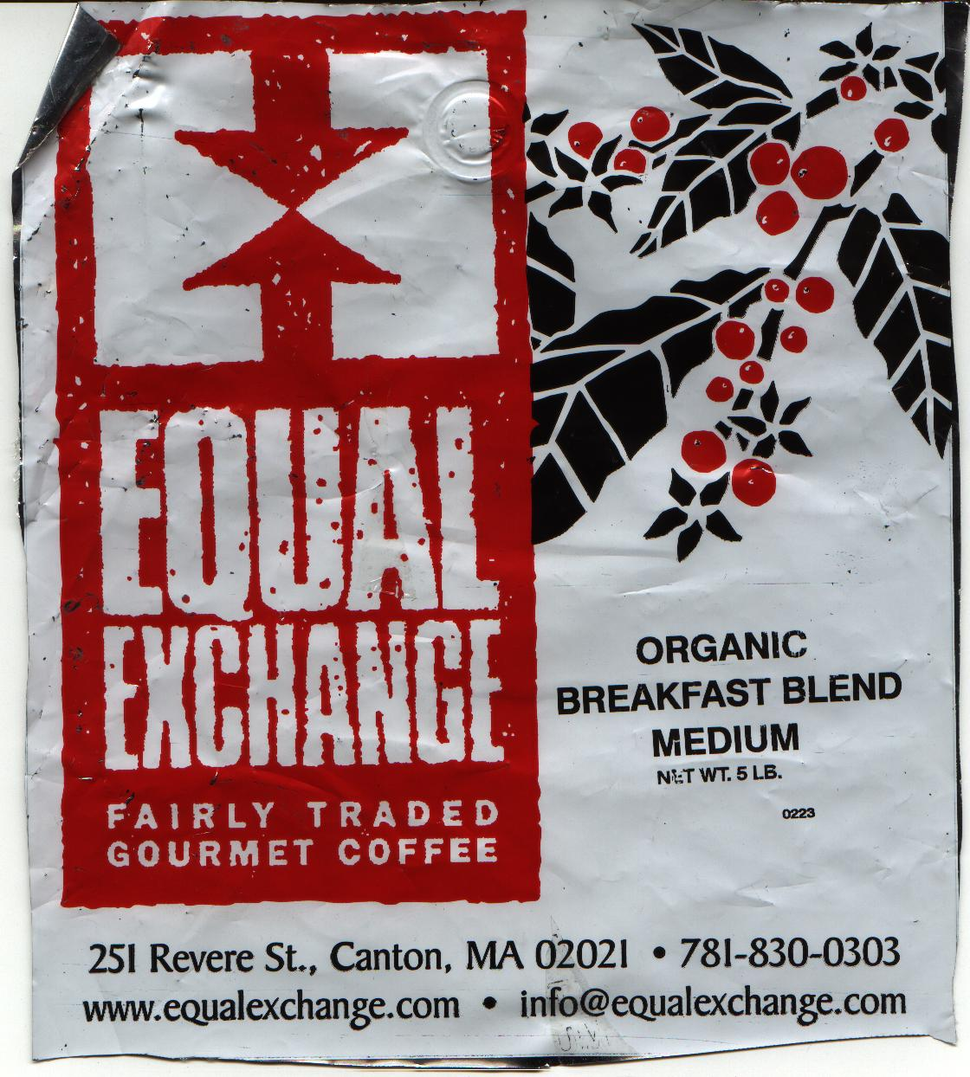
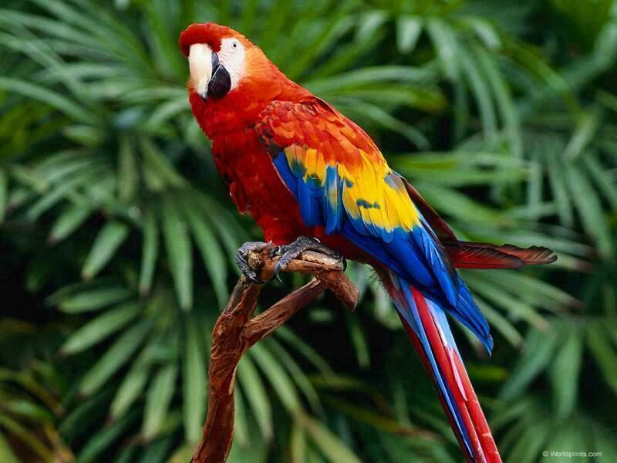
Notes:
Coffee naturally grows best in the shade of other, larger trees. In this way, raising coffee doesn't interfere drastically with the natural forest ecosystem in tropical areas where it is grown. However, higher yields can be had by packing trees closely together on hillsides in the open sunlight. Trouble is, the lack of shade stresses the trees, making it necessary to heavily fertilize them. In addition, with the forest cover now gone, so are the birds—a welcome development to insect populations. Pesticides must then be employed to control bugs.
Equal Exchange is worker-owned fair trade organization committed to fair trade on 100% of their products. For coffee, they pay their farmer partners a guaranteed minimum of $1.26 per pound ($1.41 a pound for organic) or 5 cents per pound above market price, whichever is higher. By buying directly from cooperatives, more money gets to the grower. Equal Exchange also provides advance credit and encourages organic shade-grown coffee production.

Slide 34
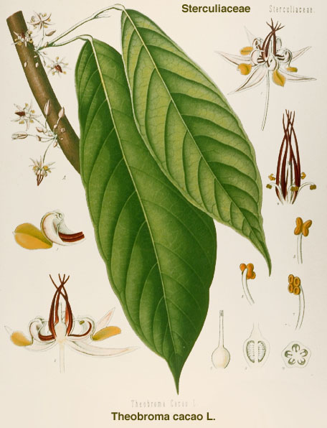
Cacao
(Theobroma cacao)
Sterculiaceae -
Chocolate Family
Theobroma means
“food of the gods”

Slide 35
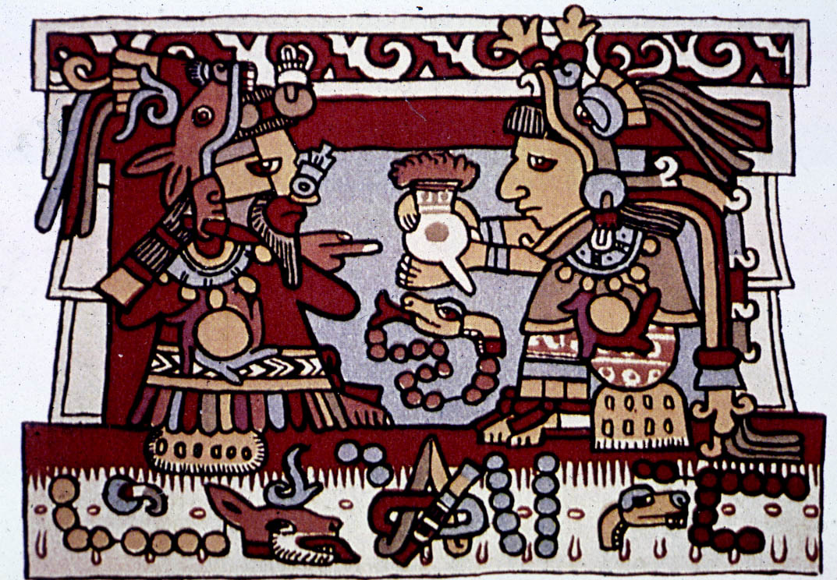
The Aztecs required that citizens pay taxes in cacao seeds
Notes:
By 1400, the Aztec empire dominated a sizeable segment of Mesoamerica. The Aztecs traded with Maya and other peoples for cacao and often required that citizens and conquered peoples pay their tribute in cacao seeds—a form of Aztec money.
When mixed with water, chili peppers, cornmeal, and other ingredients, this paste made a frothy, spicy chocolate drink.

Slide 36
… and it contains the
alkaloid theobromine,
which in chemically
nearly identical to
caffeine.
Notes:
There is roughly 20mg of theobromine in a gram of cocoa. Theobromine, like caffeine, acts as a diuretic, a vasodilater, and a heart stimulant. It is in fact responsible for many of the effects that people associate with caffeine in chocolate, and is responsible for poisoning in dogs and cats, which is why it is suggested that the animals not ingest chocolate.

Slide 37
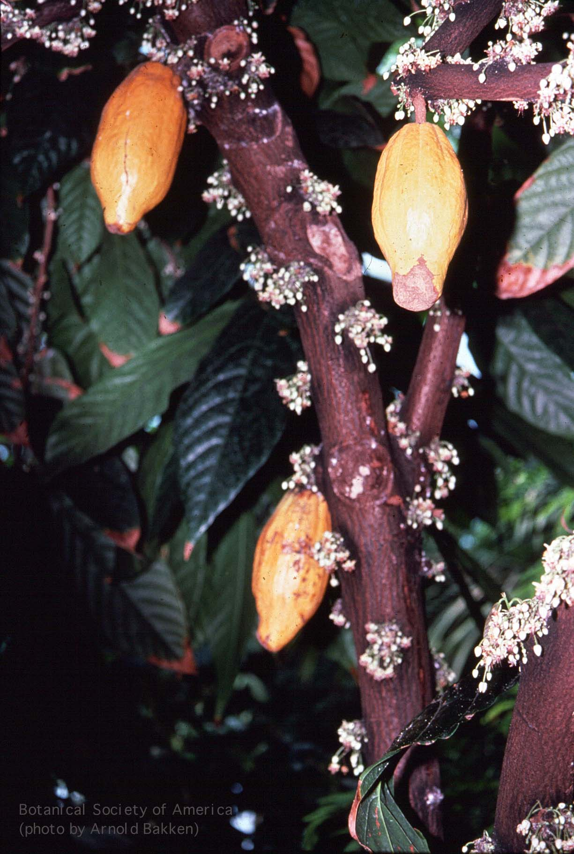
The cacao plant is
cauliflorous, which
means that the flowers
emerge directly from
the trunk

Slide 38
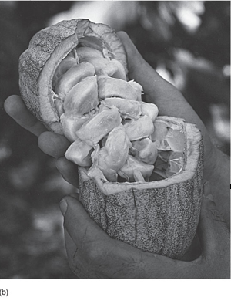
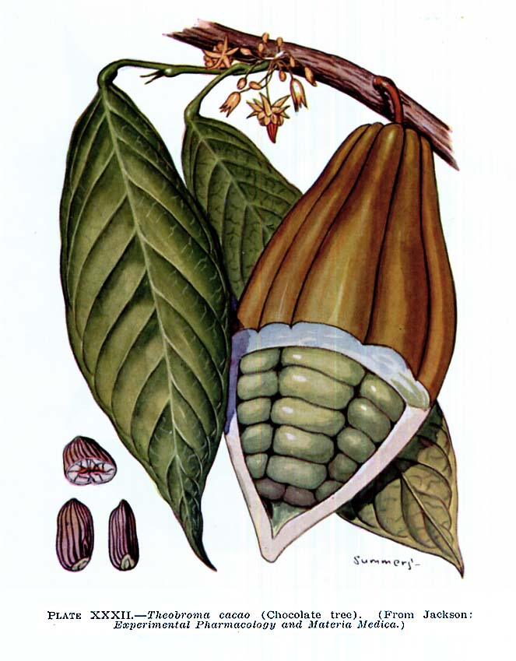
A cacao pod split open to reveal the pulpy seeds

Slide 39
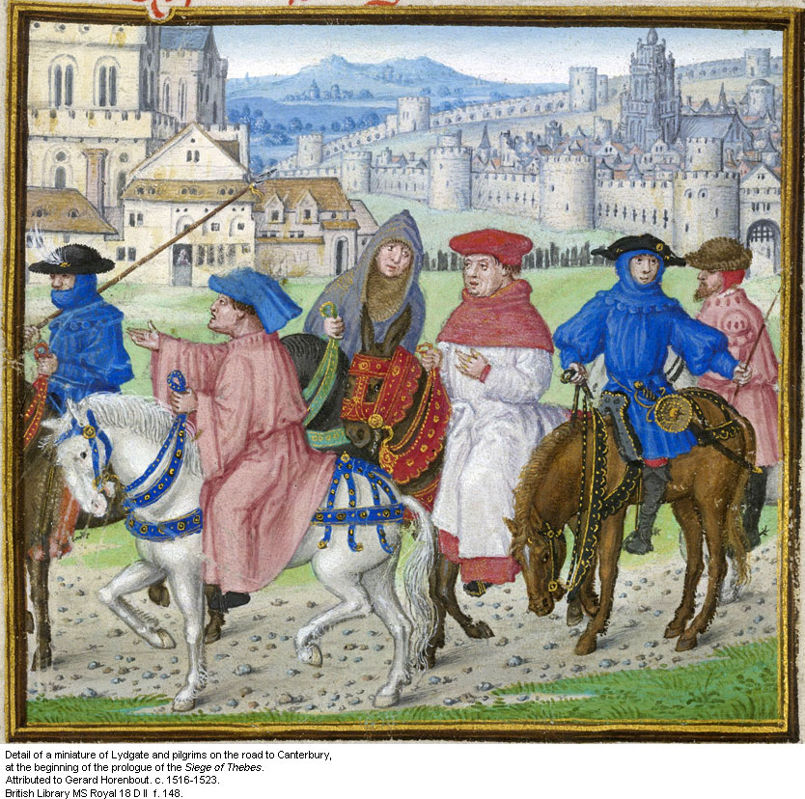
WHAN that Aprille with his shoures soote
The droghte of Marche hath perced to the roote,
And bathed every veyne in swich licour,
Of which vertu engendred is the flour …

Slide 40
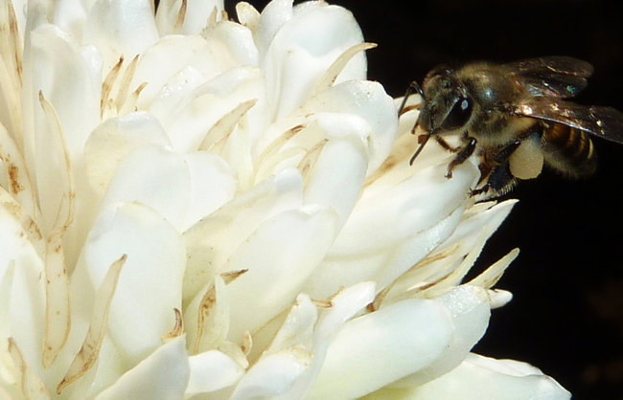
News flash: caffeine content in floral nectar lures
bees back for more …
Honeybee pollinating a coffee flower
http://www.nytimes.com/2013/03/08/science/plants-use-caffeine-to-lure-bees-scientists-find.html?_r=0

Slide 41
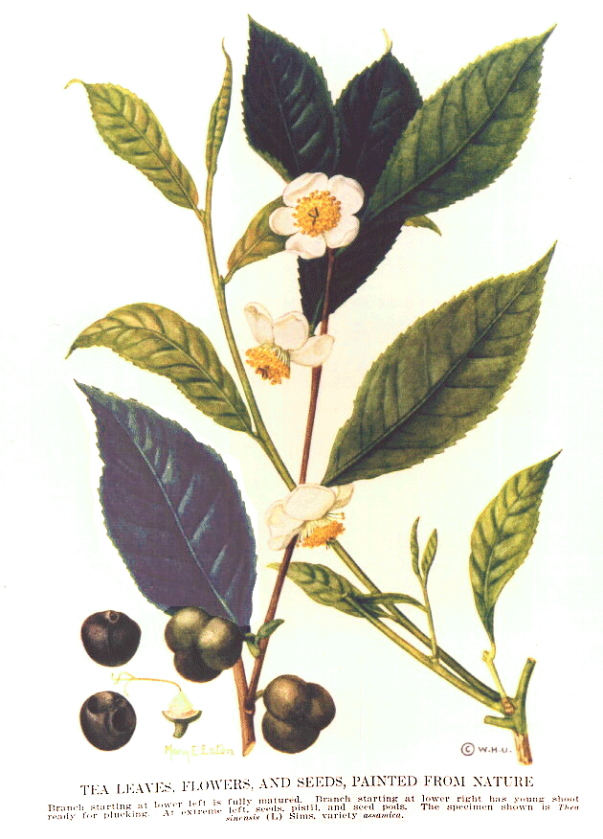
Tea
(Camellia sinensis)
Theaceae - the
Tea Family
Notes:
Start here

Slide 42
Tea is an evergreen shrub that may grow up to 35 feet tall.
In cultivation, it is pruned to a height of about three feet.

Slide 43
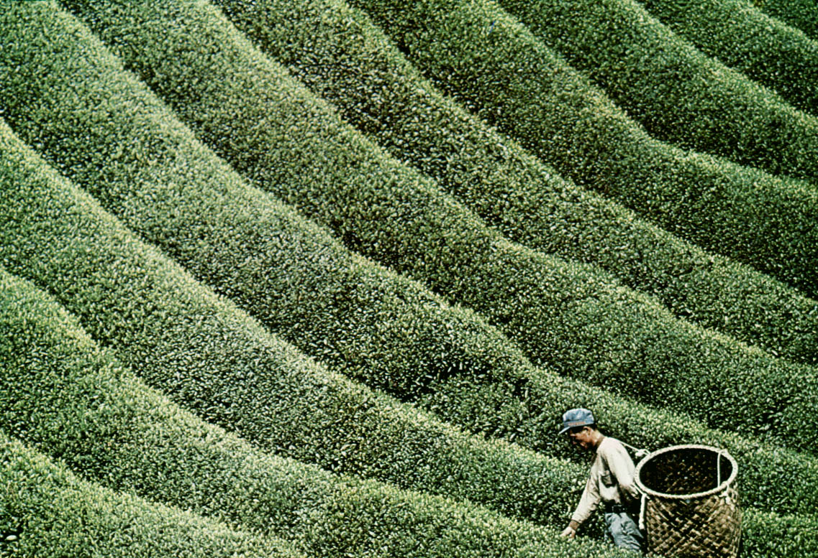
There are over 3000 varieties of tea each with its own specific characteristics.
Just as Bordeaux wine is named after the Bordeaux region in France, teas such as
Assam and Darjeeling are named after the regions where they are grown.
Notes:
There are over 3000 varieties of tea each with its own specific characteristics. Just as Bordeaux wine is named after the Bordeaux region in France, teas such as Assam are named after the regions where they are grown (Assam region is in India).

Slide 44
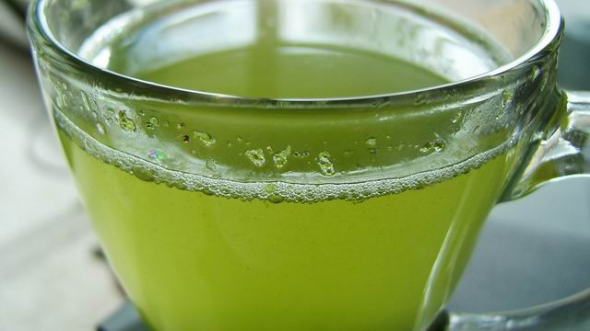
There are four types of tea:
Black - withered, fully oxidized (fermented), and dried
Oolong - withered, partially oxidized, and dried
Green - oxidation step is omitted: it is simply withered and dried
White - withered and dried

Slide 45
So what’s in tea?
Caffeine - a CNS stimulant
Essential oils - provide the aroma
Polyphenols - these give tea its anti-oxidant properties

Slide 46
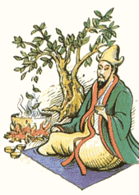
History
The story of tea begins in China,
over 5000 years ago. According
to legend, the emperor Shen Nung
and his court had stopped to rest
under a tea tree …
Notes:
One summer day while visiting a distant region of his realm, he and the court stopped to rest. In accordance with his ruling, the servants began to boil water for the court to drink. Dried leaves from the near by bush fell into the boiling water, and a brown liquid was infused into the water. As a scientist, the Emperor was interested in the new liquid, drank some, and found it very refreshing.

Slide 47
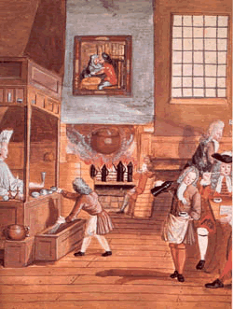
In 17th-century Great Britain, tea became popular in the newly established coffee-houses.
Tea drinking displaced coffee when, in the 1850s, a fungal pathogen destroyed the coffee plantations in Ceylon (Sri Lanka)

Slide 48
Boston Tea Party, 1773

Slide 49
Lecture Review, Chapter 16
What is a secondary metabolite? How does it differ from a primary metabolite? What kind of secondary metabolite is caffeine?
What does caffeine do to the human body to make us feel “caffeinated”?
Describe the biology and ecology Coffea arabica, Theobroma cacao, and Camellia sinensis (i.e., Is it an herb, shrub, tree? Describes the leaf and flower structure. Where does it grow?)
What part of the Coffea arabica plant is used by humans? What part of Theobroma cacao and Camellia sinensis?
Where did each of the 3 major stimulating beverages originate? Briefly describe the history of each plant.
Briefly describe the cultivation and processing of coffee, chocolate, and tea.

