Slide 1
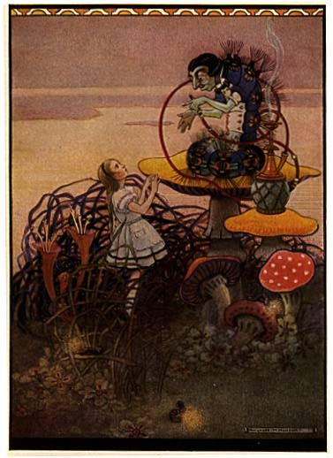
Psychoactive Plants
PBIO 006
Spring 2014
Chapter 20

Slide 2
Lecture Outline
I. Introduction
II. How psychoactive plants work in the body: neurons and neurotransmitters
III. Hallucinogens
A. Marijuana
B. Peyote
IV. Depressants
A. Opium
B. Kava

Slide 3
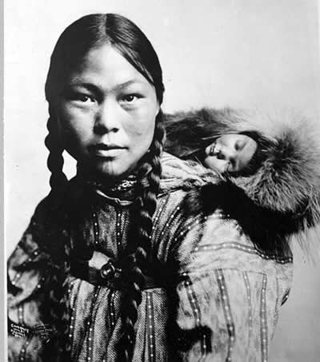
With the exception
of the Inuit, each
of Earth’s cultures
has used some form
of psychoactive to
alter consciousness.

Slide 4
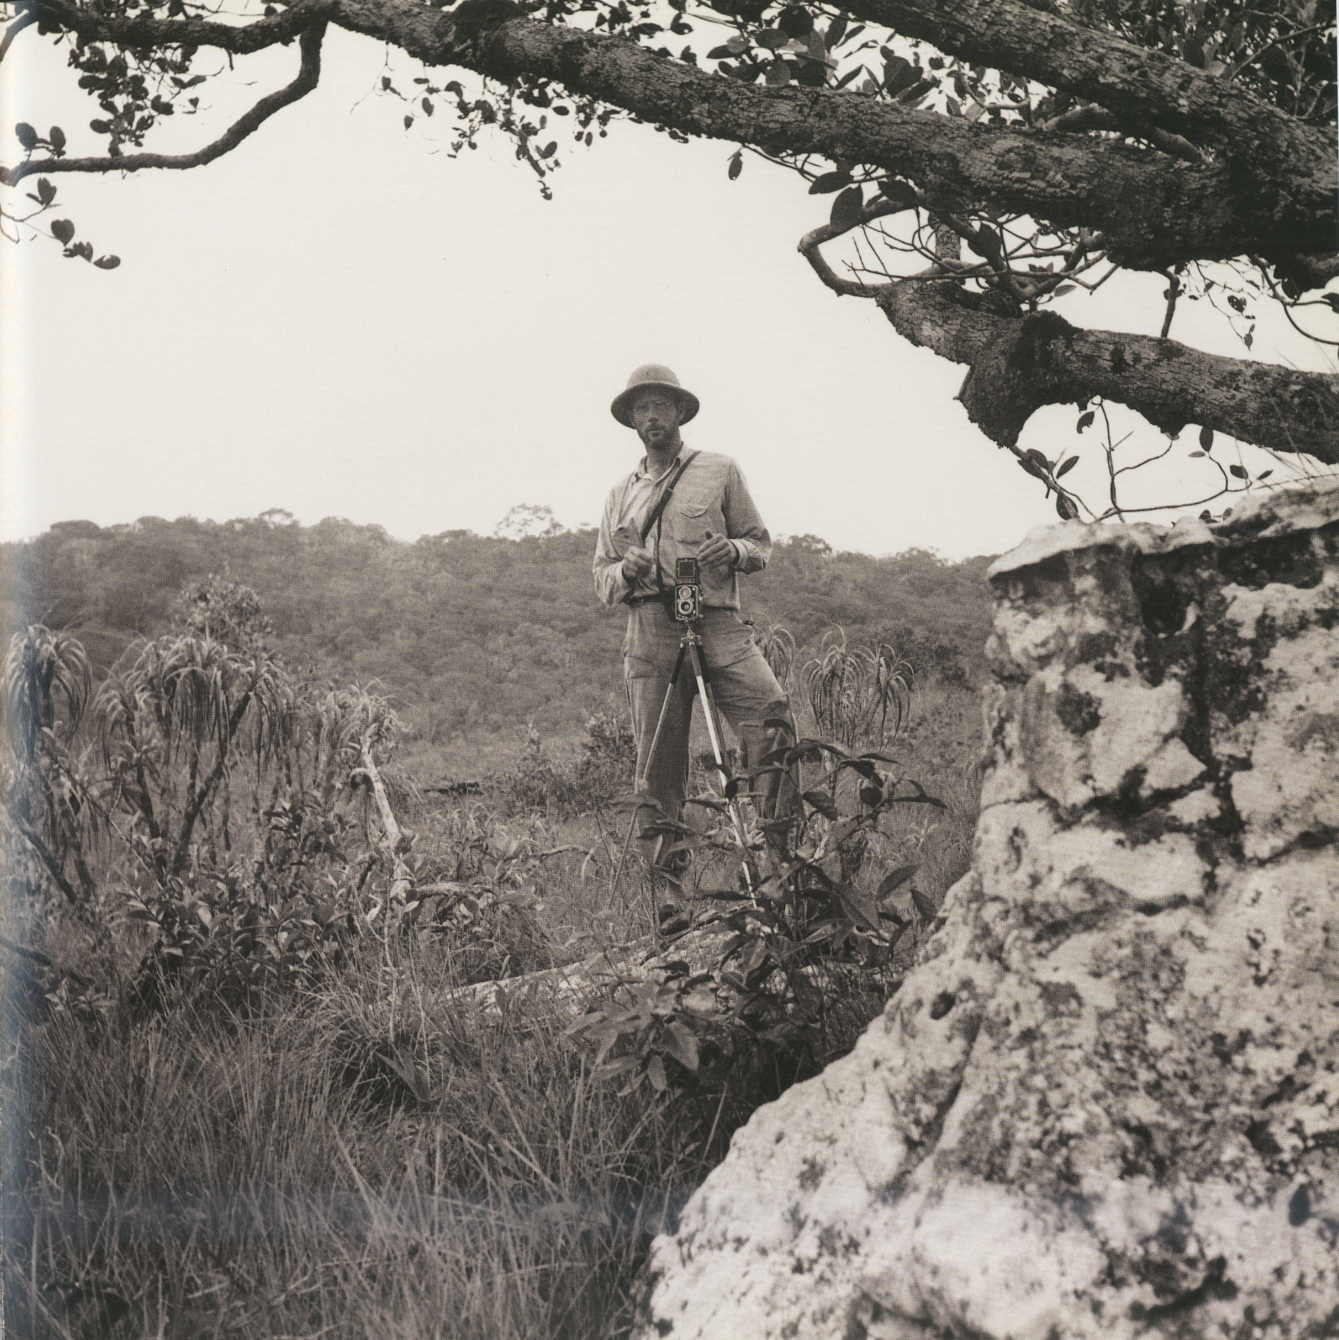
Richard Evan Schultes,
“father of modern ethnobotany”
Ethnobotanists call hallucinogenic plants entheogens, which means “the god within.”
Credit: By Richard Evans Schultes
Date: Savannah of Yapobodá, 1946

Slide 5
Psychoactive plants
Psychoactive plants can be classified as...
Hallucinogens
  e.g., marijuana, peyote
Stimulants
  e.g., cocaine, caffeine
Depressants
  e.g., opium

Slide 6
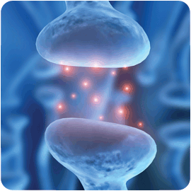
Some plant secondary compounds work by
mimicking neurotransmitters, chemical messengers that communicate between nerve cells.
neurons
neurotransmitter
Notes:
The chemical structure of many of these compounds mimics that of human neurotransmitters, those compounds that carry nerve impulses across the gap, or synapse, between adjacent nerve cells.

Slide 7
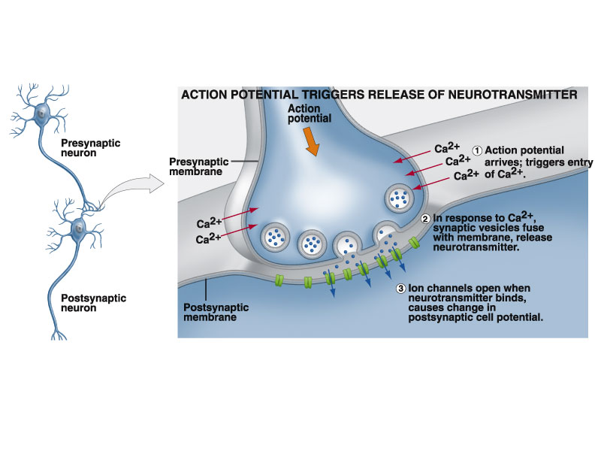

Slide 8
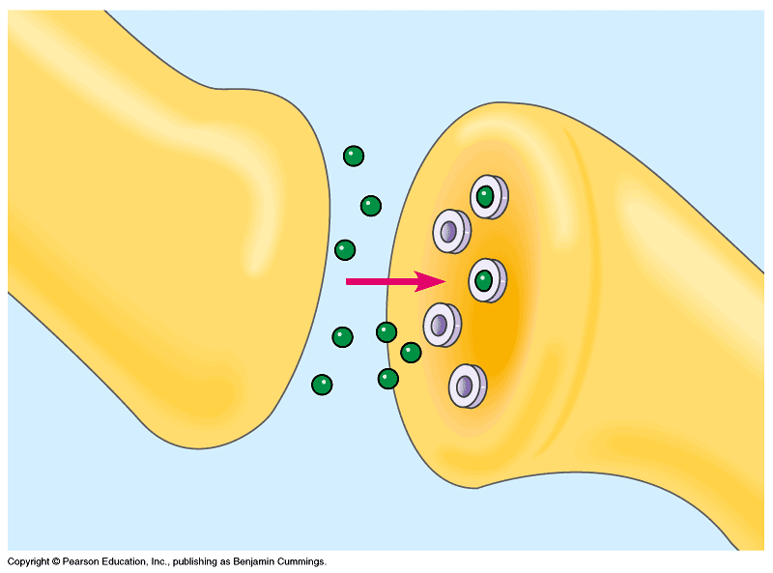
http://www.youtube.com/watch?v=hqWv0iEF4ho&NR=1

Slide 9

Intoxication
Notes:
Recall that the distinction between poison, medicinal, and psychoactive effect is often one of dose, for example the opiates, in lower doses, are invaluable as painkillers but at higher doses are lethal. And of course the opiates have a long history of use – and abuse – as psychoactives. A reminder of the relationship between the psychoactive and poisonous properties of these plants is apparent in the word intoxication.

Slide 10
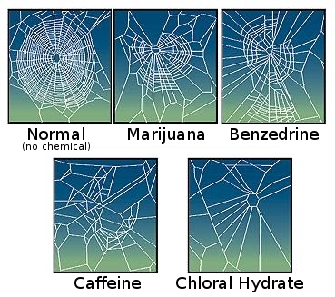
Spider on drugs: your tax dollars at work
Notes:
Begin here on Tuesday, April 2.

Slide 11
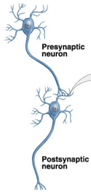
Neurotransmitters are chemical messengers
Neuron = nerve cell
synapse
Presynaptic
neuron
Postsynaptic
neuron
Neuro-
transmitters

Slide 12
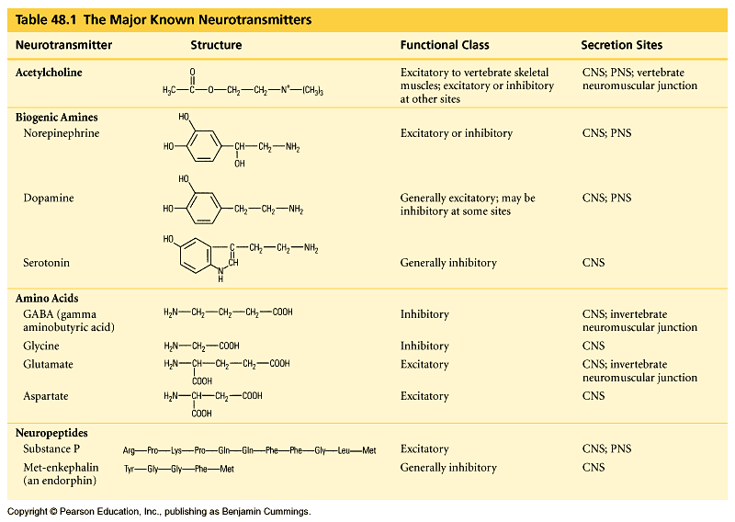

Slide 13
Hallucinogens

Slide 14
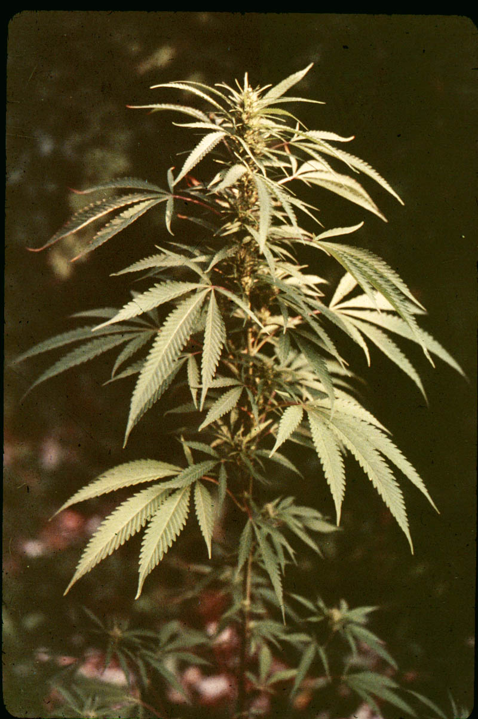
Marijuana
Cannabis sativa
The Cannabis Family
    With approximately 5.1 million weekly users, marijuana rivals caffeine, tobacco, and alcohol as
    one of the most widely used
    non-medicinal (i.e., recreational) drugs in the United States today.
Notes:
With approximately 5.1 million weekly users, marijuana rivals caffeine, tobacco, and alcohol as one of the most widely used non-medicinal (i.e., recreational) drugs in the United States today.

Slide 15
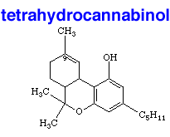
Δ⁹ tetrahydrocannabinol (THC)
Notes:
Active component is tetrahydrocannabinol (THC), a complex multicyclic alcohol.

Slide 16
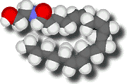
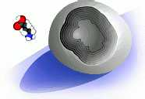

Anandamide - a human neurotransmitter with a
chemical structure similar to THC
    The activity of THC results from the structural similarity of THC to anandamide, a neurotransmitter that binds to specific receptors in the brain.
3-D model showing the lock-and-key fit of the
anandamide molecule into its cannabinoid receptor

Slide 17
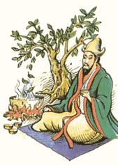
History
The Chinese were the first to use cannabis. The legendary Chinese emperor Shen Nung is said to have observed that the female plants contained a greater property of of the creative principle (yin) than did the males and so recommended the cultivation of female plants for use in correcting spiritual imbalances.

Slide 18
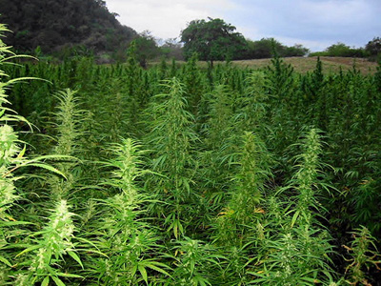
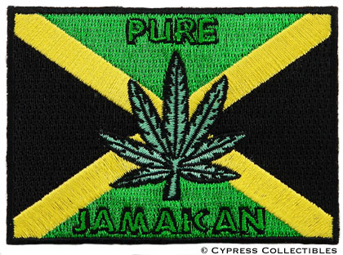
The British introduced marijuana to Jamaica around 1800 in an
attempt to establish a lucrative fiber crop.
Notes:
The British introduced marijuana to Jamaica around 1800 in an attempt to establish a lucrative fiber crop. The attempt failed, but the plant spread around the island. When African slaves were brought to Jamaica in the middle of the 19th century to harvest sugar cane, they found their familiar drug well established.

Slide 19
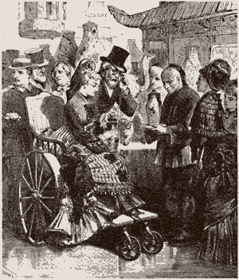
The 1876 Centennial
Exhibition included a
Turkish Bazaar featuring
hashish smoking.
Notes:
Established in the US as a fiber source, marijuana was first used as a psychedelic in the 1800s. First taken up by intellectuals and artists, then its use spread more widely. The 1876 Centennial Exposition featured a Turkish Bazaar featuring hashish smoking as a special attraction,

Slide 20
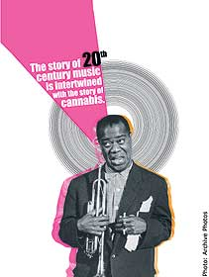
In the U.S. the use of marijuana
spread with jazz and blues through the
first decades of the last century
Notes:
Storyville, the red light district of New Orleans, is where the first recorded American use of "marihuana" occurred in 1909. According to cannabis historian Ernest Abel, "It was in these bordellos, where music provided the background and not the primary focus of attention, that marihuana became an integral part of the jazz era. Unlike booze, which dulled and incapacitated, marihuana enabled musicians whose job required them to play long into the night to forget their exhaustion.

Slide 21
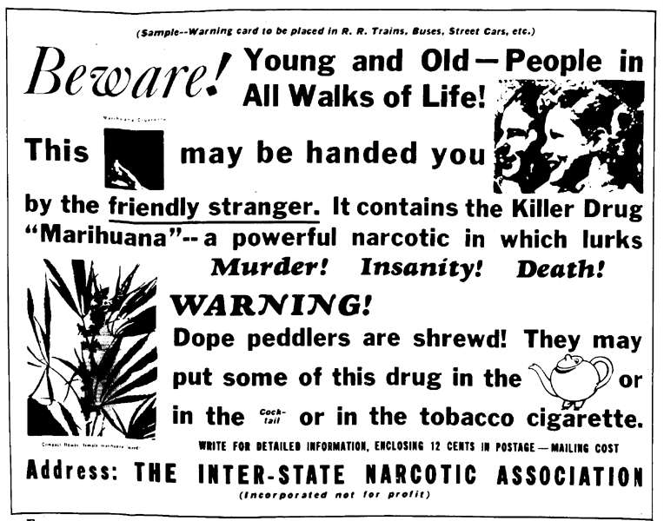
In the late ‘20s and early ‘30s, public
opinion began to change, due in part to
the efforts of the Narcotics Bureau.
Notes:
Then, in the late 20s and early 1930s, public opinion began to turn, due in part to efforts of the Narcotics Bureau.

Slide 22
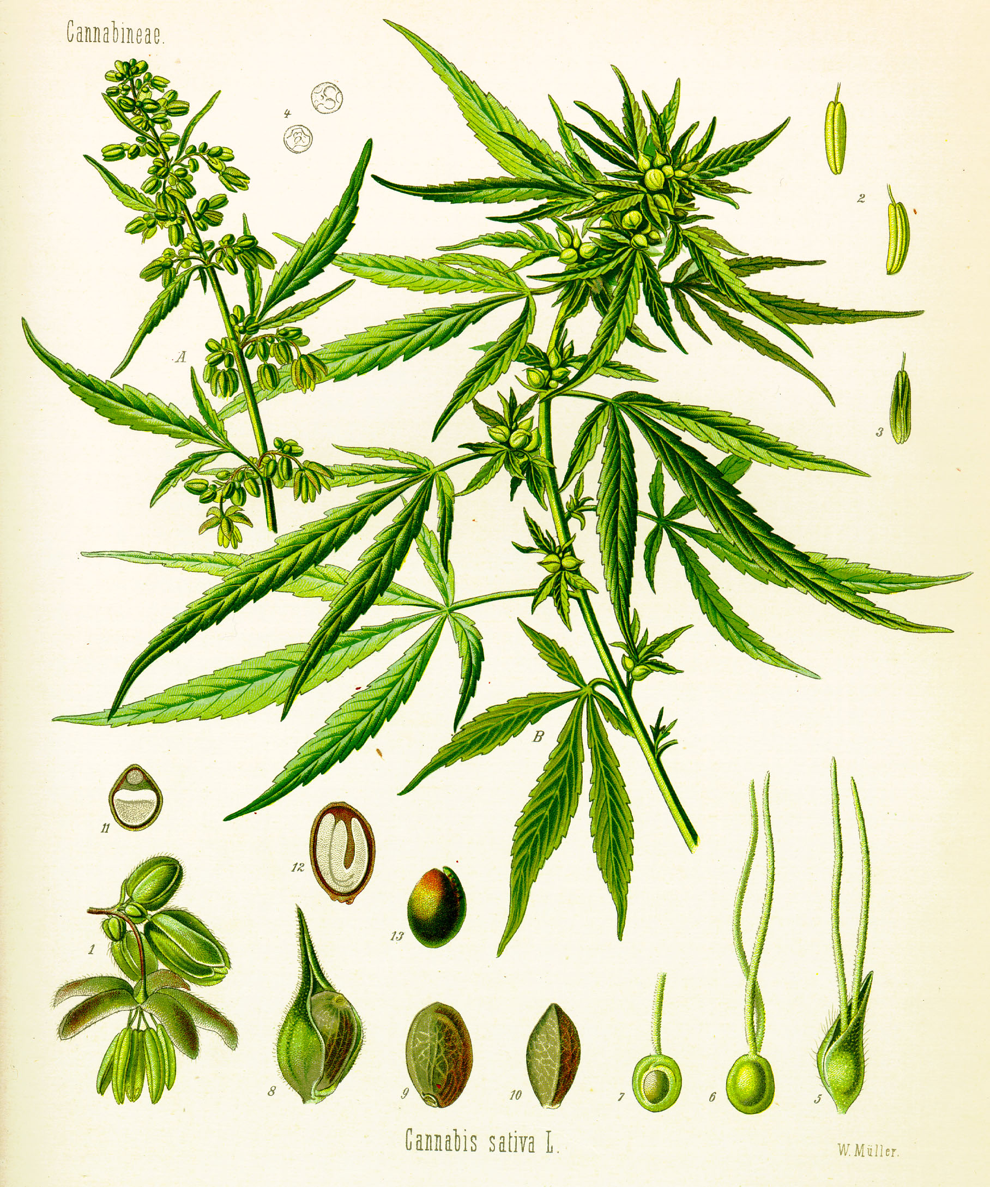


Cannabis Biology &
Cultivation
Plants are dioecious,
that is, there are
separate male and
female plants.

Slide 23
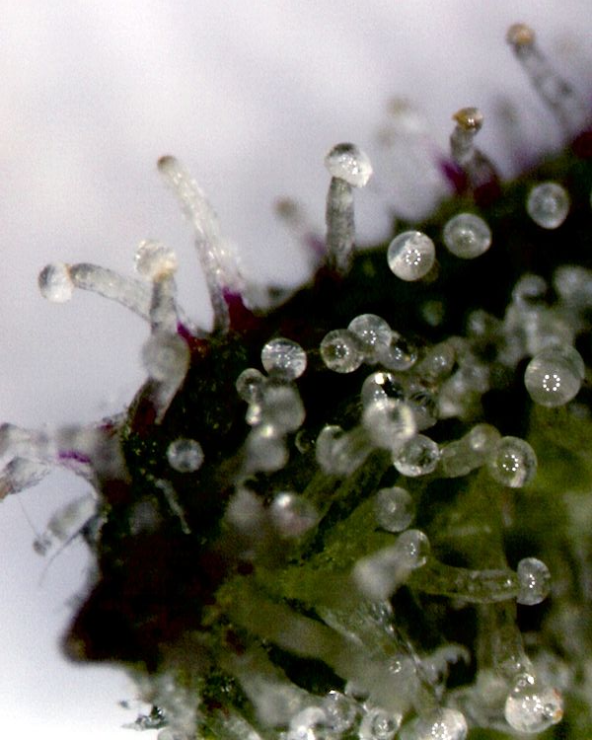
Resin-containing
glands on the bract
of a female flower

Slide 24
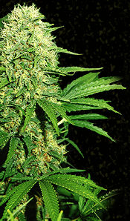
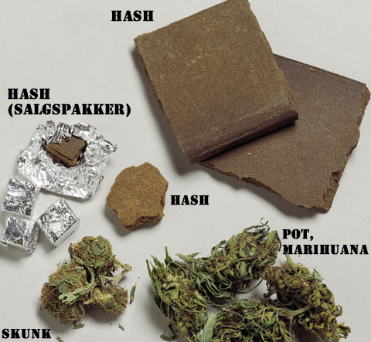
Sinsemilla
Notes:
Growers enhance resin production by removing male plants, which prolongs flowering. Unfertilized female plants are called sinsemilla (without seed). Ganja refers to the female flowers and upper leaves; hashish is the relatively pure resin.

Slide 25
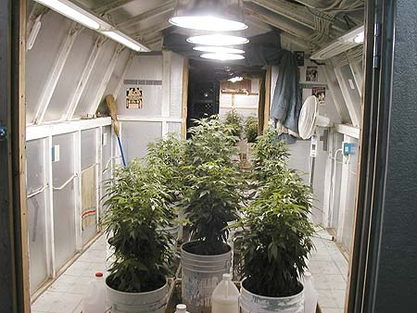
Contemporary marijuana culture, indoors, under bright
lights, in a CO₂ enriched atmosphere

Slide 26
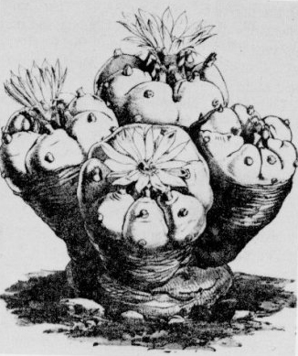
Peyote
Lophophora williamsii
Cactaceae - the Cactus
Family
Notes:
Several members of the cactus family are used as a source of peyote. The best known is Lophophora williamsii, a small, grayish-green cactus native to southern Texas and northern Mexico.

Slide 27
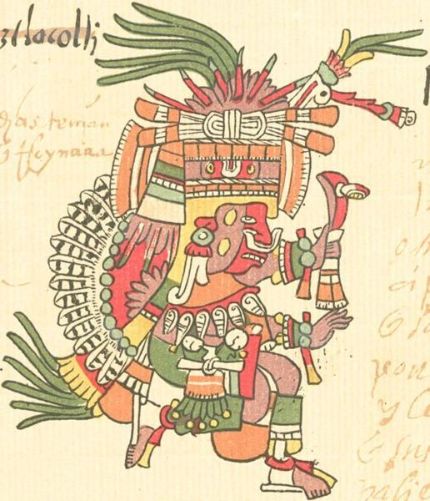
    At the time of contact by the Spanish explorers of the 16th century, peyote was used by the Aztecs. After the collapse of the Aztec empire, use of the drug survived among indigenous tribes of Mexico.
Patecatl Aztec god of healing and fertility, and
the discoverer of peyote.
Notes:
At the time of contact by the Spanish explorers of the 16th century, the plant was used by the Aztecs. After the collapse of the Aztec empire, use of peyote survived among indigenous tribes of Mexico.

Slide 28
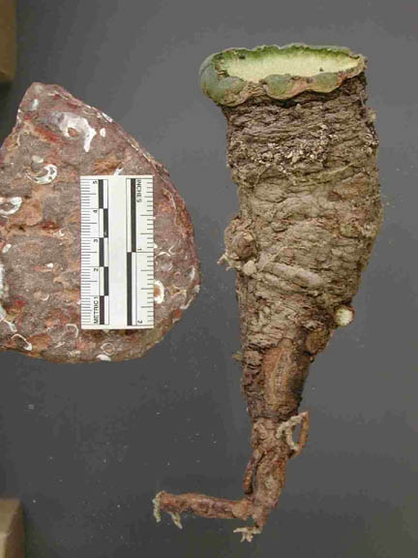
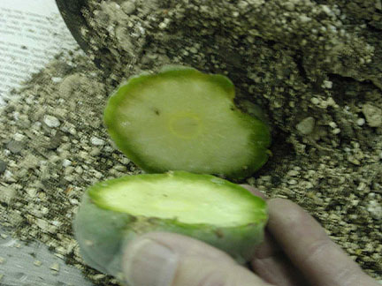
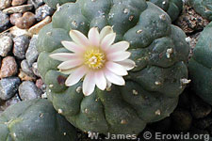
Notes:
Tops are cut off and dried, leaving the root to regenerate. The tops, or buttons, are eaten fresh or dried for later use.

Slide 29
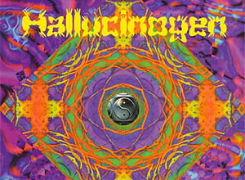
Notes:
After an initial period of nausea, the plant produces spectacular visual hallucinations.

Slide 30
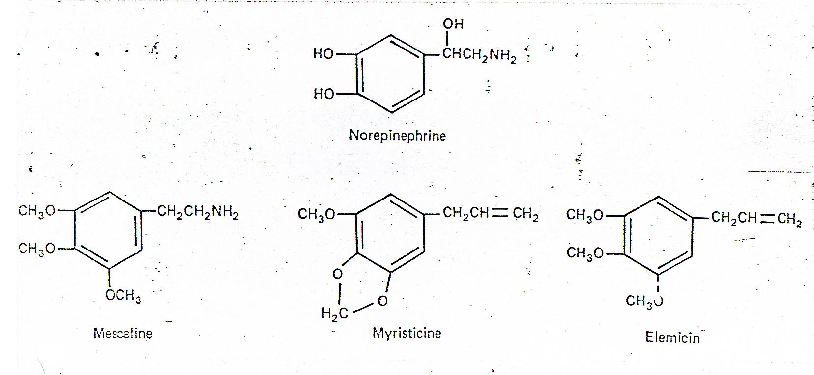
The most abundant alkaloid in peyote is
mescaline, a mimic of the human
neurotransmitter norepinephrine.
Notes:
The most active of the many alkaloids present in the plant is mescaline, a mimic of the neurotransmitter norepinepherine.

Slide 32
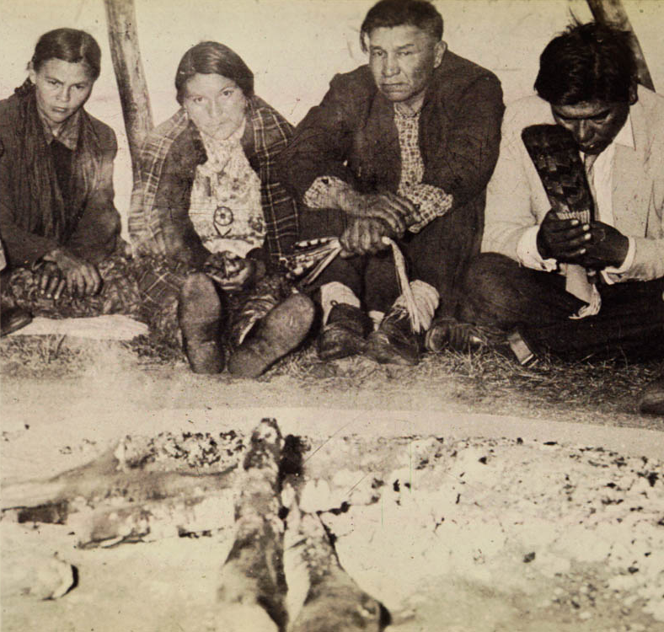
Peyote use by the Native American Church
Notes:
Although peyote is illegal in the US, the Native American Church uses peyote in its religious rituals under a special exemption from the US Supreme Court. The sect, a hybrid of Christianity and native shamanistic traditions, espouses brotherly love, abstinence from alcohol, and high moral conduct.

Slide 33
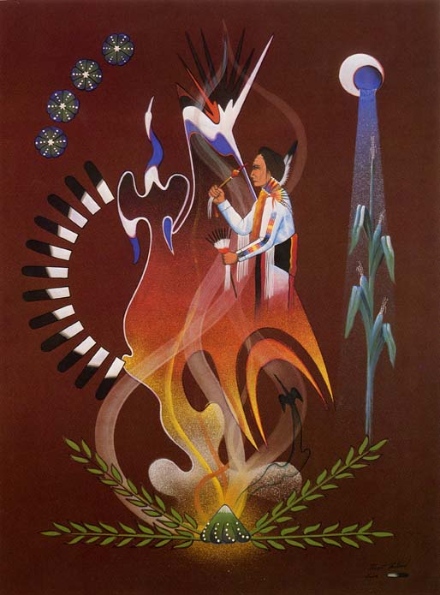

Slide 34
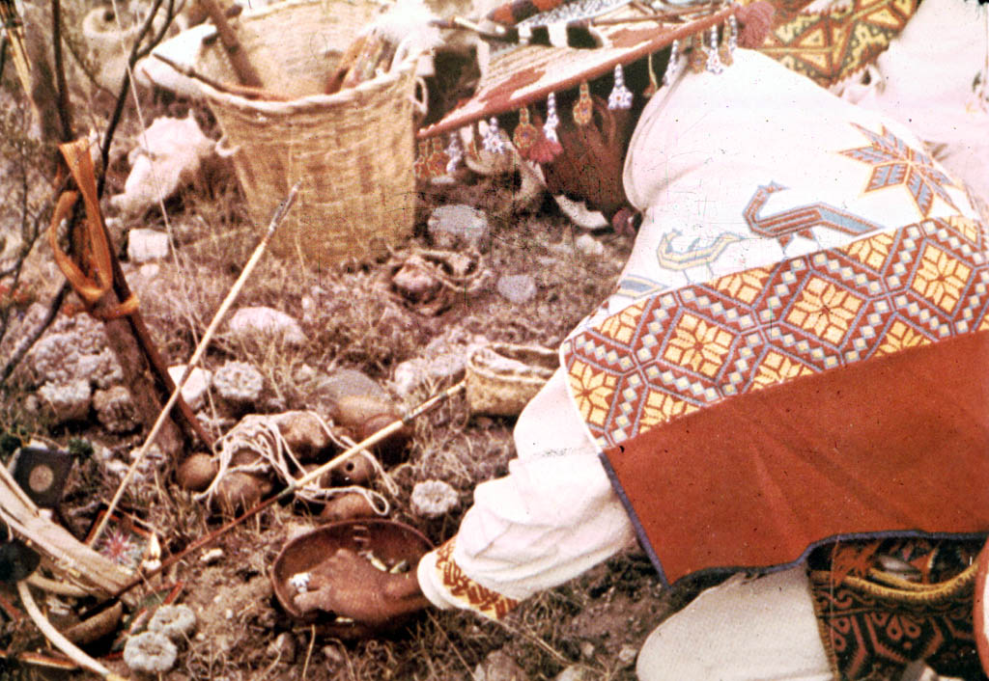

Slide 35
Psychoactive Plants from the
Nightshade Family

Slide 36
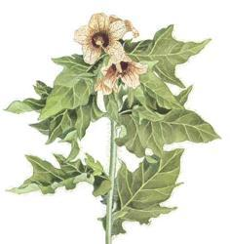
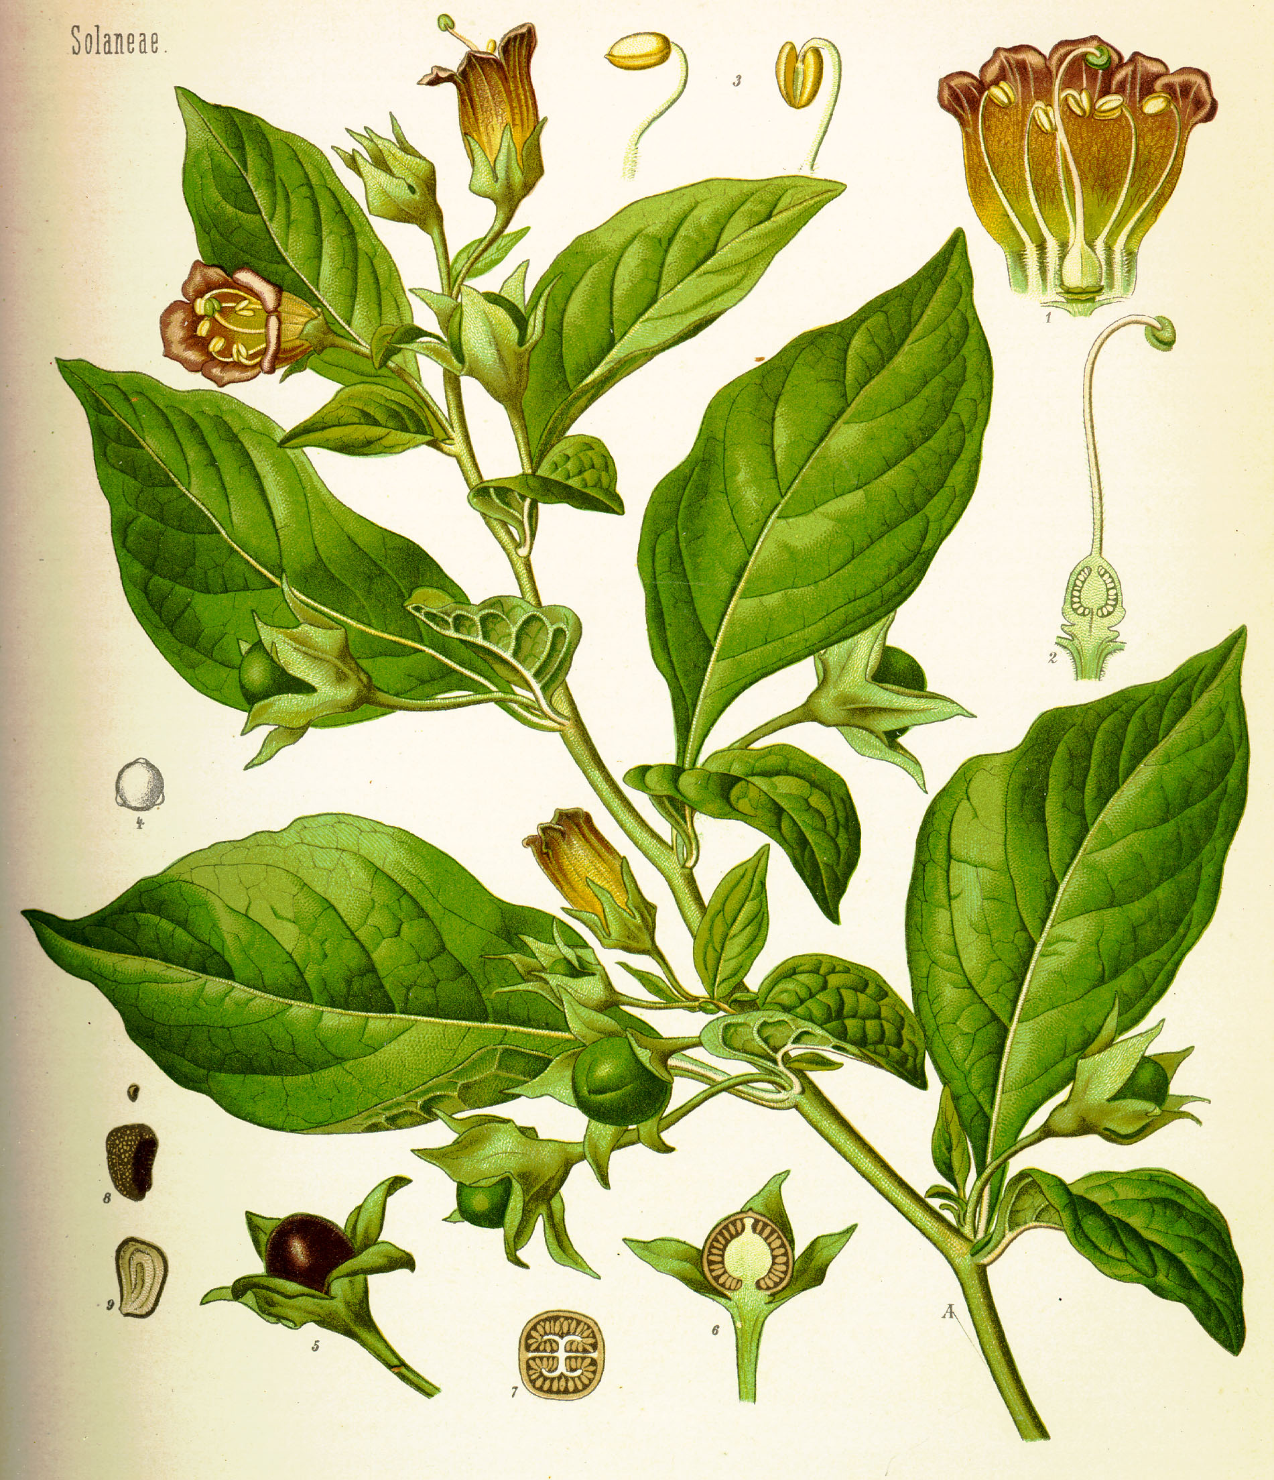
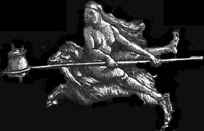
Henbane
Belladonna
These plants - and other members of the Solanaceae, such as
mandrake - contain powerful alkaloids that impart to the user
the sensation of flying.
Notes:
These plants were components of a potent mix used by witches during the Middle Ages. The intoxicating mix was administered by a special wooden dildo, thus the association of witches with broomsticks.

Slide 37
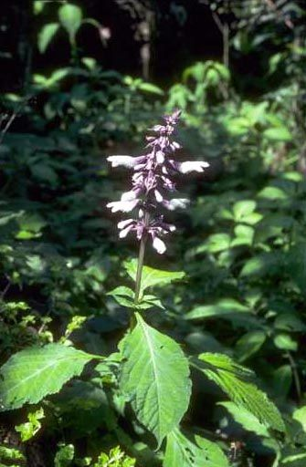
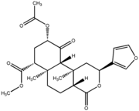
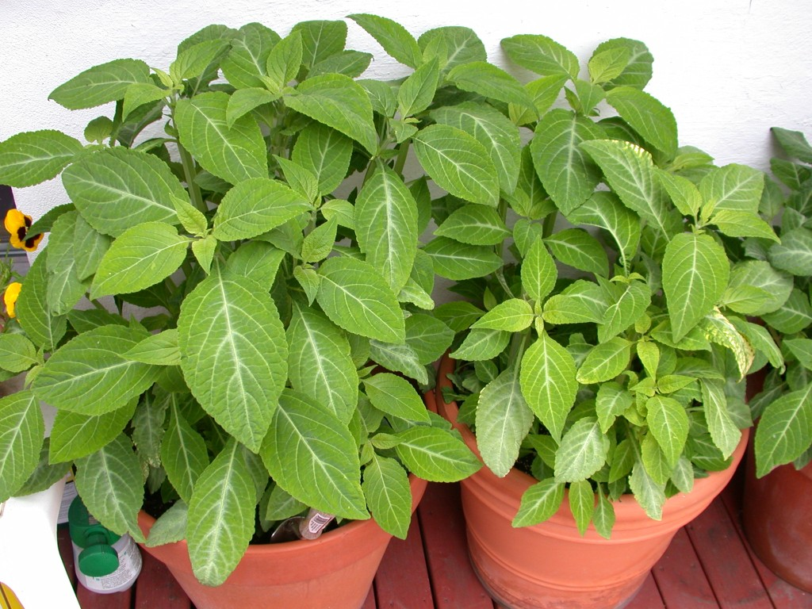
Salvia divinorum
Lamiaceae - the Mint Family
“Sage of the Diviners”
Salvinorin A,
a diterpenoid
Notes:
Salvia divinorum is an unusual member of the mint family; its name means "Sage of the Diviners". Under the right conditions, Salvia produces a unique state of "divine inebriation". For hundreds of years, Salvia divinorum has been used in religious and healing ceremonies by the Mazatec Indians, who live in the province of Oaxaca, in Mexico.
Salvinorin A is a remarkably potent and selective kappa opioid receptor agonist. Salvinorin A is unique in that it is the only naturally occurring substance known to induce a visionary state via this mechanism of action.

Slide 38
Depressants

Slide 39
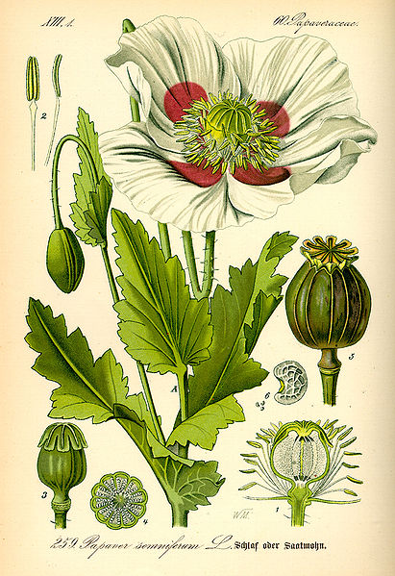
Opium poppy
Papaver sominiferum
Papaveraceae
(Poppy Family)

Slide 40
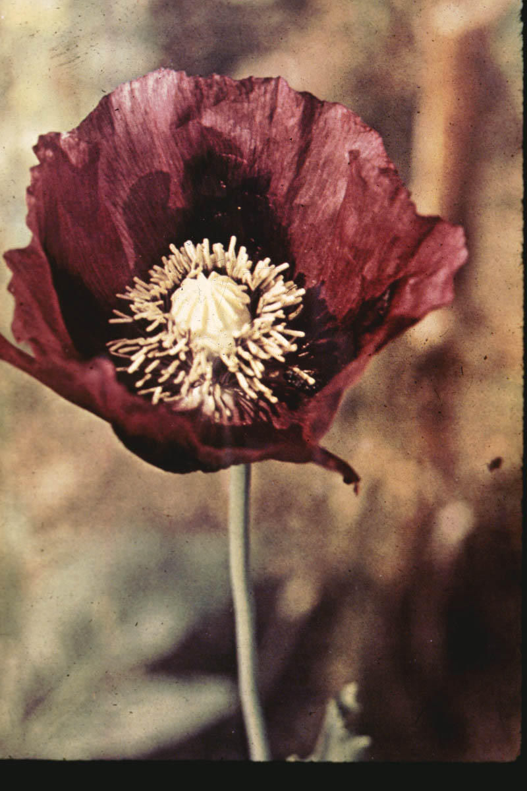
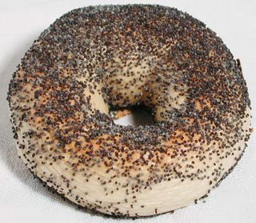

Opium poppy
(Papaver somniferum)
Notes:
The same poppy, Papaver somniferum, that is planted as a garden ornamental and which provides the poppy seeds used in cooking is also the source of opium.

Slide 41
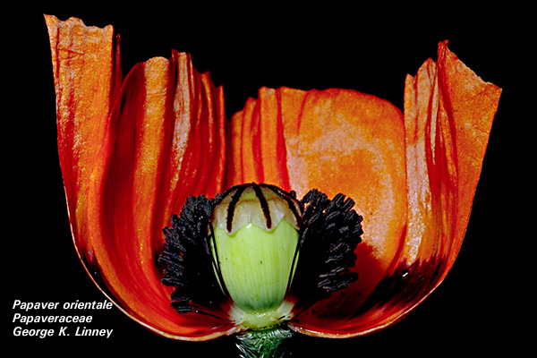
Notes:
Opium alkaloids are produced by the plant’s capsule fruit.

Slide 42
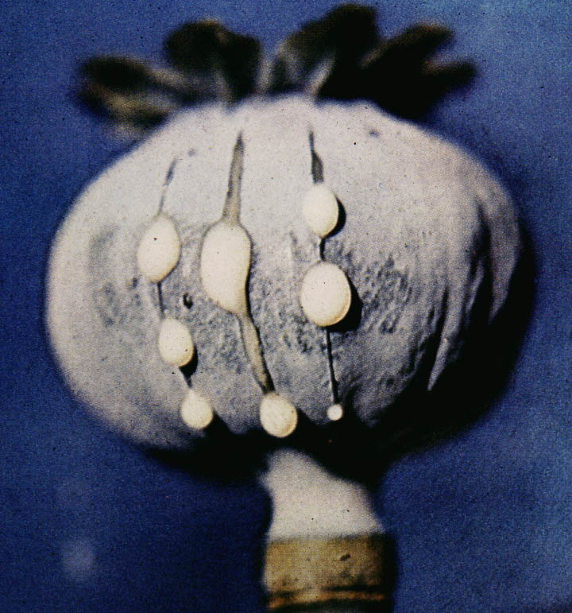
Alkaloid-rich latex exuding from a cut poppy capsule
Notes:
Scoring the immature capsule with a blade causes it to ooze the alkaloid-rich latex …

Slide 43
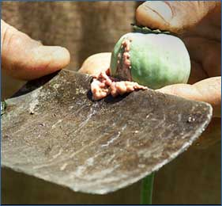
This raw opium is a potent cocktail of alkaloids, including morphine
and codeine.
Notes:
… which, after drying, is scraped off with a knife.

Slide 44
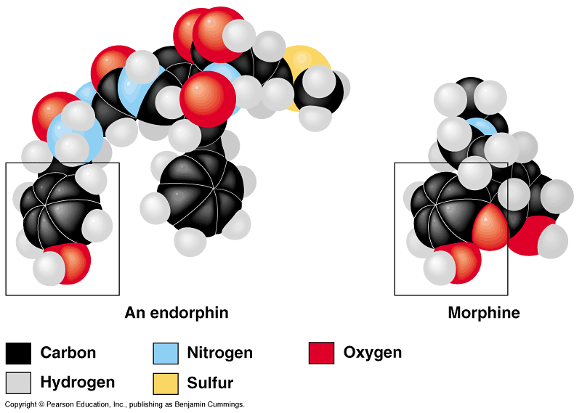
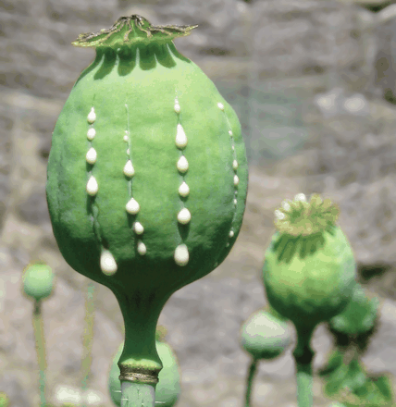
The effect of opiates on the brain
Opium poppy,
Papaver somniferum

Slide 45
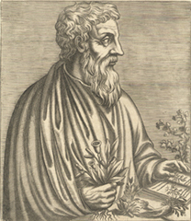
Opium has been used since at least 3000 BC.
All the classical medical texts of ancient Greece and Rome refer to it.
Dioscorides, author of
Materia Medica
Notes:
Opium has been used as a pain reliever since at least 3000 BC. All the classical medical texts of ancient Greece and Rome refer to it.

Slide 46
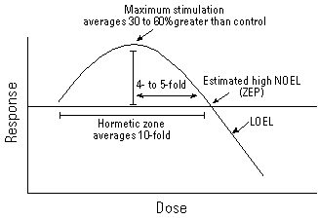
"The right dose differentiates a poison and a remedy."
- Paracelsus
Dose-response curve

Slide 47

In 1525, Paracelsus discovered that
opium could be dissolved in alcohol,
a preparation called laudanum.
Notes:
its use in Europe was uncommon until 1525, when Paracelsus (Mr. Doctorine of Signatures) discovered the strategy of dissolving it in alcohol, producing a tincture called laudanum

Slide 48


The addictive properties of this remarkable painkiller weren’t fully
recognized until the end of the American Civil War …
“Many also cultivated a few rows of poppies in their garden to make opium, from which our laudanum was created; and this at times was very needful.”

Slide 49

Some 45,000 soldiers returned
from the Civil War addicted to
morphine.
Notes:
… when some 45,000 soldiers returned from the war addicted to the drug.
The Civil War ushered in a new era of reliance on narcotics for pain relief and ultimately, escape from the emotional sufferings that accompanied the war. Following the war, medicines, tonics and cure-alls of all kinds began to be patented and sold by traveling salesmen, pharmacists and doctors, still without benefit of any centralized regulation. The drug trade, free of restrictions, began to thrive in the United States, with no differentiation between legal and illegal drugs.

Slide 50
Common opiates in the late 19th century:
Opium: a derivative of the poppy plant which was smoked
Laudanum: A tincture of opium used in droplet form
Codeine: An analgesic in tablet form
Morphine: A crystalline substance which was
liquefied and then injected

Slide 51

Purified morphine was first isolated in 1806
Notes:
Opium contains a mixture of alkaloids. The isolation of purified morphine in 1806 allowed for controlled dosage for medicinal purposes.

Slide 52
In 1874, pharmacists modified morphine by adding two acetyl groups
to the molecule. The result was heroin.
Notes:
In an attempt to devise a non-addictive painkiller, pharmacists in 1874 modified morphine by adding two acetyl groups. The result was heroin, first thought to be a wonder drug

Slide 53

Notes:
Marketed by the Bayer Company …

Slide 54

Soothe your cranky baby
with Mrs. Winslow’s syrup
(contained heroin!)
Notes:
… , and included in cough syrups for children.

Slide 55

Religion is the opiate of the masses.
- Karl Marx
Opium
In the United States today, roughly 980,000 people are addicted to opiates such as heroin, morphine, and Oxycontin.

Slide 56


Kava
Consumed to “relax without disrupting
mental clarity.”
Kavalactone, the active principle
Piper methysticum
Piperaceae - Black pepper Family
Notes:
Its primary uses in the United States and Europe are as an anti-depressant, stress reliever and muscle relaxant. Kava kava also is gaining popularity as a sleep aid. In Europe, Kava kava is being used as a natural alternative to Prozac, Valium and Xanax.

Slide 57



Elizabeth II, enjoying kava
on a state visit to Polynesia
Kava is used in sacred ceremonies in Fiji, Samoa,
and Tonga, where it is drunk in ceremonies to
honor visitors, unite participants, and validate
their social identities.
It was first introduced to Europeans
by Captain James Cook,
ca. 1771
Notes:
Captain Cook’s voyage to the Pacific in 1768-1771 that Europeans first encountered the plant and its consumption in sacred ceremonies. According to Cook’s account, natives chewed or pounded the root and mixed it with water to produce a brownish, often bitter brew, which they then consumed for its psychoactive properties.
This traditional drink still plays a key role in Fijian, Samoan, and Tongan societies where it is drunk in ceremonies meant to honor visitors, unite participants and validate their social identities. Kava can be found in recreational and social gatherings.

Slide 58


Slide 59
Lecture Review, Chapter 20
What are the 3 categories of psychoactive drugs? What are the differences among these categories?
How to cells communicate? What are neurotransmitters and how do they work?
Describe the biology of Cannabis sativa, Papaver sominiferum, Lophophora williamsii, and Piper methysticum (i.e., Is it an herb, shrub, tree? Describes the leaf and flower structure, etc.). What is the psychoactive component of each plant?
Briefly describe the history of each of these psychoactive plants.
What part of the Cannabis sativa plant is used by humans? What part of Papaver sominiferum, Lophophora williamsii, and Piper methysticum?
How does each psychoactive chemical produced by each plant affect humans? (e.g., how does THC act as a hallucinogen?)

