Slide 1
Origins of Agriculture
Levetin and McMahon Chapter 11

Slide 2
Lecture Outline
Agriculture is the intentional cultivation of plants and animals
Humans have been foragers for most of their history
The shift from foraging to agriculture took place about 10,000 ybp
Competing explanations of the shift include ‘revolution’ vs. ‘evolution’
Climate change may have played a role in the shift
Agriculture facilitated the development of civilization and empire
Sites of early agriculture
The spread of agriculture into Europe
Characteristics of domesticated plants
Agriculture today: ecological impacts of a meat-based diet

Slide 3
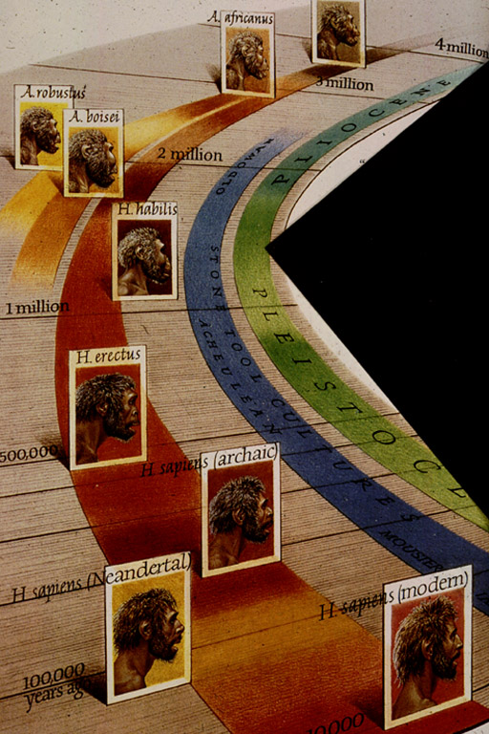
For most of their early history,
humans survived as foragers or
hunter-gatherers, gathering
wild plants and hunting animals
in their natural environment.

Slide 4
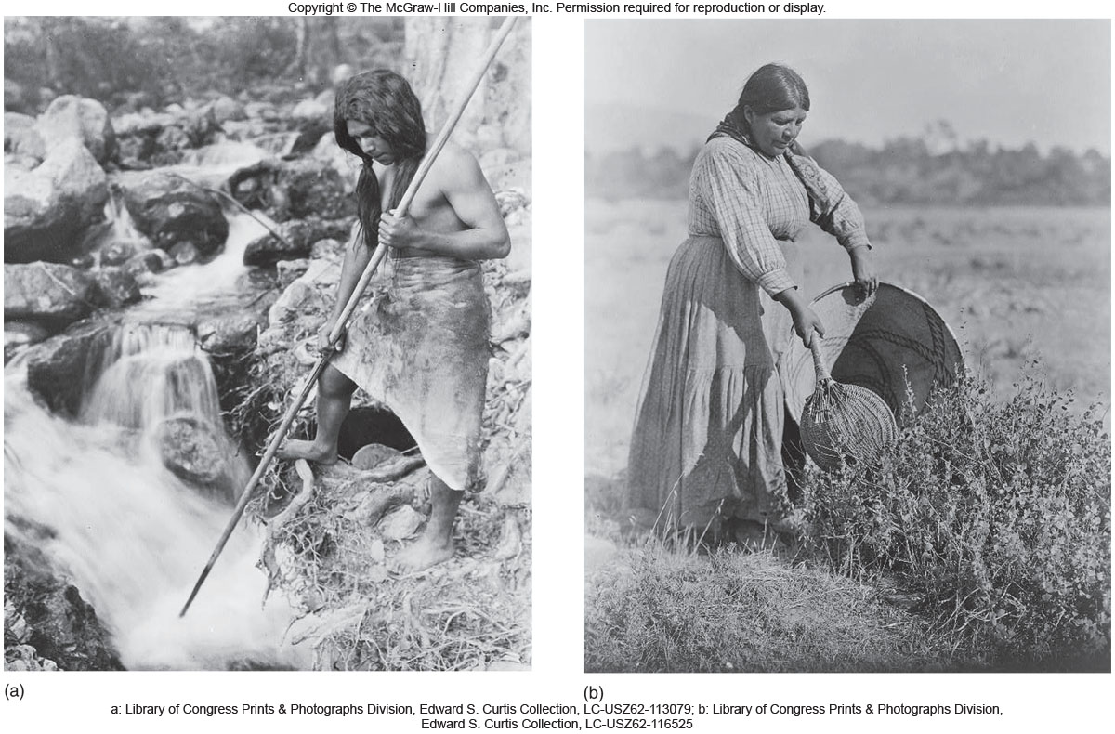
Early foragers knew which plants were edible, which were poisonous, and which had medicinal properties.
Notes:
lev70065_11_01.jpg

Slide 5
Paleolithic paintings from Chauvet Cave in Ardeche, France, provide a window on the activity of Paleolithic foraging societies.

Slide 6
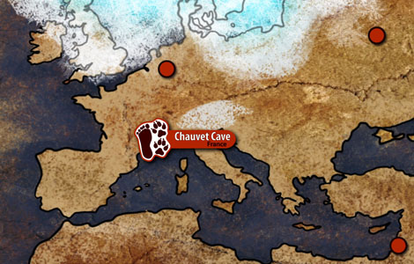

Slide 7
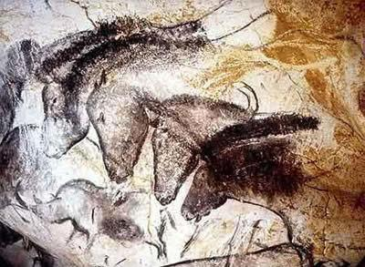

Slide 8
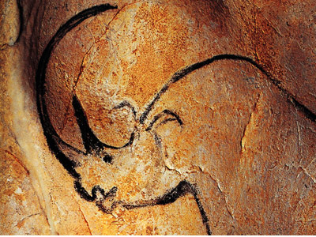
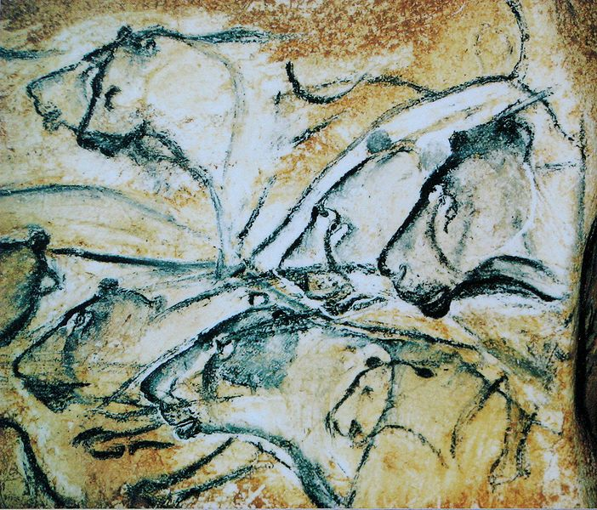

Slide 9
Neanderthal
Homo sapiens (archaic)
Homo sapiens (modern)
200,000 100,000 present
Chauvet
cave
Agriculture
Around 10,000 years ago in many areas of the world, there was a shift
from foraging to farming

Slide 10
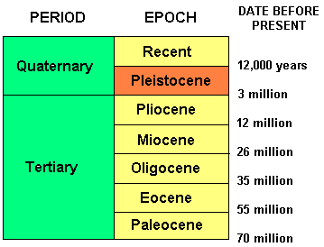
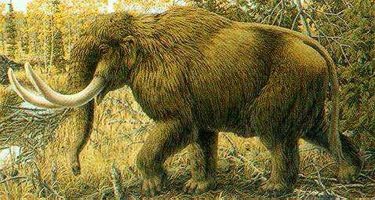
The shift from foraging to farming happened shortly after the end of
the last Ice Age

Slide 11
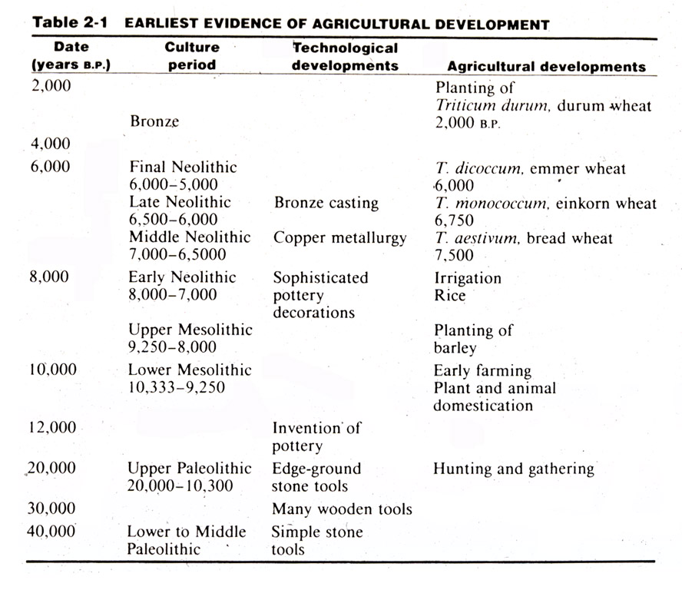

Slide 12
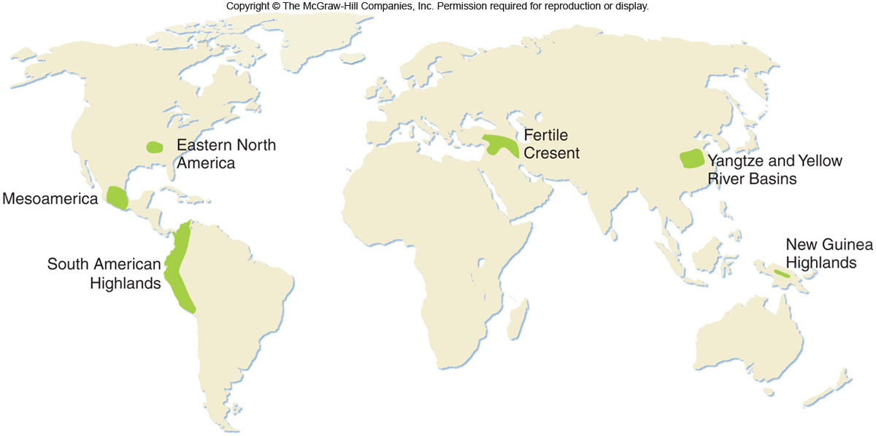

Slide 13
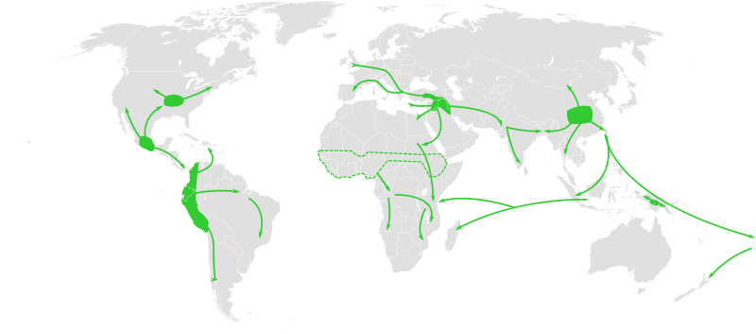
Notes:
And it spread around the world in just a few years (relatively speaking).

Slide 14
What prompted the switch from foraging to
agriculture?
Is it that foraging is too taxing on human time and energy?
Is it too unreliable as a source of adequate nutrition?

Slide 15
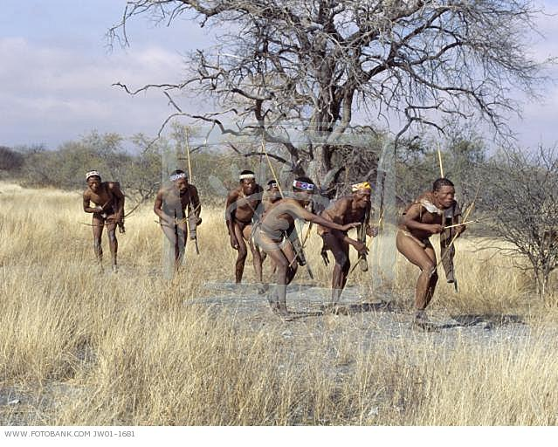
Contemporary studies of the !Kung, a hunting and foraging tribe of southern Africa, show that these people have a very good diet, including about 2,300 cal./day and 96 grams of protein per day. To obtain food supplies, the !Kung spend about 2.5 days per week per person in food acquisition.

Slide 16
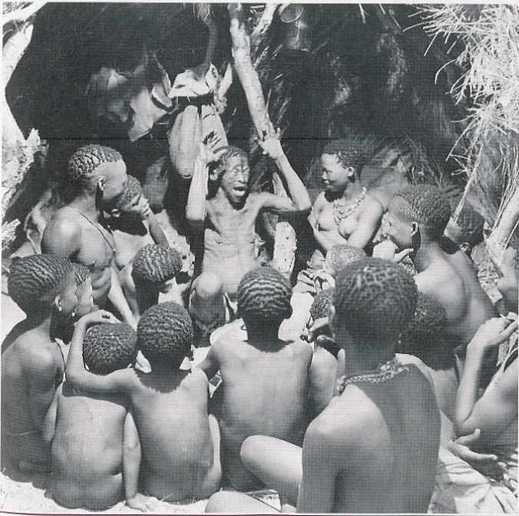
When asked by researchers Lee and Devore why they
did not practice the intentional cultivation of plants,
the !Kung responded, “Why should we?”

Slide 17
What prompted the switch from foraging to
agriculture?
The modern theory is an evolutionary one, and postulates that the hunter-gatherers, based on their knowledge of wild plants, began to incorporate farming along with foraging as part of an overall food collection strategy.

Slide 18
There may have been a transition period during which
societies carried out the cultivation of plants and animals, but also sent out hunting and gathering parties in search
of food.
This transition period may have lasted several thousand
years, until climate change prompted the wholesale
adoption of agriculture.

Slide 19
Climate Change:
Following the end of the last ice age, earth’s climate warmed significantly. Changes in vegetation patterns were brought about by changes in rainfall patterns, not just temperature. The Near East became considerably
drier about 13, 500 years ago, forcing people to live together in dense settlements around water sources. This increased population density may have prompted the development of agriculture.

Slide 20
By the Bronze Age (5500-3100 years ago), wild food
contributed a nutritionally insignificant component to the
usual diet in most cultures.

Slide 21
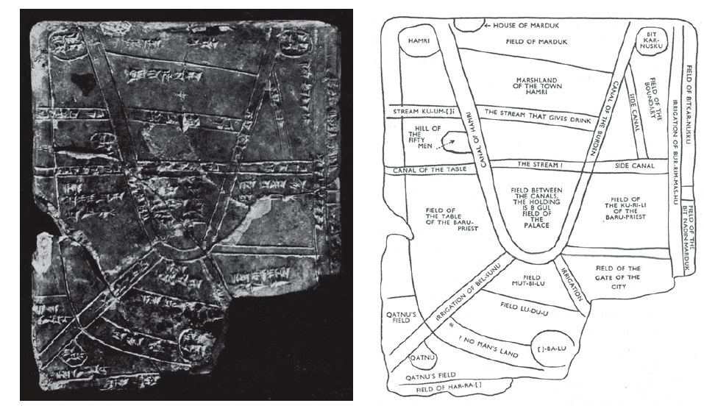
So who invented agriculture?
If the operative definition of agriculture includes large-scale, intensive
cultivation of land, mono-cropping, organized irrigation, and use of a
specialized labour force, the title "inventors of agriculture" would
fall to the Sumerians, starting ca. 5,500 BC.

Slide 22
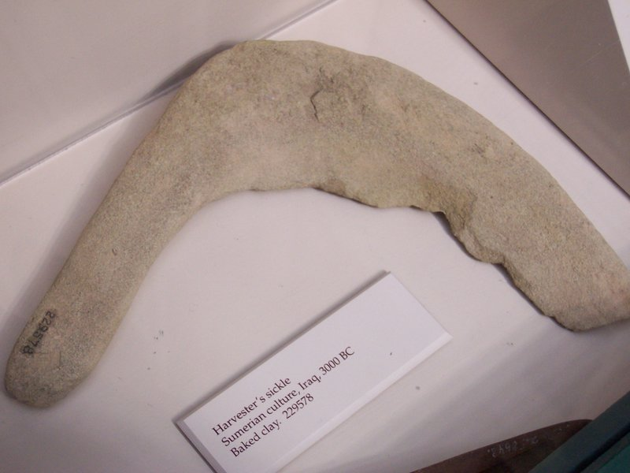

Slide 23
Early cuneiform writing was closely linked to agriculture.
These Sumerian clay tablets dating to ca. 5000 years ago,
appear to deal with crops and livestock.

Slide 24
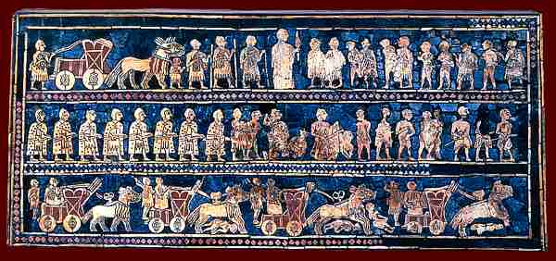
The ability of farmers to feed large numbers of people whose
activities have nothing to do with agriculture was the crucial
factor in the rise of standing armies.

Slide 25
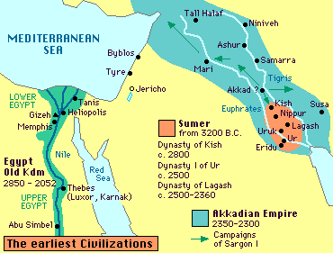
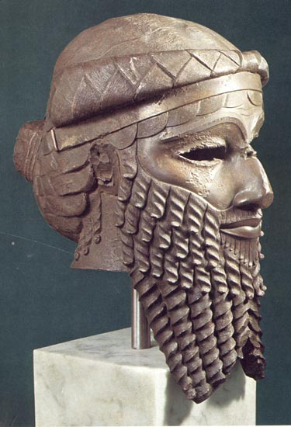
Sumerian agriculture supported a substantial territorial expansion,
which helped to make them the first empire builders

Slide 26
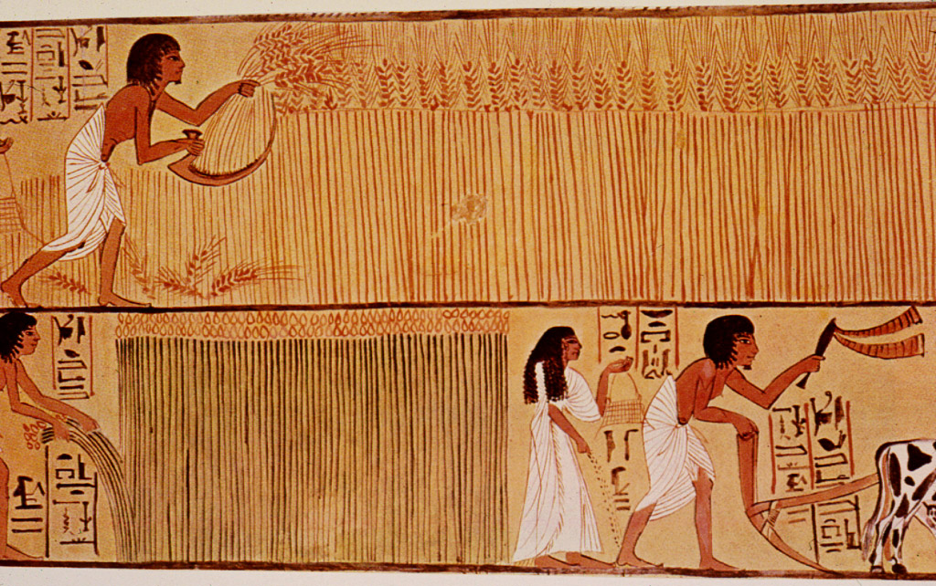
Not long after, the Egyptians, powered by farming in the fertile
Nile valley, achieved a population density from which enough warriors
could be drawn for a territorial expansion more than tripling the
Sumerian empire in area.

Slide 27
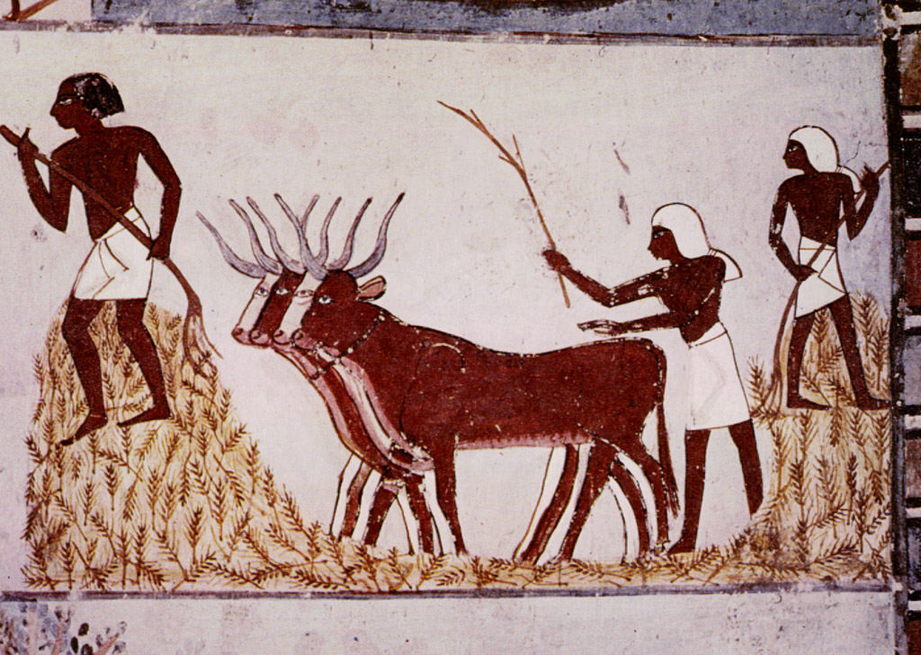

Slide 28
Sites of Early Agriculture
Wheat and barley,
ca.10,000 years ago
Rice cultivation
ca.11,500 years ago
Maize,
ca.10,000 years ago
Notes:
lev70065_11_04.jpg

Slide 29
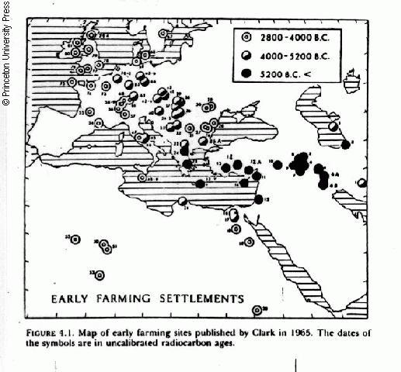
4800-6000 ybp
6000-7200 ybp
> 7200 ybp
Near East - Hungary
Near East - Mediterranean
The spread of agriculture into Europe
Notes:
Agriculture established in central and western Europe by 6-7 thousand years before the present.
It is currently accepted that agriculture reached Central and Western Europe by two routes. One agricultural movement from the Near East followed the Mediterranean. The other general route seems to have led from the Near East, probably across Greece to Hungary.

Slide 30
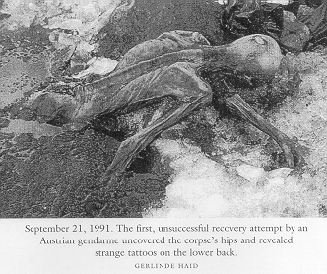
Oetzi, the Iceman: an early agricultural European
Dated to 5100-5350 ybp
Notes:
Dated to 5100-5350 ybp; 5’2” tall; 40-45 years yrs. old
His last meal was of einkorn, based on remains in colon
Charcoal: einkorn used to make "bread" (cracker-like), baked over open fire

Slide 31
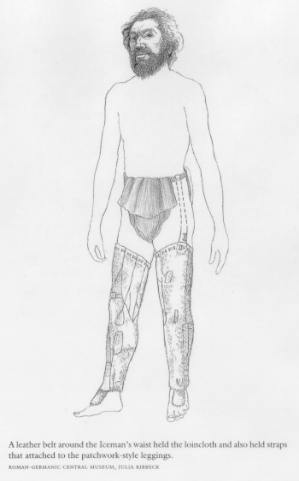
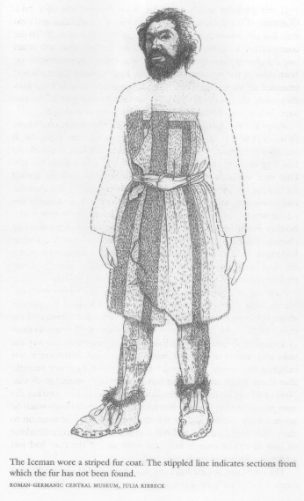
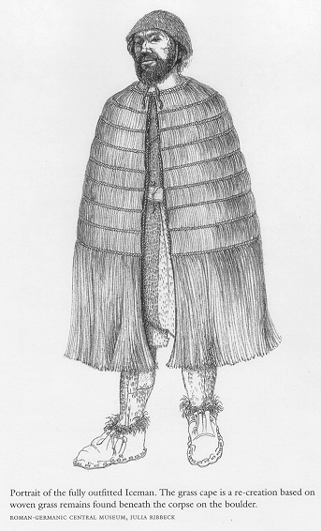

Slide 32
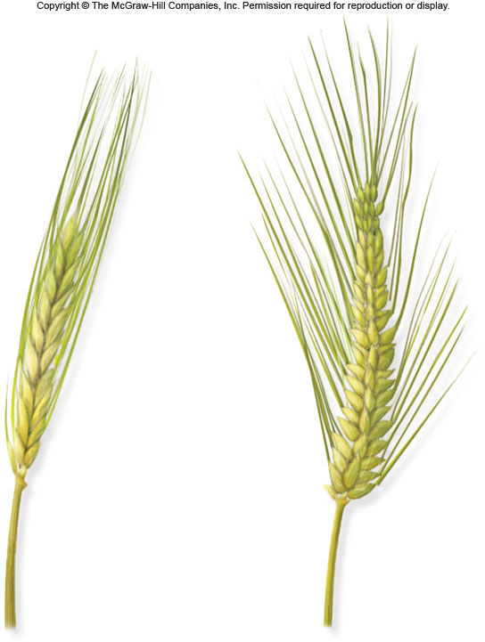
Characteristics of domesticated plants
Humans select for:
Grains - nonshattering heads
Larger/more - fruits, seeds
More easily processed
Less toxins
Few domesticated plants can survive in the wild!

Slide 33
Lecture Review, Chapter 11
Humans have been foragers for most of their history. The shift from foraging to agriculture took place about 10-11 thousand years ago. Was this development a ‘revolution’ or an ‘evolution’?
Explain how climate change played a role in the shift from foraging to agriculture.
Agriculture arose in several places in the world at the same time, about 10-11,000 years ago. What factors lead to the development of agriculture?
What is artificial selection, and why is it important? What traits did humans select for with artificial selection?

