Slide 1
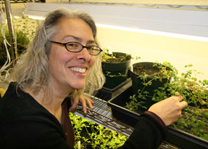
What are GMOs?
Dr. Jeanne Harris
Associate Professor,
Plant Biology

Slide 2
What are GMO’s?
Genetically Modified Organisms

Slide 3
What are GMO’s?
Genetically Modified Organisms
Conventional breeding
Genetic Engineering

Slide 4
What are GMO’s?
Genetically Modified Organisms
Conventional breeding
Genetic Engineering

Slide 5
Conventional Breeding
Selecting individuals for breeding that have desired traits.

Slide 6
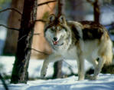
Conventional Breeding
Selecting individuals for breeding that have desired traits.
wolf

Slide 7
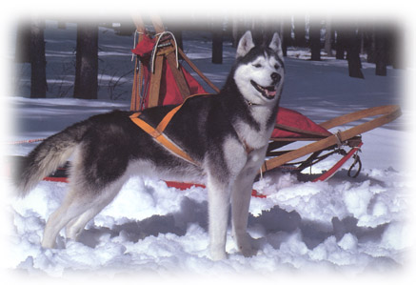
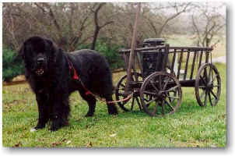
Conventional Breeding

Slide 8
Effects of conventional breeding on familiar crops
cultivated tomato
wild tomato
Prakash, 2001

Slide 9
Effects of conventional breeding on familiar crops
cultivated tomato
wild tomato
Wild teosinte
Modern corn
Teosinte/corn
hybrid
Prakash, 2001

Slide 10
Conventional breeding
Which statement is true?
Is based on selecting individuals for breeding based on desired traits
Is a genetic engineering technique
Is a recent invention
None of the above

Slide 11
How do you make a GMO?

Slide 12
How do you make a GMO?
or
How does Genetic Engineering work?

Slide 13
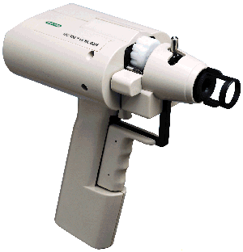
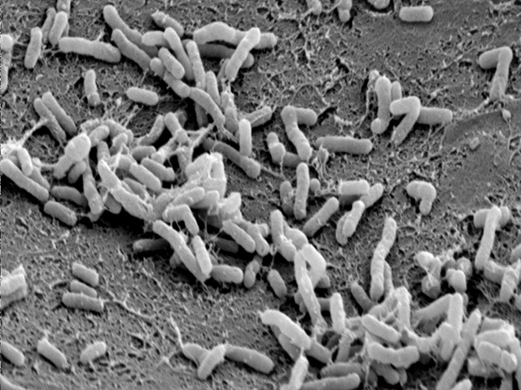
How do you make a GMO?
1. Biolistics
2. Agrobacterium tumefaciens
Shirley Owens

Slide 14
Why do people make GMOs?
Agricultural reasons
Health reasons
“Factory” reasons
Environmental reasons

Slide 15
Why do people make GMOs?
1. Agricultural Reasons
Confer herbicide resistance
Confer pathogen resistance
Control fruit ripening/rotting
Increase production

Slide 16
Why do people make GMOs?
1. Agricultural Reasons
Confer herbicide resistance
Confer pathogen resistance
Control fruit ripening/rotting
Increase production

Slide 17
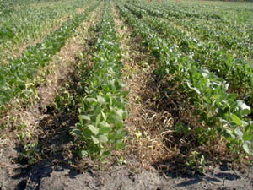
Herbicide resistance
Plants engineered to be resistant to the common herbicide, RoundUp.
“RoundUp Ready” soybeans

Slide 18
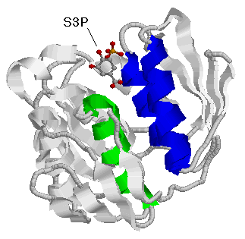
How RoundUp resistance works:
RoundUp inactivates an essential enzyme - EPSP synthase

Slide 19
How RoundUp resistance works:
RoundUp inactivates an essential enzyme - EPSP synthase

Slide 20
How RoundUp resistance works:
RoundUp inactivates an essential enzyme - EPSP synthase
The plant DIES

Slide 21
How RoundUp resistance works:
In RoundUp Resistant plants EPSP synthase no longer binds RoundUp.
Gly96-> Ala
The plant LIVES
1 amino acid is changed in this enzyme to make it resistant.
The other 443 amino acids remain the same.

Slide 22
Why do people make GMOs?
1. Agricultural Reasons
Confer herbicide resistance
Confer pathogen resistance
Control fruit ripening/rotting
Increase production

Slide 23
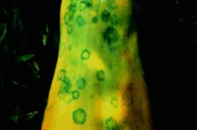
Papaya Pathogen
Papaya ringspot virus (PRSV)
Interferes with the plant’s ability to photosynthesize
Transmitted by aphids
Symptoms
Most plants fail to flower
Plants die young
Fruits are marred with green spots

Slide 24
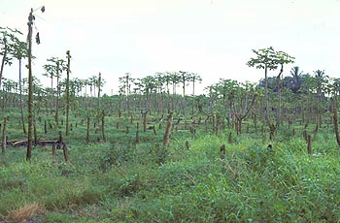
History of PRSV in Hawaii
First reported in Hawaii in the 1940’s
Wiped out papaya production in Oahu in the 1950’s and 1960’s.
Commercial Papaya production moved to the Puna district on Hawaii Island
PRSV found in backyard gardens in the 1970’s
In 1992 PRSV was discovered in Puna
By 1994, PRSV was wide-spread in Puna
By 1997, commercial papaya production was cut by 50% due to losses from PRSV
Puna

Slide 25
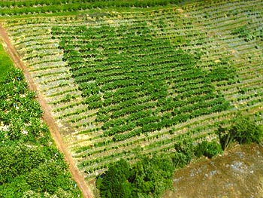
Goal: develop a PRSV-resistant papaya
No naturally resistant cultivars
Previous finding: tobacco plants that make a protein from the virus were resistant to the virus
Tried the same approach with PRSV - it worked!

Slide 26
Who developed the transgenic papaya?
Dennis Gonsalves (virologist) - Cornell University (USDA)
Jerry Slightom (molecular biologist) - Upjohn Company
Richard Manshardt (horticulturalist) - University of Hawaii
Maureen Fitch (tissue culture specialist)- University of Hawaii (USDA)

Slide 27
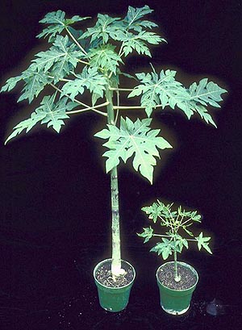
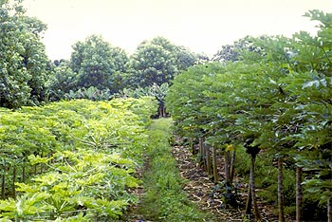
Field trials of the transgenic papaya
Started in 1992, just months before PRSV swept through Puna
The transgenic lines were made from cultivars already popular with Puna farmers (Sunset, Kapaho)
Rainbow (transgenic)
Non-transgenic
Rainbow (transgenic)
Non-transgenic

Slide 28
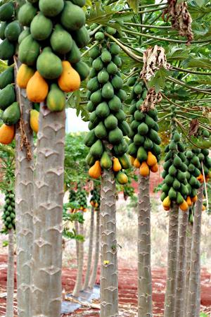
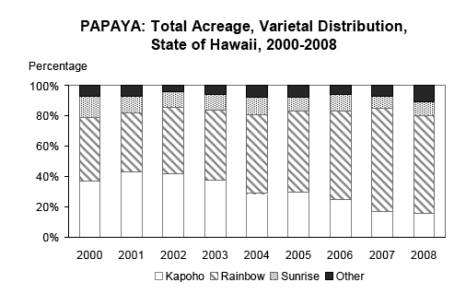
Papayas in Hawaii today
The researchers gave seeds of the transgenic plants, “Rainbow”, to growers for free. (1998).
http://www.nass.usda.gov/hi
http://www.apsnet.org/ONLINE/FEATURE/RINGSPOT/
http://www.agbioforum.org/v7n12/v7n12a07-gonsalves.htm

Slide 29
Why do people make GMOs?
1. Agricultural Reasons
Confer herbicide resistance
Confer pathogen resistance
Control fruit ripening/rotting
Increase production

Slide 30
Why do people make GMOs?
2. Health Reasons
Increase nutrition
vitamin biosynthesis (ex. Golden rice) (Plants can make many vitamins humans can’t)
increase protein content
Decrease allergenicity
Decrease toxicity
Edible vaccines

Slide 31
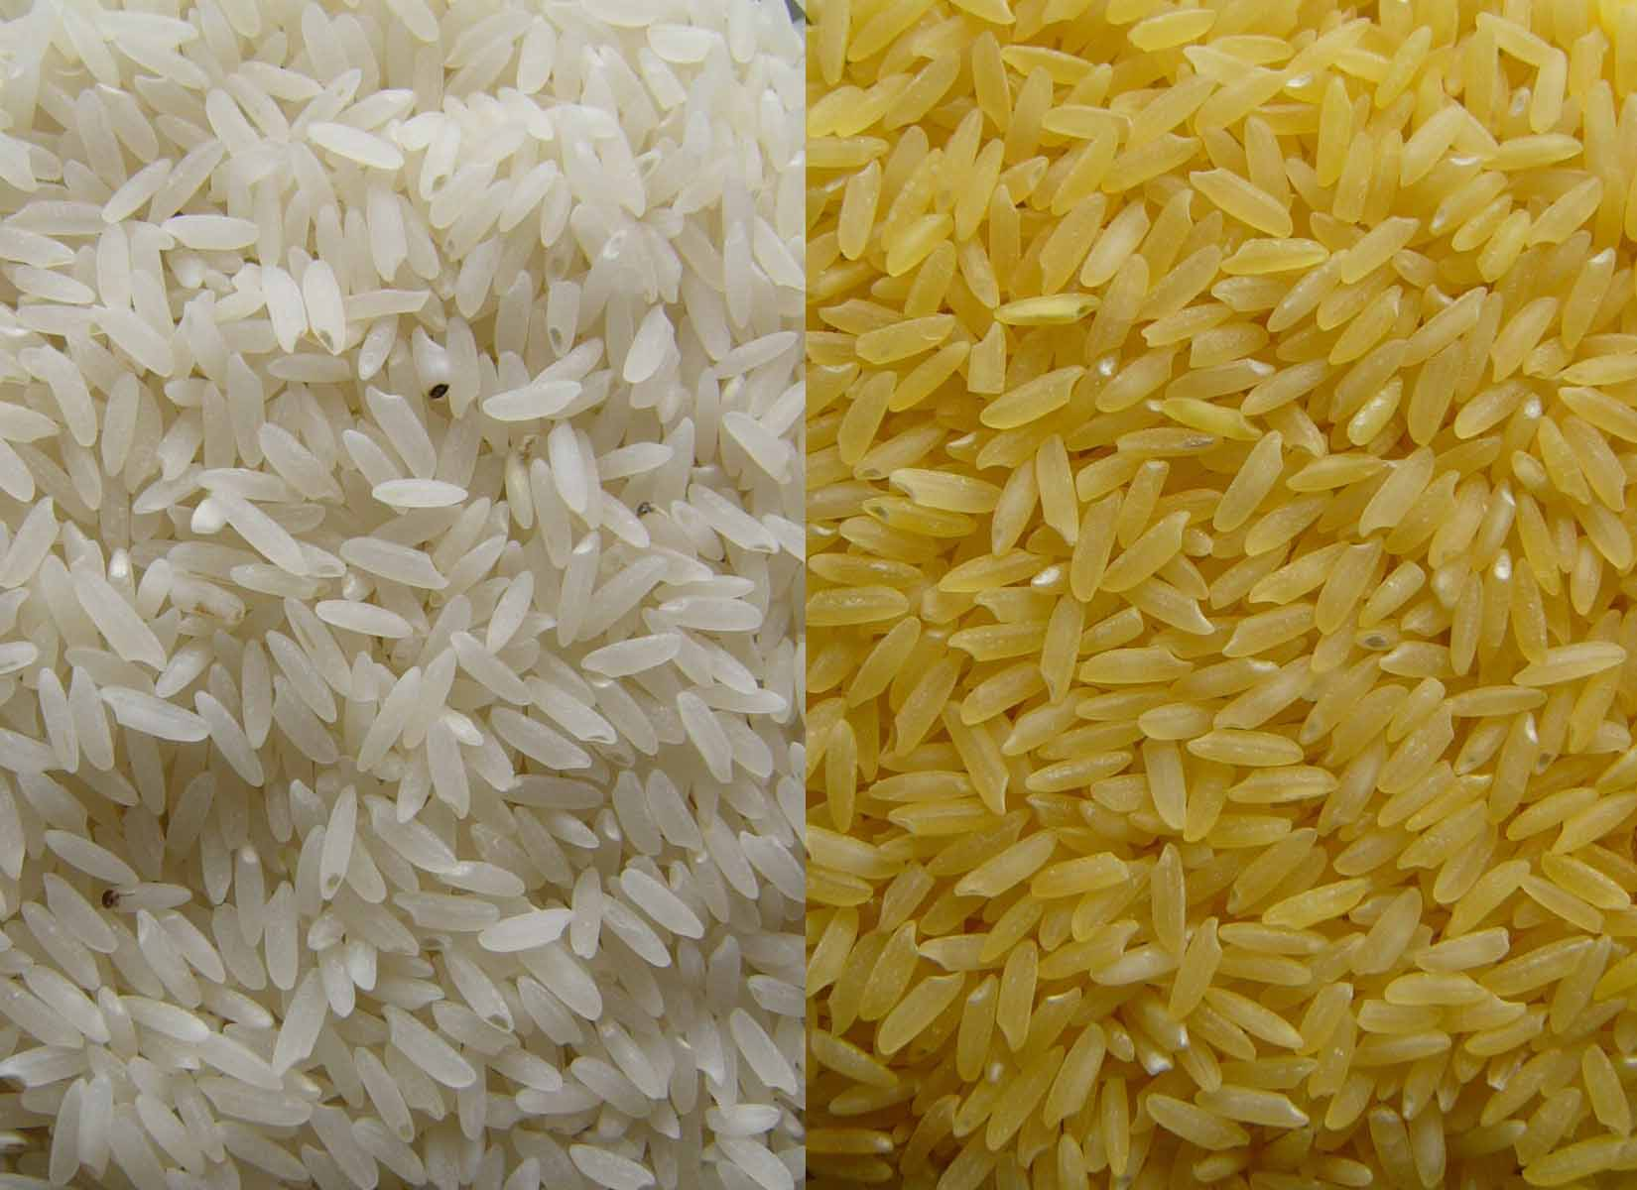
Golden Rice
Vitamin A deficiency
Each year 250,000 to 500,000 children go blind worldwide
Half of those children will die from vitamin A deficiency within a year.
For many people, rice contributes 80% of their daily calories
http://www.goldenrice.org/

Slide 32
Golden Rice
Developed by two independent researchers:
Ingo Potrykus
Peter Beyer
Rice naturally produces beta-carotene
--> but not in the rice grain
http://www.goldenrice.org/
Golden Rice:
Increased beta-carotene content
Can supply daily requirement of vitamin A

Slide 33
Golden Rice
Developed by two independent researchers:
Ingo Potrykus
Peter Beyer
Rice naturally produces beta-carotene
--> but not in the rice grain
http://www.goldenrice.org/
Potrykus and Beyer turned ON the genes for beta-carotene synthesis in the rice grain, by transferring the gene from daffodils.
--> now the rice is yellow!

Slide 34
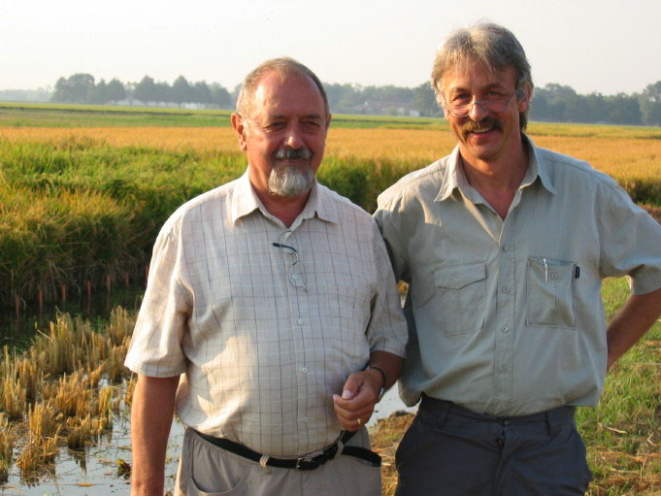
Golden Rice - current status
The plan is to give seed for free to farmers
All patents have been waived (took only 6 months!)
Now have a collaboration with Syngenta for production
Currently going through the testing process before seed is available to farmers (since 2000)
First US field trial in 2004, in Louisiana
Many countries in south-east Asia did not have a regulatory process in place, since this is the first GM crop there
http://www.goldenrice.org/

Slide 35
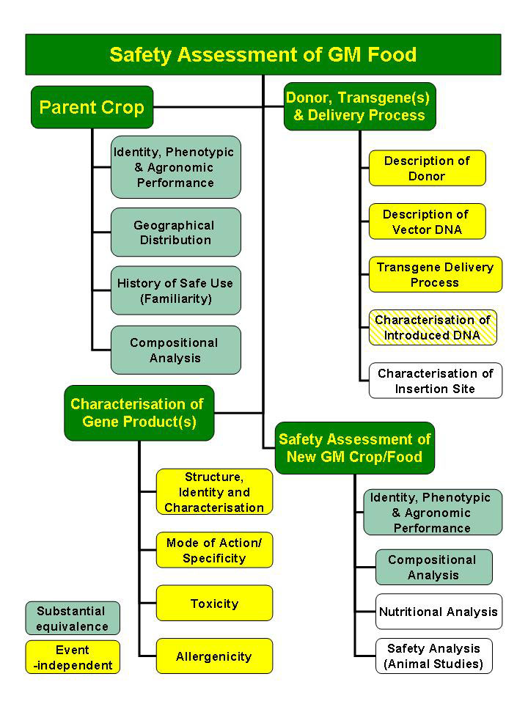
Why are most GM crops that make it to farmers’ fields produced by large companies?
A multi-year, very expensive regulatory process.
This process has taken over 10 years so far for Golden Rice.
Scientists associated with a university or research organization do not have the financial resources to fund all the research teams necessary for the different parts of the process.

Slide 36
Why do people make GMOs?
2. Health Reasons
Increase nutrition
vitamin biosynthesis (ex. Golden rice) (Plants can make vitamins, humans can’t)
increase protein content
Decrease allergenicity
Decrease toxicity
Edible vaccines

Slide 37
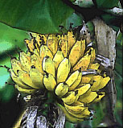
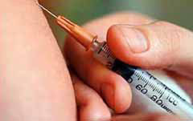
Edible Vaccines
Will vaccines in plants replace injected vaccines?

Slide 38
Edible Vaccines
Dr. Charles Arntzen
Arizona State University
Vaccines in:
potatoes
tomatoes
bananas

Slide 39
The idea:
Make transgenic plants that contain proteins from disease-causing organisms that would trigger an immune response but NOT cause disease.
Norwalk virus
Pathogenic E. coli
Cholera
Hepatitis B

Slide 40
In the developing world, diarrhea means death for many children
2.5 million children each year die from diarrhea-causing illnesses

Slide 41
Why have Edible Vaccines?
Traditional Vaccines work well in the developed world.

Slide 42
Why have Edible Vaccines?
Traditional Vaccines work well in the developed world.
Problems with traditional vaccines in the Third World:
Lack of refrigeration
Lack of sterile syringes
Difficulty tracking people for repeat booster shots

Slide 43
Advantages to delivering vaccines in plants
Easy to produce
Easy to transport
Avoid allergies to animal protein
No refrigeration needed
Don’t need specialized training to administer

Slide 44
Disadvantages to edible vaccines
Controlling the dose?
Controlling access to a medicine that looks like a “food”
Food Allergies
Developing “oral tolerance”
Aversion to GMO’s
Preventing the transgenic plant from spreading out of cultivated areas

Slide 45
Disadvantages to edible vaccines
It must be eaten raw.
- this is a problem with potatoes…

Slide 46
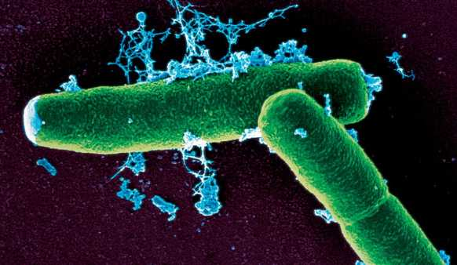
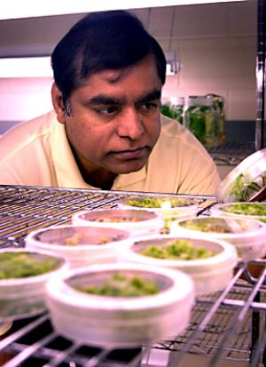
An anthrax vaccine in tobacco?
Anthrax bacteria
Major bioterrorism threat
Current vaccine has unpleasant side effects
Shortage of vaccine (difficult to produce)
Dr. Henry Daniell
University of Central Florida

Slide 47
An anthrax vaccine in tobacco?
Mice immunized with this vaccine survived lethal doses of anthrax
One acre of the transgenic tobacco could provide enough vaccine for the entire country.
Lacks side effects caused by current vaccine (produced in bacteria)
Dr. Henry Daniell
University of Central Florida

Slide 48
Why do people make GMO’s?
3. “Factory” Reasons
Make plant “chemical factories”
--> plastics and oils
Reduce our reliance on petroleum
Reduce greenhouse gases
Products are often biodegradable
Phytomining – mine naturally occurring metals from the soil

Slide 49
Why do people make GMO’s?
3. “Factory” Reasons
Make plant “chemical factories”
--> plastics and oils
Reduce our reliance on petroleum
Reduce greenhouse gases
Products are often biodegradable
Phytomining – mine naturally occurring metals from the soil

Slide 50
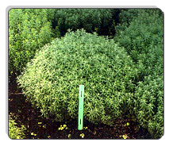
Phytomining
Using plants to mine metals from soil.
Alyssum

Slide 51
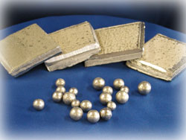
Phytomining
Alyssum
Nickel

Slide 52
Alyssum - Phytomining
Hyperaccumulates
Nickel
Cobalt
Up to 2.5% of dry weight
NOT a GMO
Alyssum

Slide 53
Nickel farming with Alyssum
Ni
Ni
Ni
Ni
Ni
Ni
Ni
Ni

Slide 54
Nickel farming with Alyssum
Ni
Ni
Ni
Ni
Ni
Ni
Ni
Ni

Slide 55
Nickel farming with Alyssum
Ni
Ni
Ni
Ni
Ni
Ni
Ni
Ni
Ni
Ni
Ni

Slide 56
Nickel farming with Alyssum
Ni
Ni
Ni
Ni
Ni
Ni
Ni
Ni
Ni
Ni
Ni
Ni
Ni
Ni
Ni
Ni
Harvest shoots, make hay
Ni
Ni
Ni

Slide 57
Nickel farming with Alyssum
Ni
Ni
Ni
Ni
Ni
Ni
Incinerate hay
Ni
Ni
Ni
Ni
Ni
Ni
Ni
Ni
Ni
Ni
Ni
Ni
Ni
Ni
Ash with high nickel content
Harvest shoots, make hay
Ni
Ni
Ni

Slide 58
Nickel farming with Alyssum
Ni
Ni
Ni
Ni
Ni
Ni
Incinerate hay
Ni
Ni
Ni
Ni
Ni
Ni
Ni
Ni
Ni
Ni
Ni
Ni
Ni
Ni
Ash with high nickel content
Harvest shoots, make hay
Ni
Ni
Ni

Slide 59
Advantages to Phytomining over conventional mining
Minimal effect on the environment
Can extract metals from soils - an unavailable resource using conventional mining techniques
Can clean up contaminated soils (heavy metals are toxic!) --> Phytoremediation
Can generate power when burning the hay
Metal content of ash is superior to commercial mined ore

Slide 60
Phytomining can be lucrative
Phytomining produces:
400 kg of nickel per hectare
-->$2000 per hectare per year
If you add in the energy produced by burning the hay
-->$3000 per hectare per year
Compare:
Low-grade pasture or forest
-->$50-100 per hectare per year

Slide 61
Phytomining/Phytoremediation - would it be more effective with larger plants?

Slide 62
Why do people make GMOs?
3. “Factory” Reasons
Make plant “chemical factories”
--> plastics and oils
Reduce our reliance on petroleum
Reduce greenhouse gases
Products are often biodegradable
Phytomining – mine naturally occurring metals from the soil

Slide 63
Why do people make GMOs?
4. Environmental Reasons
Phytoremediation - remove toxic compounds from the environment
→ ex. Arsenic or Nickel
Phytosensors – plants that report the presence of explosives, heavy metals or other compounds present in soils, water or air.

Slide 64
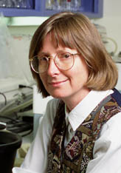
Phytosensors!
Plants that can detect explosives!
(more effective than the TSA?)
Dr. June Medford
Colorado State University
http://www.youtube.com/watch?v=kObTt_dR7IM

Slide 65
Transgenic plants can help scientific research
Plants that can indicate when they are
Stressed
Growing
Sense gravity
Sense a hormone
Etc.

Slide 66
Who benefits the most from GMOs?
A. Large companies
B. Individual researchers
Farmers
The consumer

Slide 67
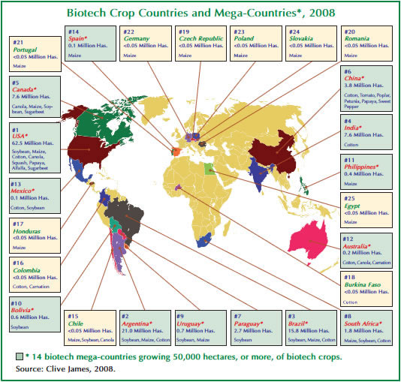
What GM crops are grown throughout the world?
http://www.isaaa.org/Resources/Publications/briefs/39/executivesummary/default.html

Slide 68
Would you eat food made from GMO’s?
Class responses:
55.5%
44.4%

Slide 69
What % of crops in the US are GM?
93% of soybeans
86% of corn
80% of papaya
93% of canola

Slide 70
Concerns about GMOs
Harmful to consumers? --> would you eat food made from GMO’s?
Crops will breed with weeds and transgenes will spread.
Herbicide-resistant plants will increase use of herbicides.
Pathogen-resistant plants will cause pathogens to evolve to be more infectious.

Slide 71
Risk Tolerance
Known risks vs. New risks

Slide 72
Lecture Review
What is meant by the expression ‘genetically modified organism?’ Is the process of genetically modifying organisms a new phenomenon? Explain.
Briefly describe two biotechnological methods used to move genes from one organism to another.
Once a foreign gene has been moved successfully into the cell of a different organism, how is the cell with the new gene identified? How do you get from a genetically modified cell to a genetically modified plant?
Discuss two “for profit” and two “not for profit” applications of GMO technology.
Are genetically modified foods common or uncommon on grocery store shelves in the U.S. today? Explain.

