Slide 1
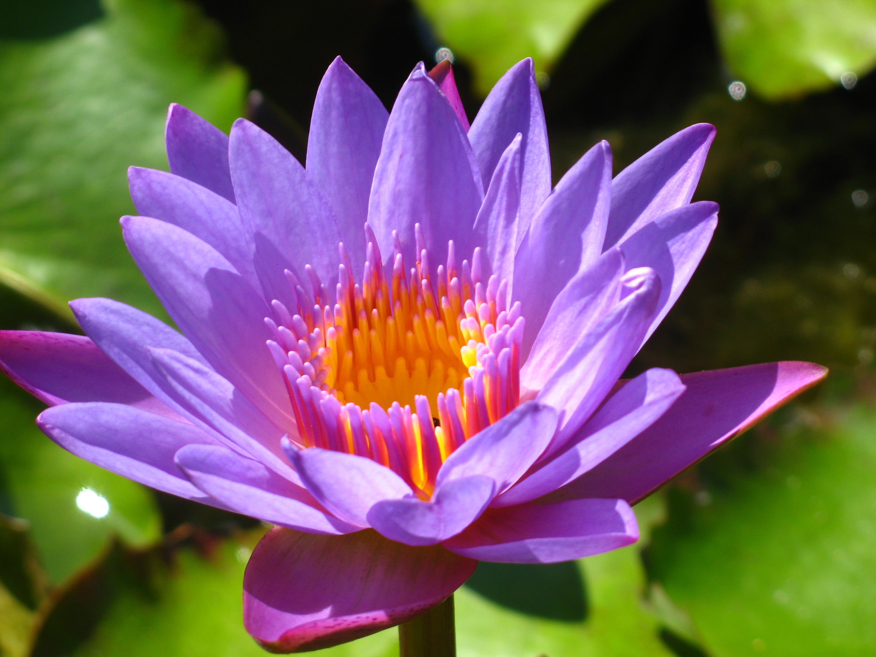
Flower Structure and Function
PBIO 006
Spring 2014

Slide 2
Outline
Flower Structure
Mitosis vs. Meiosis
Flowering Plant Life Cycle
IV. Flowering Plants and their Pollinators

Slide 3
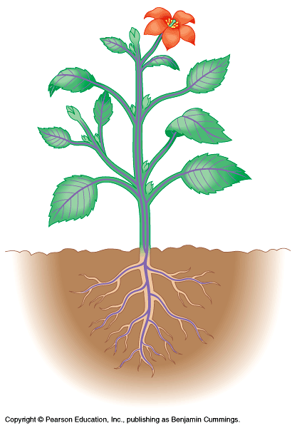
Reproductive Body
Shoot
Vegetative Body
Root

Slide 4
Pistil

Slide 6
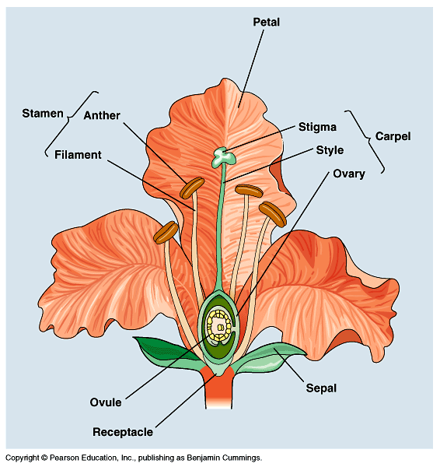
Four whorls of the flower:
Set of sepals = Calyx
Set of petals = Corolla
Set of stamens = Androecium
Carpel (or set of carpels) = Gynoecium

Slide 7
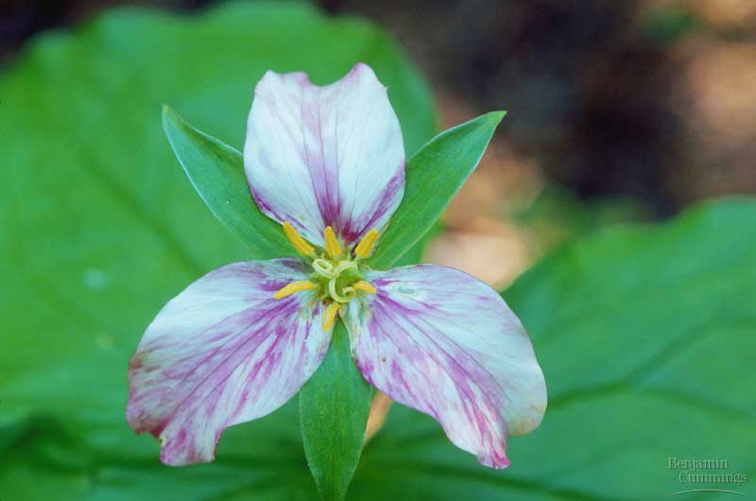
A flower that has all four whorls is said to be complete. If it has both sexual whorls, it is said to be perfect.
Notes:
Begin here on Thursday

Slide 8
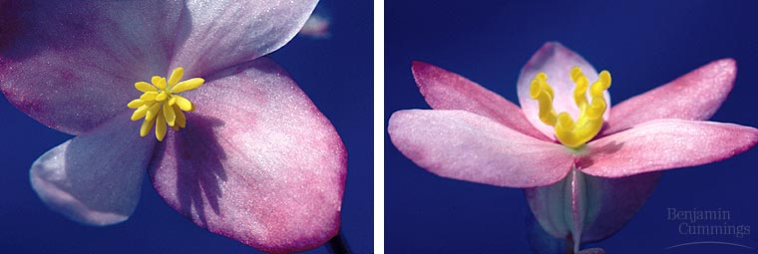
A flower lacking either stamens or carpels is imperfect
staminate (male)
Begonia
carpellate (female)

Slide 9
Petals may be separate ...

Slide 10
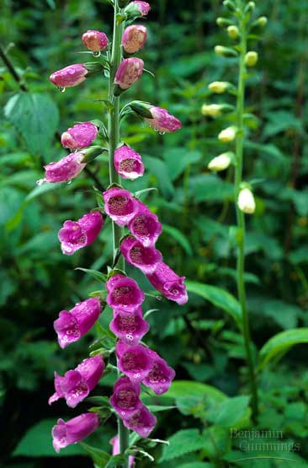
or they may be fused

Slide 11
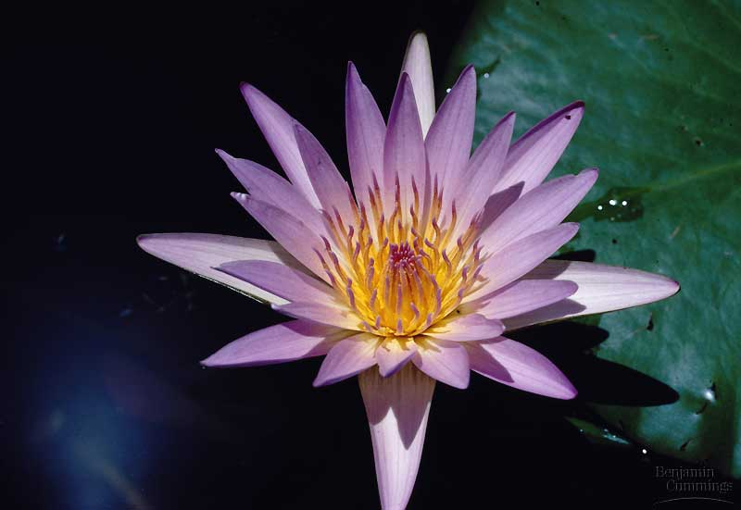
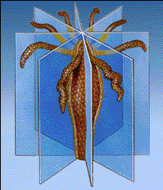
Symmetry
Water lily: symmetry is radial

Slide 12
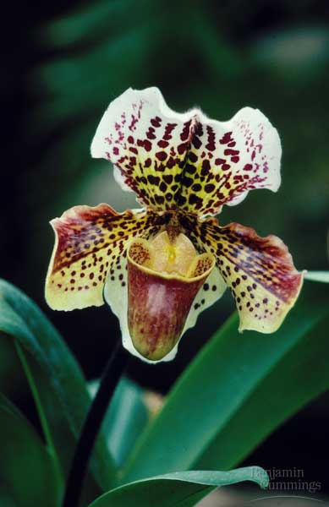
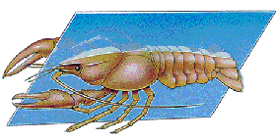
Symmetry
orchid: symmetry is bilateral

Slide 13
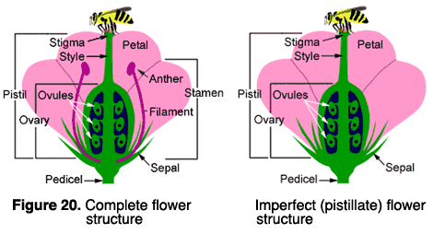
Concept Test: A botanist would describe this flower as imperfect because:
It is pollinated by insects.
It is radially symmetrical.
It lacks stamens.
It has an unpleasant odor.
It lacks sepals.

Slide 14
Gynoecium Structure

Slide 15
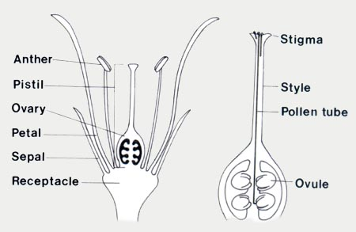
Carpel
Ovary
The terms carpel and pistil are often used interchangeably, but …

Slide 16
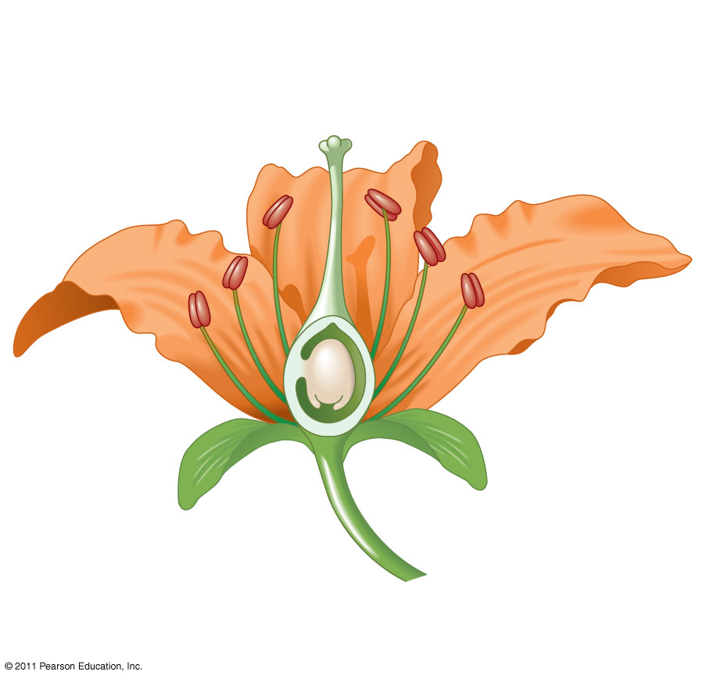
Concept Test: Flower structure
Arrange the following structures from the female part of the flower from the largest size to smallest size.
1. ovary
2. ovule
3. egg
4. carpel (or pistil)
4, 2, 1, 3
4, 3, 1, 2
1, 4, 2, 3
4, 1, 2, 3

Slide 17
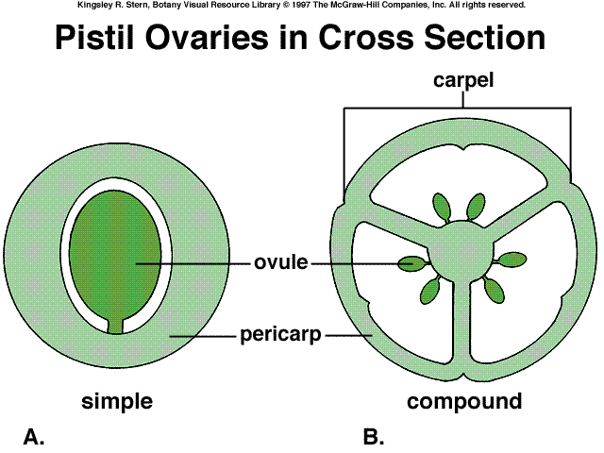
In a simple pistil,
carpel = pistil
In a compound pistil, the
carpel is a subunit of the pistil

Slide 18
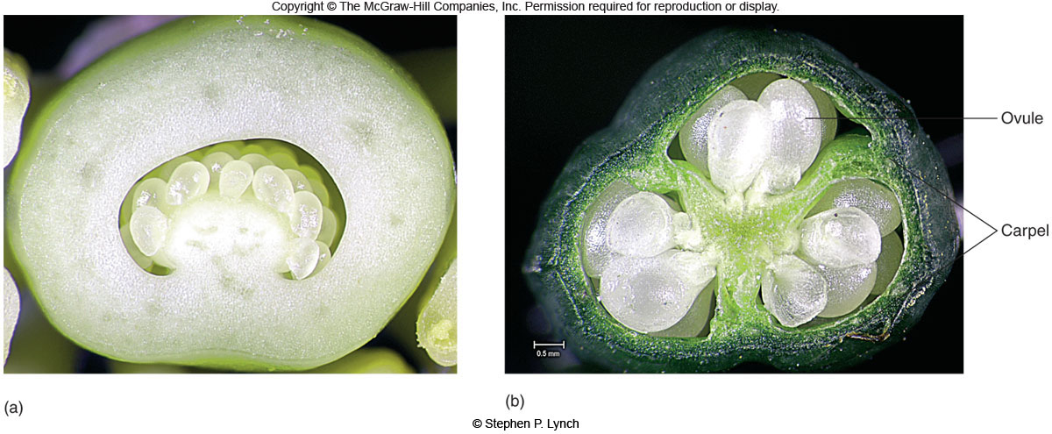
simple pistil
compound pistil
Notes:
lev70065_05_02.jpg

Slide 19
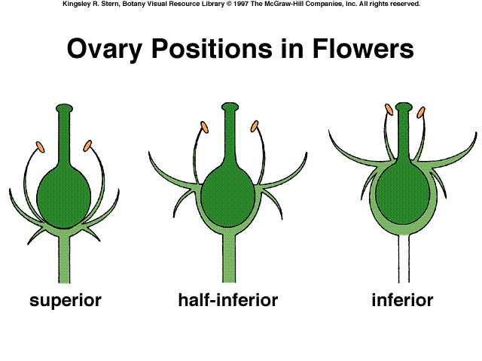

Slide 20
Meiosis
Notes:
Begin here on Tuesday

Slide 21
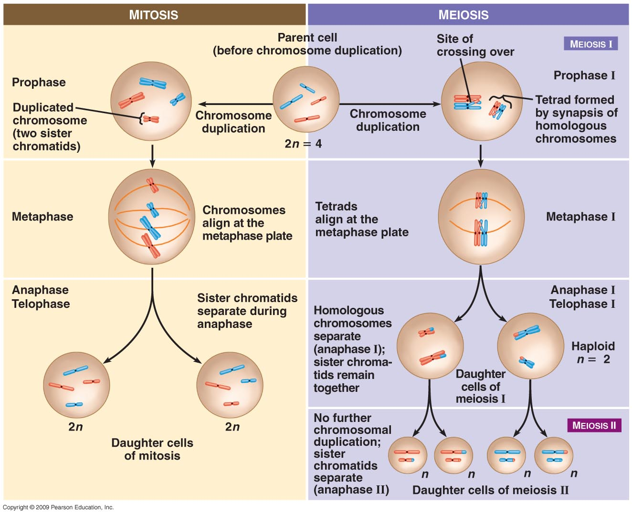
Parent Cell
(before DNA replication)

Slide 22
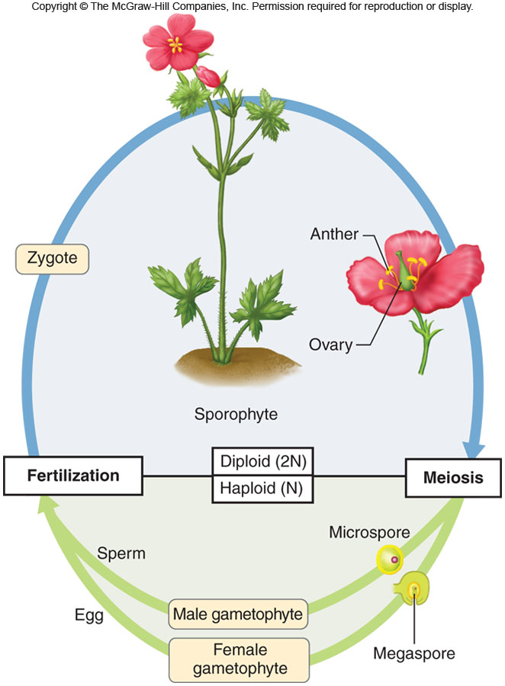
The Flowering Plant
Life Cycle … and
how it is different
from yours
Notes:
lev70065_05_06.jpg

Slide 23
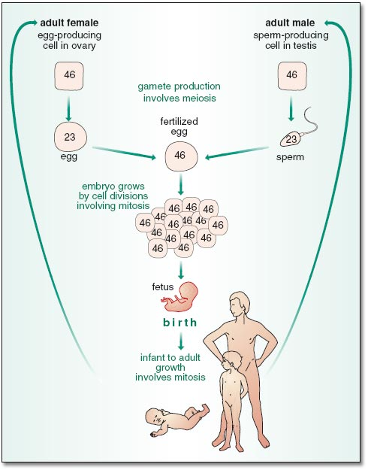
MEIOSIS
MITOSIS

Slide 24
MEIOSIS

Slide 25
The Flowering Plant
Life Cycle
Notes:
lev70065_05_06.jpg

Slide 26
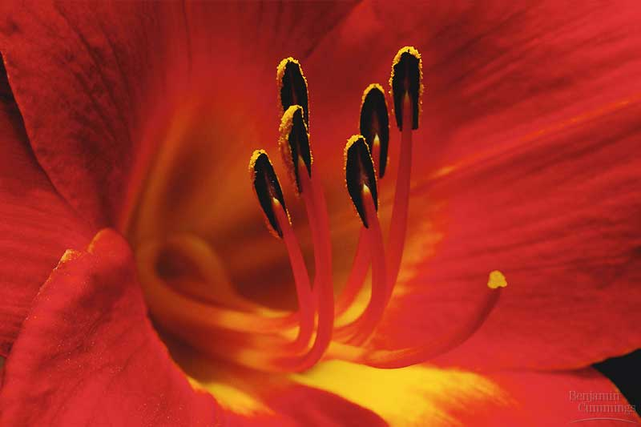
Figure 38.3ax2 Lily
The male gametophyte (pollen)

Slide 27
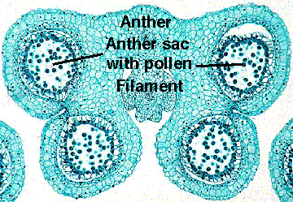
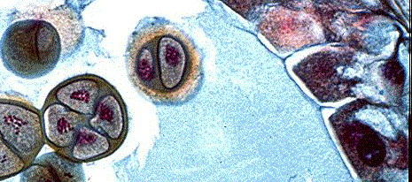
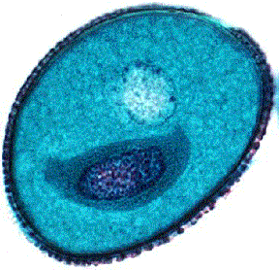
4 Microspores
A pollen grain con-
sists of two cells:
a generative cell
surrounded by a
tube cell.
Tube Cell
Generative Cell
Dispersed Pollen Grain
Pollen Coat

Slide 28
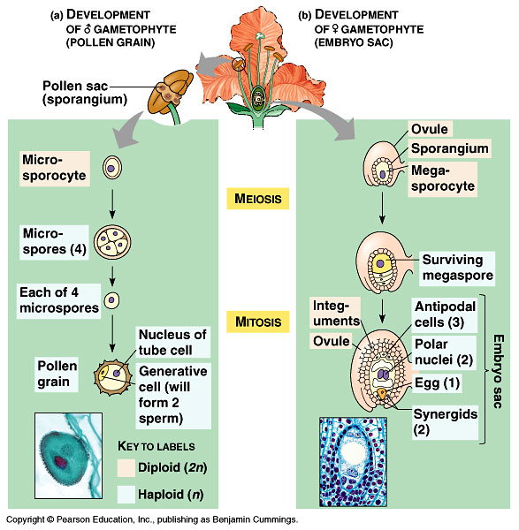
2-celled
pollen grain

Slide 29
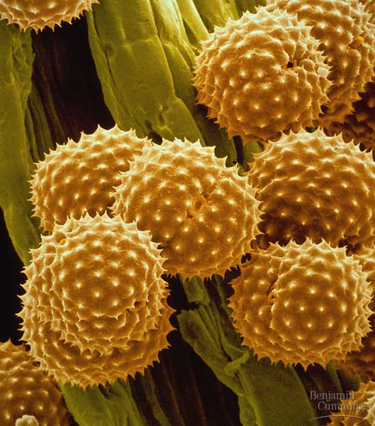
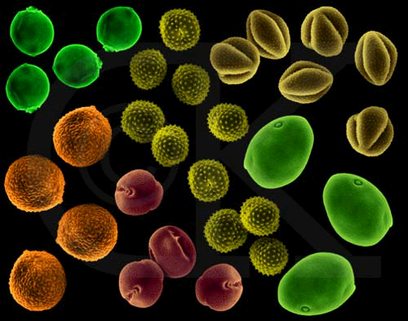
Figure 38.5 Pollen grains have tough, ornate, and distinctive walls

Slide 30
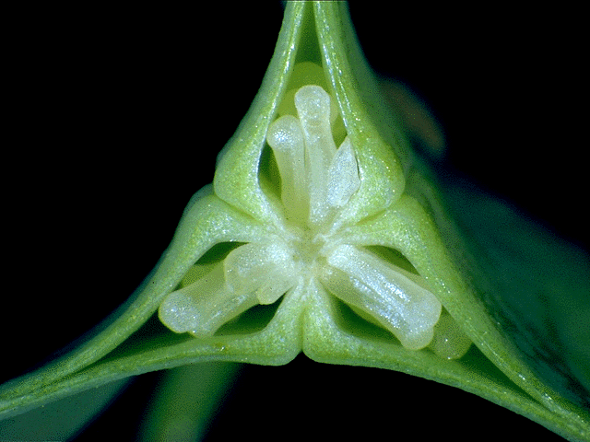
Development of the female gametophyte (embryo sac)

Slide 31
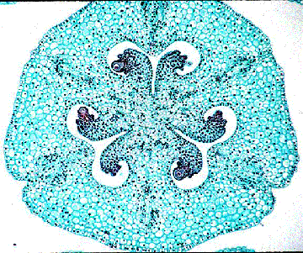
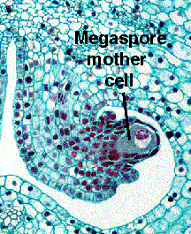
Cross Section of an Ovary
One ovule just after meiosis

Slide 32
7-celled
embryo sac

Slide 33
Pollination: the Transfer of Pollen to the Stigma

Slide 34
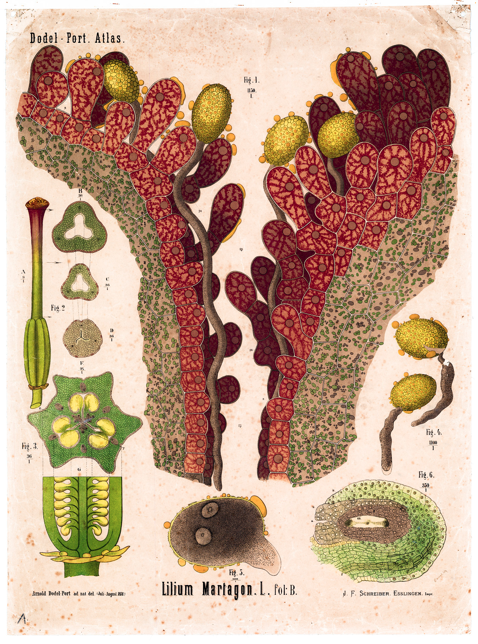
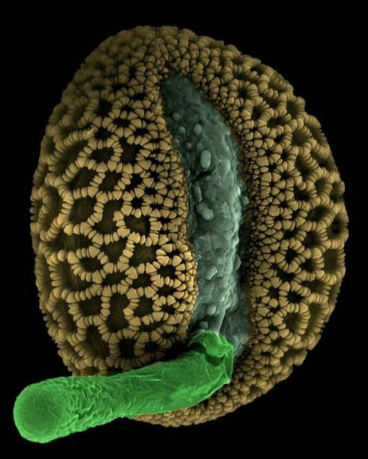
Pollen Tube
Germination
and Growth

Slide 36
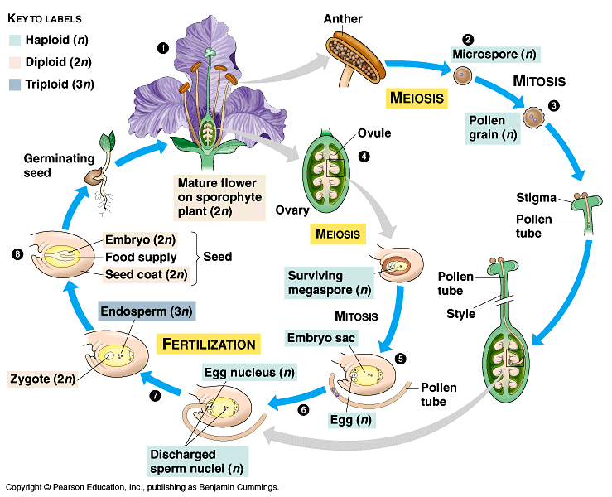

Slide 37
Concept Test: Double fertilization
Angiosperms are unique in that they undergo a process called double fertilization. Double fertilization means that:
flowers must be pollinated twice in order to produce fruits and seeds.
every egg must receive two sperm to produce an embryo.
one sperm is needed to fertilize the egg, and a second sperm is needed to form the endosperm.
the egg of the embryo sac is diploid.
every sperm has two nuclei.

Slide 38
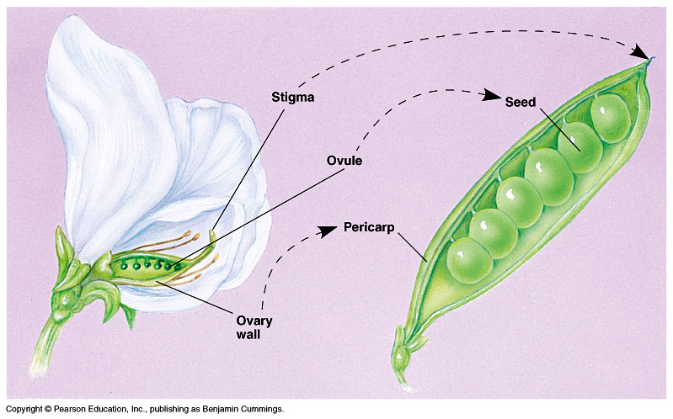
Ovaries ripen to become fruits;
ovules ripen to become seeds

