Slide 1
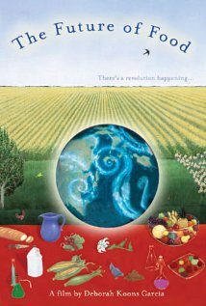
Extra Credit Opportunity
View the documentary “The Future of Food.” It is available online via Blackboard, as a DVD from the Media Library, and probably also through Netflix, etc.
Write a one-page response (instructions on BB). Email to me by Sunday, March 25 at midnight.
Please consult Blackboard for full instructions.

Slide 2
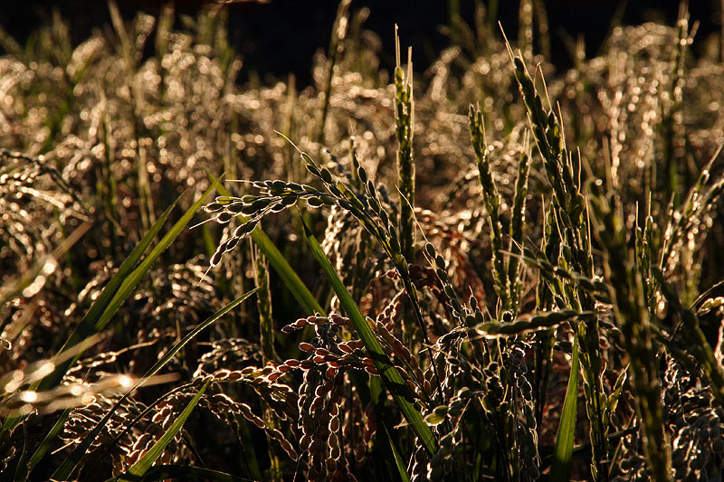
The Grasses That Feed the World
PBIO 006
Spring 2014
Ben Falk, Whole Systems Design Research Farm

Slide 3
The Grasses That Feed the World Chapter 12
Poaceae: The Grass Family
Grass Morphology
Grain and Flour
Wheat: Evolution, History, Uses, Morphology, Processing
Rice: History, Cultivation, Processing
Maize: Morphology, Evolution, History, Uses

Slide 4
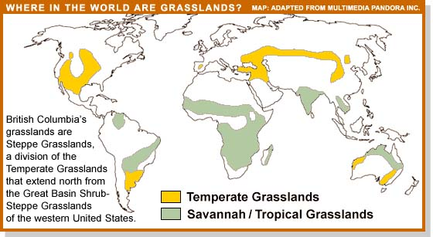
Grasses are the ecologically dominant plants in the temperate zone
in areas with rainfall between 10 and 30 inches/year.
Notes:
Grasses are the ecologically dominant plants in the temperate zone areas with rainfall between 10 and 30 inches/year.

Slide 5
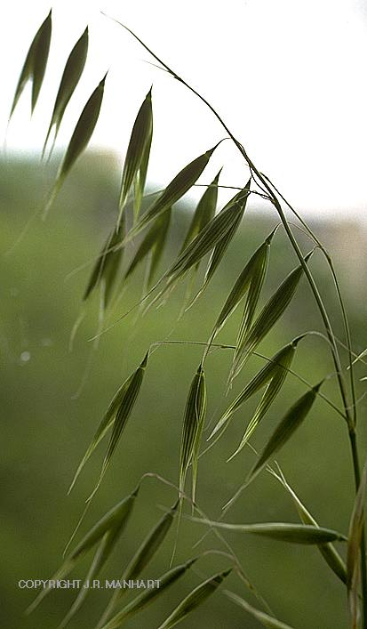
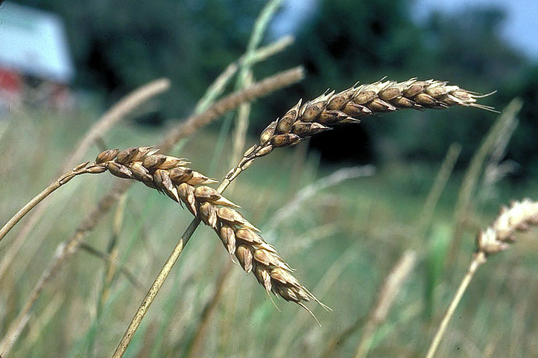
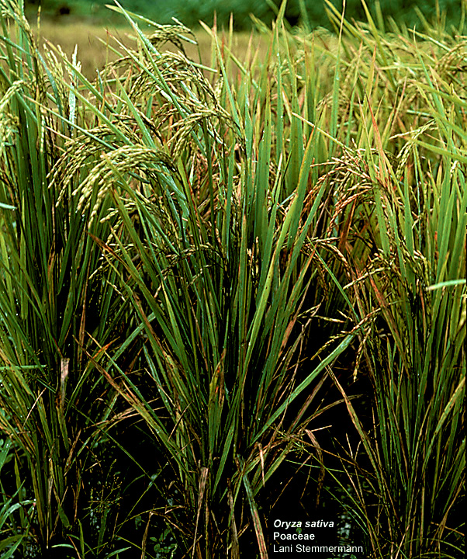
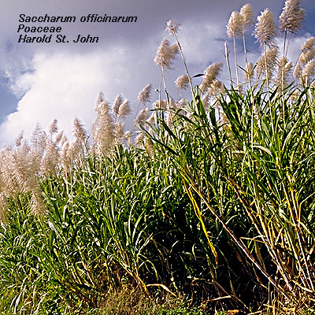
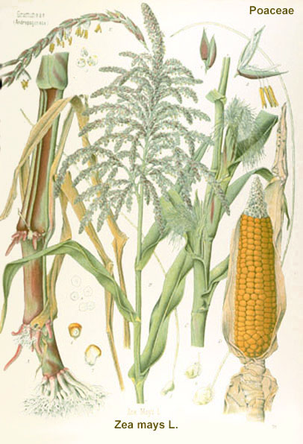
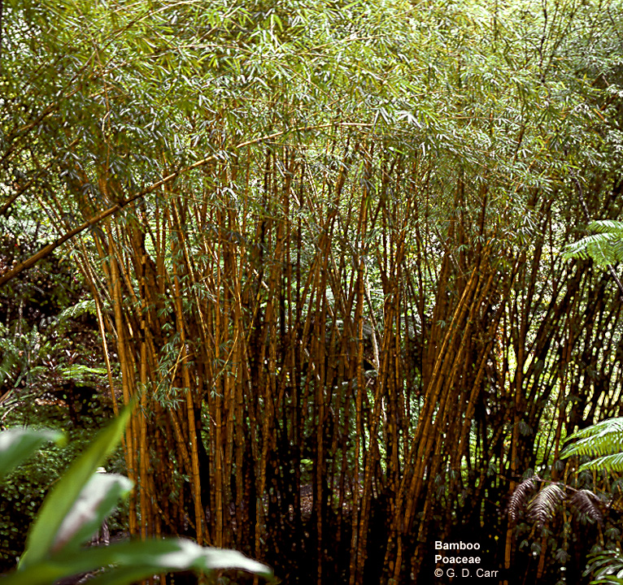
oats
rice
wheat
The grass family is the most economically important family of flowering plants ...
maize
sugar cane
bamboo

Slide 6
 | Crop Species | Million metric tons
1 | Wheat | 468
2 | Maize | 429
3 | Rice | 330
4 | Barley | 160
5 | Soybean | 88
6 | Cane Sugar | 67
7 | Potato | 60
8 | Sorghum | 54
9 | Oats | 43
10 | Cassava | 41
11 | Sweet Potato | 35
12 | Beet Sugar | 34
13 | Rye | 29
14 | Millet | 26
15 | Rape (Canola) Seed | 19
The World’s Top
15 Food Crops

Slide 7
 | Crop Species | Million metric tons
1 | Wheat | 468
2 | Maize | 429
3 | Rice | 330
4 | Barley | 160
5 | Soybean | 88
6 | Cane Sugar | 67
7 | Potato | 60
8 | Sorghum | 54
9 | Oats | 43
10 | Cassava | 41
11 | Sweet Potato | 35
12 | Beet Sugar | 34
13 | Rye | 29
14 | Millet | 26
15 | Rape (Canola) Seed | 19
The World’s Top
15 Food Crops
(Members of the grass family in red)

Slide 8
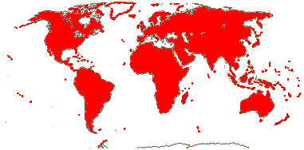
It is also the fourth largest flowering plant family,
including 600 genera /10, 000 species worldwide

Slide 9
Ceres - the
Roman
goddess of agriculture

Slide 10
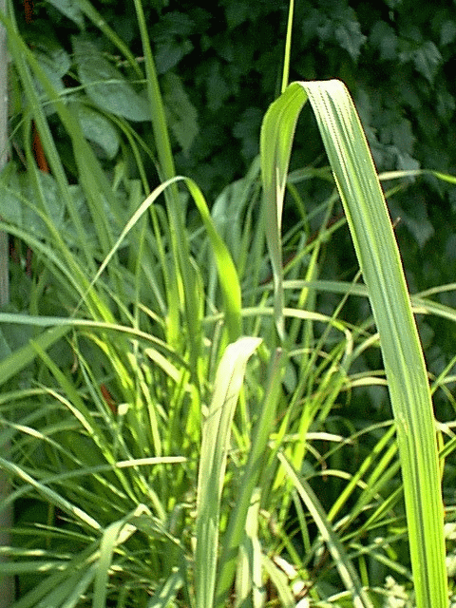
Vegetative features:
Long linear leaves with parallel venation
Upright stems (culms)
Creeping rhizomes
Swollen nodes
Hollow internodes

Slide 11
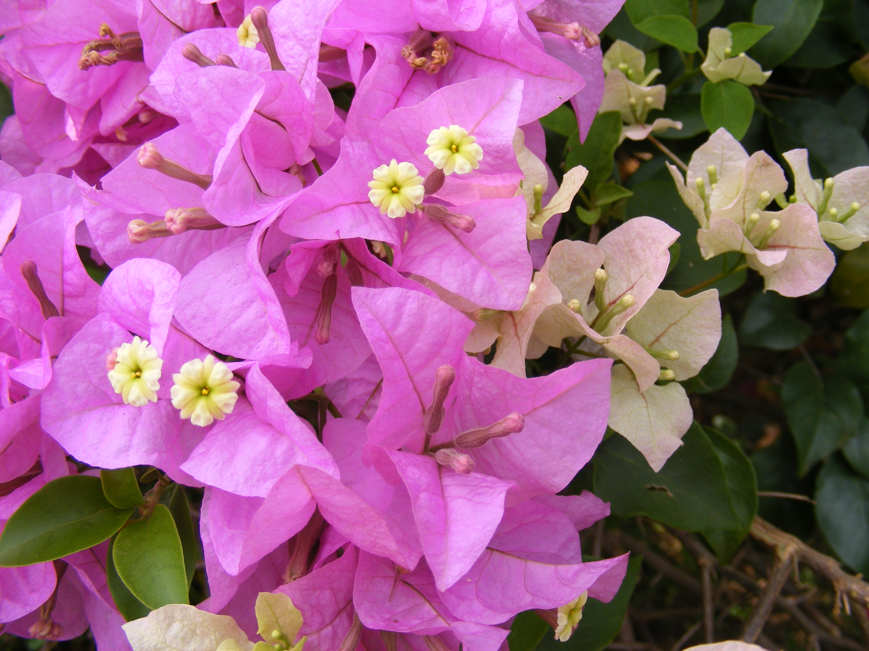
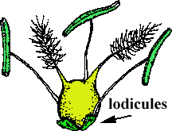
Reproductive features:
stigmas
No sepals or petals
Three stamens
One ovary with two styles and feathery stigmas
stamens
Grass flower (floret)

Slide 12
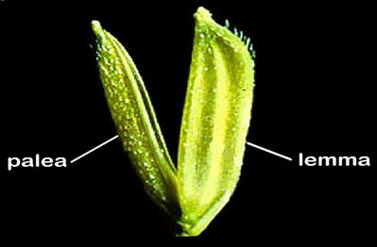
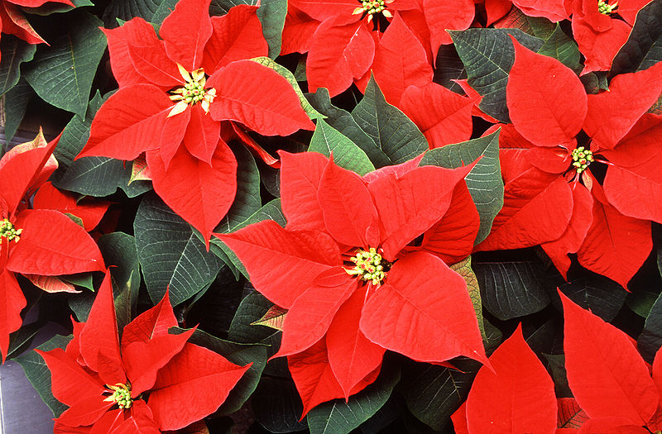
Reproductive features:
Perianth, if present, of lodicules
Androecium of usually 3 stamens
Ovary superior, of 3 fused carpels
Fruit a caryopsis
Florets are enclosed by two bracts, the lemma and the palea
Bract: a modified leaf associated
with a flower
bract

Slide 13
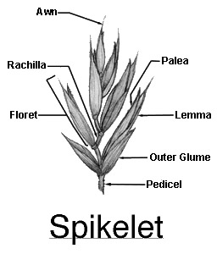
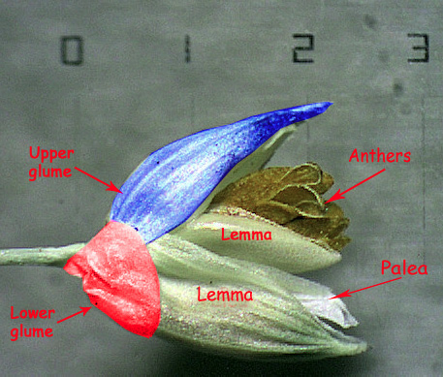
Florets are grouped in spikelets. These are sub-tended by a pair of glumes. Glumes are bracts, too.
Glumes
one spikelet; two florets

Slide 14
Concept Test
Given what you learned about the structure of flowers and how they are pollinated, how do you think the small, non-showy flowers of the grass family get pollinated? Grass flowers are pollinated by:
A. Bats
B. Hummingbirds
C. Wind
Sweat bees
Butterflies

Slide 15
Concept Test
Given what you learned about the structure of flowers and how they are pollinated, how do you think the small, non-showy flowers of the grass family get pollinated? Grass flowers are pollinated by:
A. Bats
B. Hummingbirds
C. Wind
Sweat bees
Butterflies

Slide 16
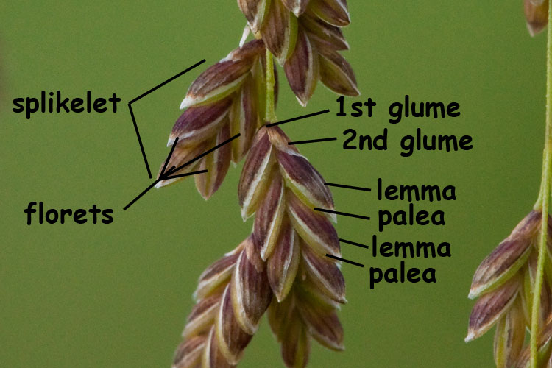
In the grass family, the lemma, the palea, and the glumes (all bracts) are together called the chaff.

Slide 17
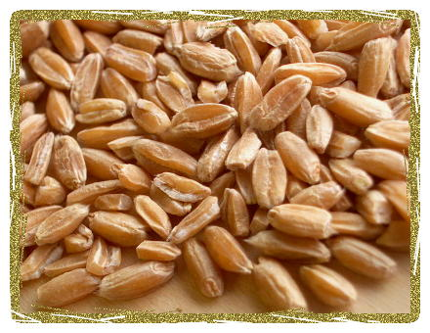
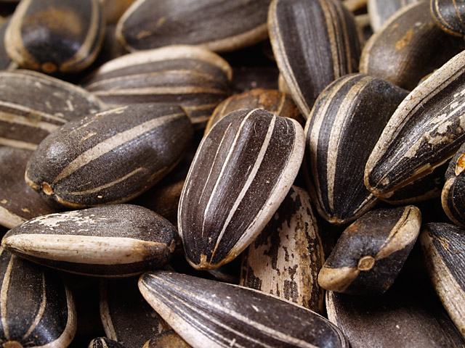
The fruit is a caryopsis, or grain.
So what’s that?
grain
achene
It’s a dry, indehiscent fruit like an achene, except that the fruit wall is fused to the seed.
Notes:
lev70065_12_03.jpg

Slide 18
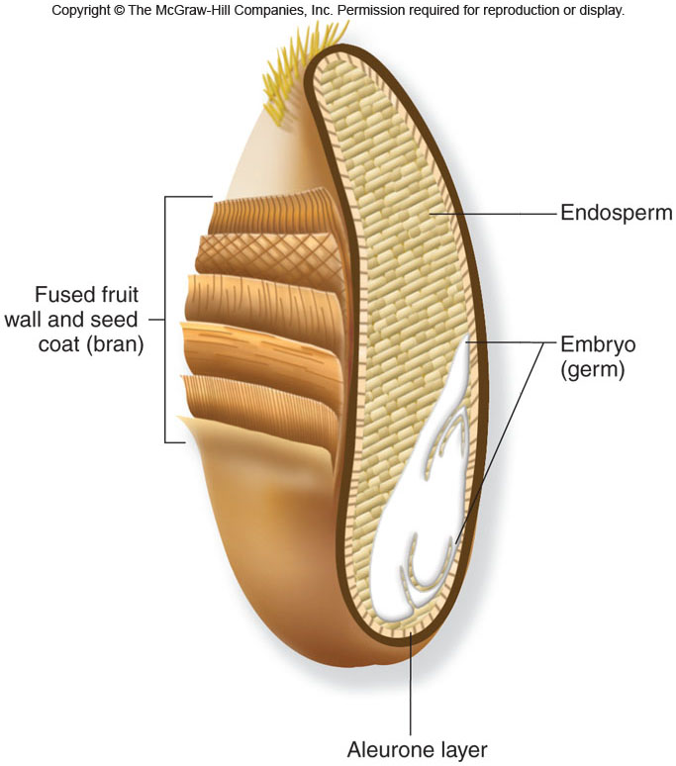
Parts of the Grain
The endosperm is full of starch, which is what makes grain such an excellent food source.
Notes:
The grain normally dries until it is only 5-15% water
The bran consists of the outer layers of the fruit wall and seed coat

Slide 19
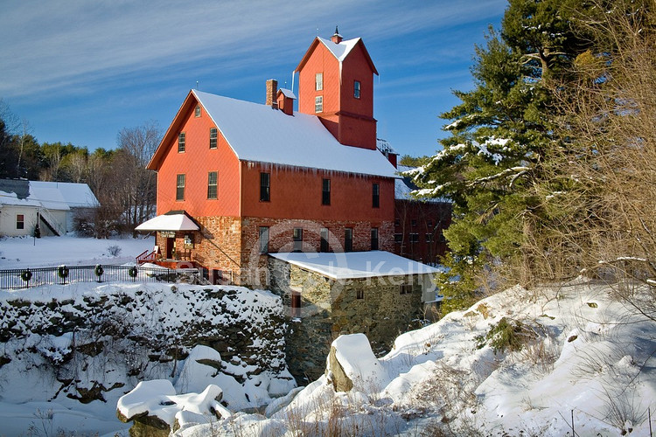
Milling is the process by which the parts of the grain are separated.
In whole grain flours, only the chaff is removed. In white flours,
the bran and the germ are removed.
Notes:
Chaff = lemma, palea, glumes

Slide 20
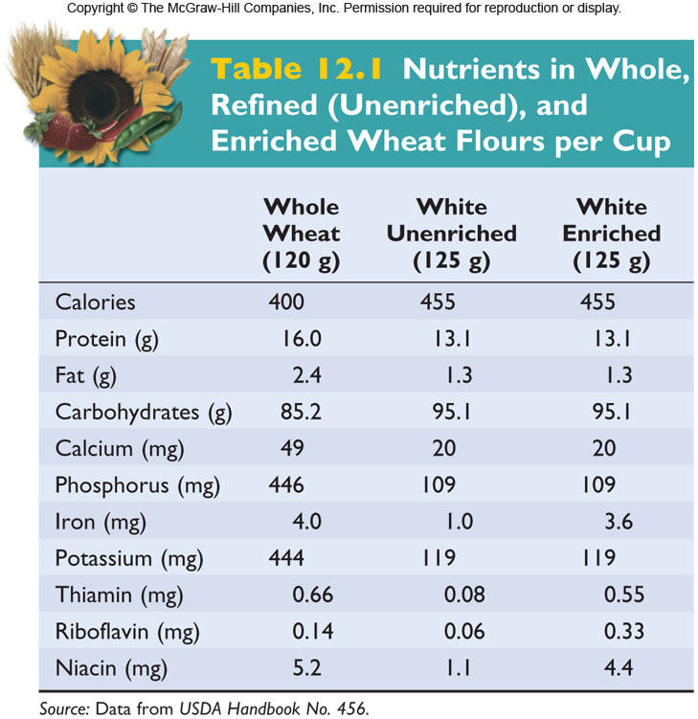
Nutrients in Whole Wheat and
White Flours, per Cup

Slide 21
Concept Test
A company created a new brand of blended wheat flour for the marketplace. Called “Golden Organic Harvest,” it consisted of vitamin-enriched white flour plus wheat germ. The new blend was not popular with consumers. What is the most likely reason?
the presence of wheat germ caused the flour to go rancid after a very short period of storage
B. wheat germ prevented bread dough from rising
C. wheat germ had too much fiber, making tough bread
D. wheat germ contains enzymes that degrade starch

Slide 22
Concept Test
A company created a new brand of blended wheat flour for the marketplace. Called “Golden Organic Harvest,” it consisted of vitamin-enriched white flour plus wheat germ. The new blend was not popular with consumers. What is the most likely reason?
the presence of wheat germ caused the flour to go rancid after a very short period of storage
B. wheat germ prevented bread dough from rising
C. wheat germ had too much fiber, making tough bread
D. wheat germ contains enzymes that degrade starch

Slide 23
Wheat
Triticum spp.

Slide 24
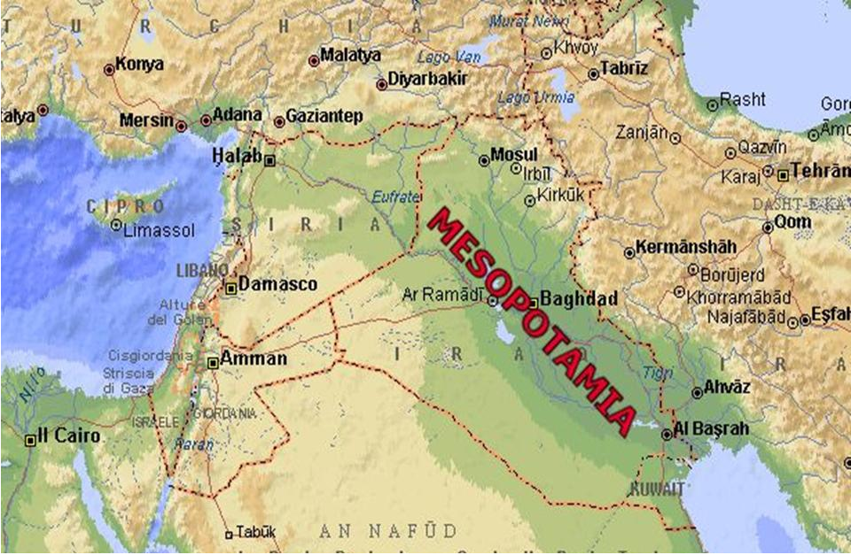
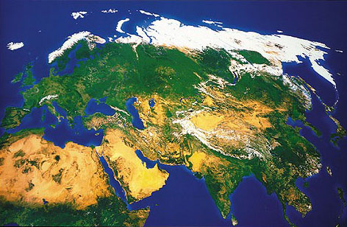
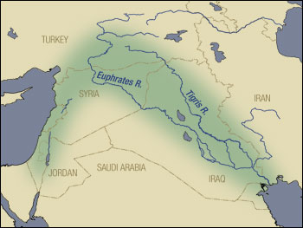
Wheat originated in the Fertile Crescent, at least 9,000 years ago

Slide 25
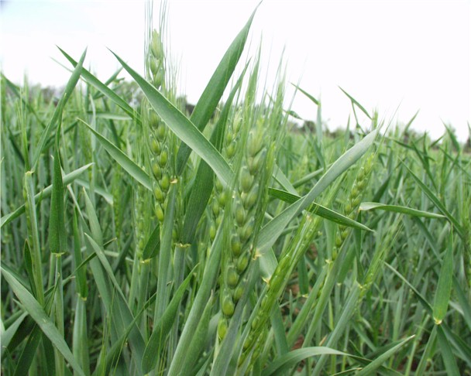
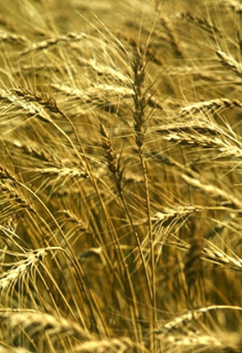
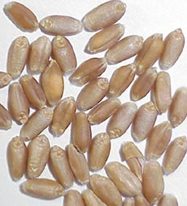
Wheat – three species of Triticum

Slide 26
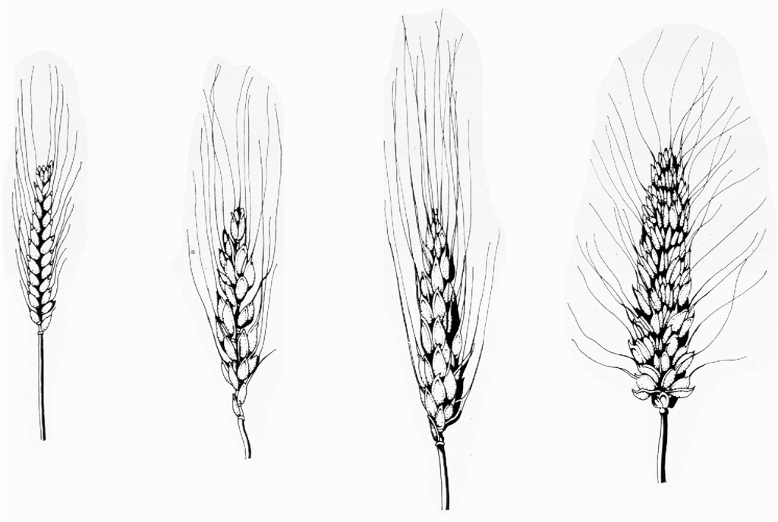
Triticum spp.
Wheat – three species of Triticum
AA
AABB
AABBDD
Einkorn
Durum
Emmer
Bread
Triticum monococcum
T. turgidum
T. aestivum
(one species; two varieties)
Notes:
Durum wheats are used for pasta.
Ended here on Thursday.

Slide 27
Evolution of Domesticated Wheat
Goat grass

Slide 28
Triticum spp.
AA
AABB
AABBDD
Einkorn
Durum
Emmer
Bread
Triticum monococcum
T. turgidum
T. aestivum
Notes:
Durum wheats are used for pasta.

Slide 29
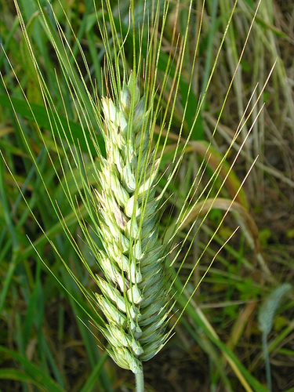
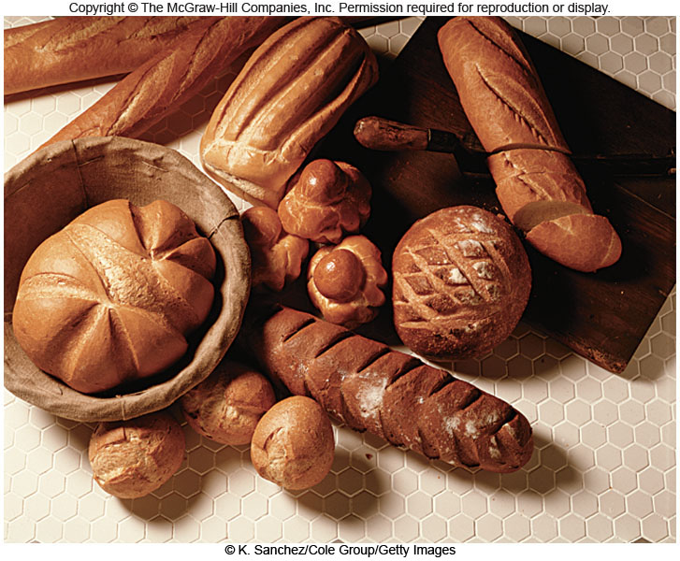
Bread wheat (Triticum aestivum) is higher in protein than its diploid and tetraploid ancestors. The protein gluten is what makes bread dough elastic, allowing it to rise.
6X
Notes:
Bread wheat flour is the only flour that can make a dough that rises.

Slide 30
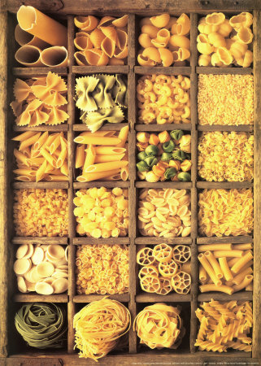
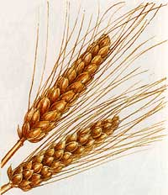
4X
Durum wheat (Triticum turgidum) is used to
make pasta.

Slide 31
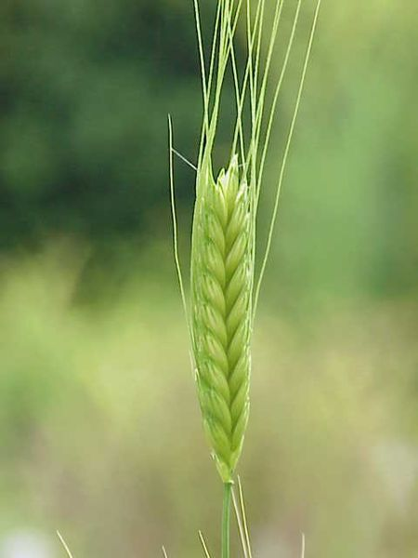
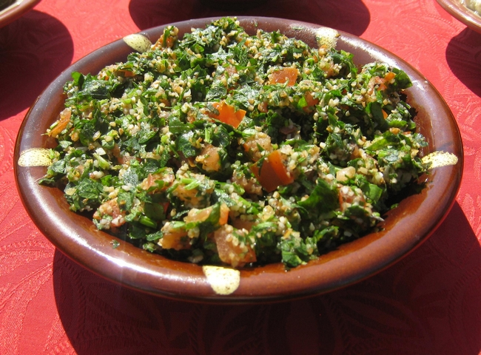
2X
Einkorn wheat (Triticum monococcum) is used mostly for bulghar,
the main ingredient in tabouleh.

Slide 32
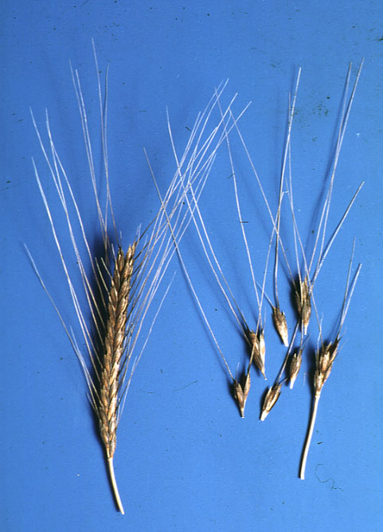
Characteristics of domestication: Artificial selection for non-shattering heads
Wild einkorn wheat had shattering
heads, while cultivated einkorn had
non-shattering heads
.

Slide 33
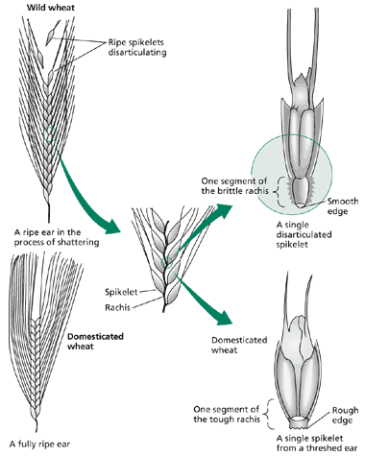
Shattering to non-shattering - one gene

Slide 34
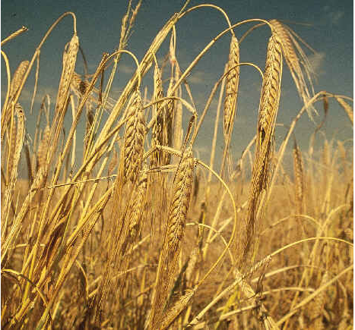
Characteristics of domestication: Artificial selection for easier processing
Durum and bread wheats lack clinging chaff, a trait referred to as free threshing.

Slide 35
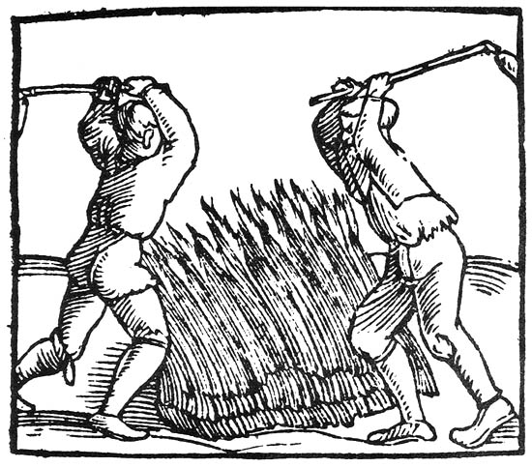
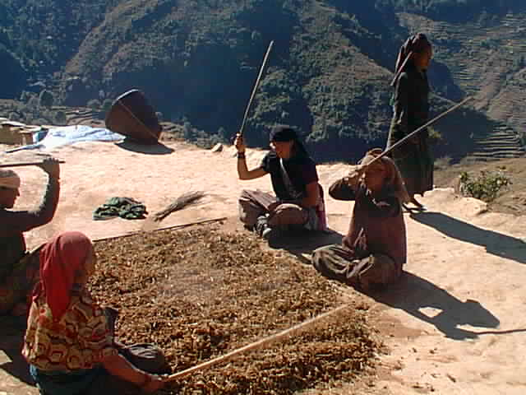
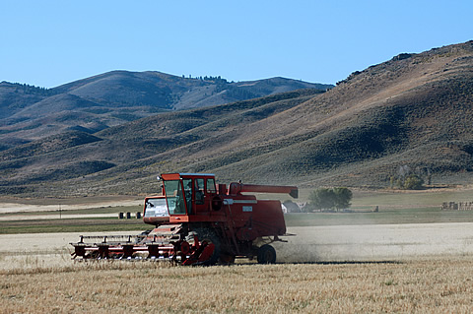
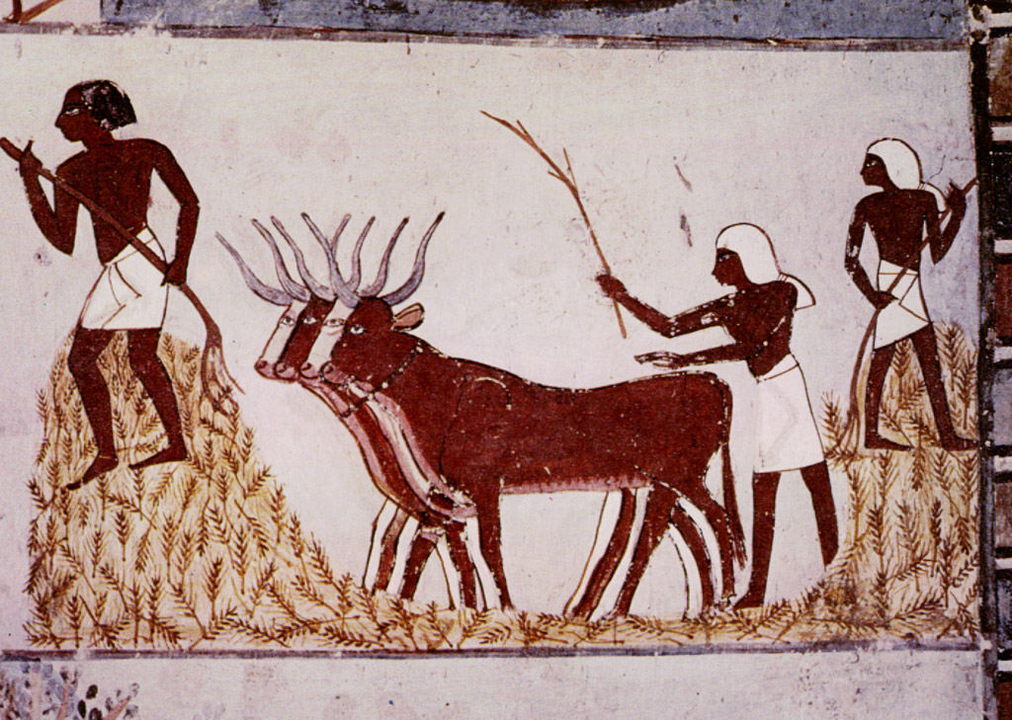
Threshing: loosening the chaff from the grains

Slide 36
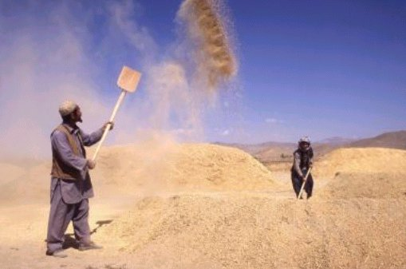
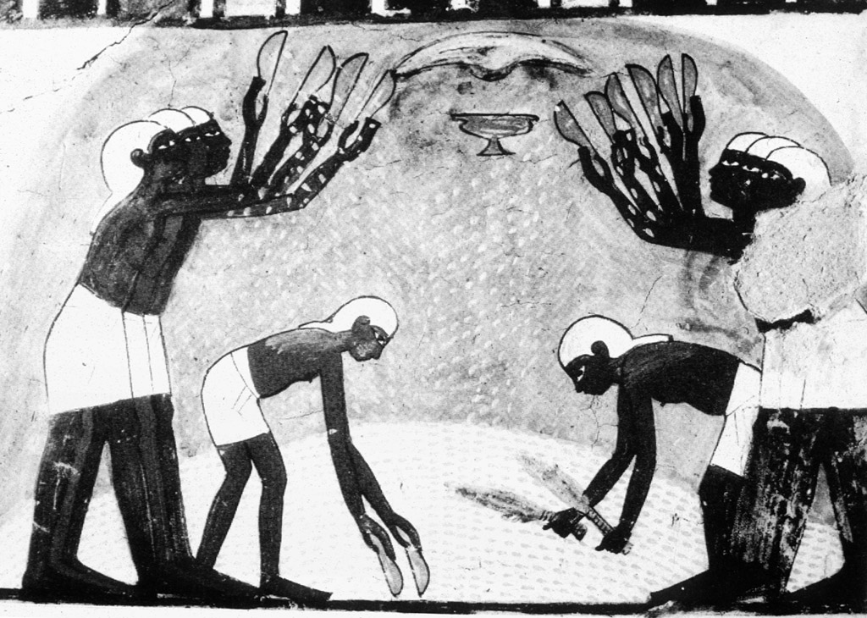
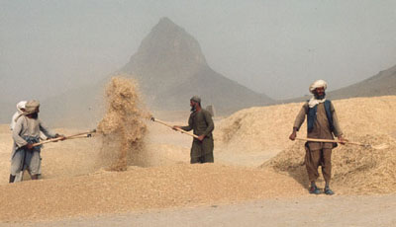
Winnowing: separating the loose chaff from the grains

Slide 37
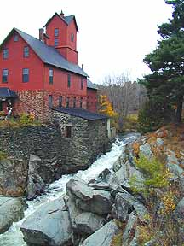
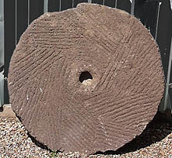
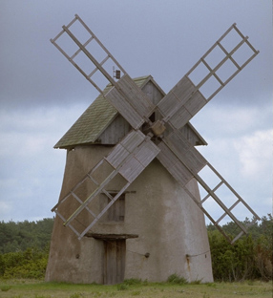
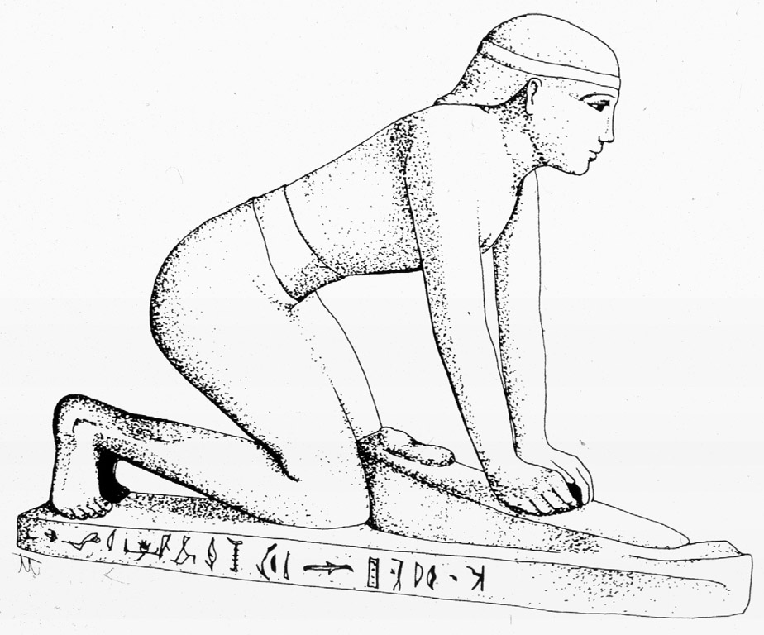
Milling: grinding grain into flour or meal

Slide 38
World wheat-
producing centers

Slide 39
Rice
Oryza sativa

Slide 40
Cultural Significance of Rice
Rice feeds more people than any other grain, especially in Asia.
It provides more than 1/5 of all human calories consumed.
Rice is the only important cereal grain grown entirely for human food, not animal feed.
Notes:
Importance: Rice feeds more people than any other grain; especially in Asia. Provides more than 1/5 of all human calories consumed. Rice is the only important cereal grain grown entirely for human food, not animal feed.

Slide 41
Rice - the first domesticated grass
Oryza sativa
Evidence of cultivation at least 7,000
or maybe as long as 11,000 years ago
Notes:
Origin and evolution Rice began as a marsh grass in southeast Asia; evidence of cultivation at least 7000 years ago; maybe as long as 11,000 years ago

Slide 42
The majority of cultivated rice is paddy rice, transplanted to flooded fields. This simple method reduces the growth of lesser robust weed and pest plants.
Notes:
Majority of cultivated rices are paddy rice, transplanted to flooded fields.

Slide 43
root cross-section,
rice plant
Root cross section
Air chambers in the stem and roots allow aeration of
the submerged parts.
Notes:
Extensive air chambers in stem and roots allow aeration of submerged parts.

Slide 44
Rice cultivation is well-suited to countries and regions with
low labor costs and high rainfall, as it is labor intensive to cultivate
and requires plenty of water.

Slide 45
It is also well-suited to Vermont!
Ben Falk, Whole Systems Design Research Farm

Slide 46
The heavy clay soils of the Champlain Valley are ideal for rice paddies.
Josh Brill, Breezy Meadows Orchard

Slide 47
Currently, there is very little local rice for sale, but the demand is there. Ben Falk, of Whole Systems Design Research Farm, calculates that it would only take 0.04% of land in Vermont to produce the average 15 lbs of rice per person consumed annually!
- Dr. Laura Hill-Bermingham
Erik Andrus, Boundbrook Farm

Slide 48
Currently, there is very little local rice for sale, but the demand is there. Ben Falk, of Whole Systems Design Research Farm, calculates that it would only take 0.04% of land in Vermont to produce the average 15 lbs of rice per person consumed annually!
- Dr. Laura Hill-Bermingham
Erik Andrus, Boundbrook Farm

Slide 49
Azolla, an aquatic fern cultivated in rice paddies,
grows symbiotically with a nitrogen-fixing bacterium.
Notes:
Water fern (Azolla spp.) grows in paddies with rice. Fern has pockets in leaves, filled with cyanobacterium Anabaena which fixes nitrogen from the air, makes it available to fern. When fern dies and decays, nitrogen is available to rice; natural fertilizer.

Slide 50
Rice grain with chaff present
Rice grain with chaff removed

Slide 51
Brown Rice: the grain with the chaff removed
Notes:
The grains are first hulled to remove the chaff (lemmas, paleas, and glumes: the bracts surrounding the grain). At this point the product is called brown rice.

Slide 52
White rice, polished with talc powder
to remove the bran
Notes:
White rice is often polished by buffing it with talc powder.

Slide 53
A diet of polished rice can
lead to beriberi, a thiamine
(vitamin B₁) deficiency
disease.
Notes:
Diet based on polished rice may result in beriberi = thiamine (vitamin B1) deficiency. Thiamine occurs naturally in unrefined cereals and fresh foods, particularly whole grain bread, fresh meat, legumes, green vegetables, fruit, and milk.

Slide 54
Though nutritious, rice does not provide all of the essential amino acids and
thus should be combined with other protein sources, such as meat or beans.
Notes:
Though nutritious, rice does not provide all of the essential amino acids and thus should be combined with other protein sources, such as meat or beans

Slide 55
Zizania aquatica
Wild rice

Slide 56
Chippewa women harvesting wild rice by beating the plants with paddles,
knocking the ripe grains into the canoe.
Notes:
Wild rice was harvested by native Americans, such as these Chippewa gatherers, who harvested it by beating the plants with paddles, knocking the ripe grains into their canoes.

Slide 57
Maize
Zea mays
We call it “corn” in the U.S.

Slide 58
Maize is monoecious (unisexual flowers, males and females on the same plant).
staminate (male) flowers:
together make up the tassel
pistillate (female) flowers:
together make up the ear

Slide 59
Staminate flower
Fruit (grain)
Pistillate flower
Notes:
lev70065_12_06.jpg

Slide 60
In domesticated maize, the
pistillate spike (the “ear”) is
surrounded by bracts we
call husks.

Slide 62
The wild ancestor of Zea mays is understood to be a Mexican
grass species called teosinte, which means “mother of corn.”
Notes:
a ear has 6-10 triangular kernels, each surrounded by hard case called cupule.
b Several small ears, several tassels at ends of main and side branches.
c Spike shatters easily, scatters seed.

Slide 63
4 cm
The ears of teosinte are quite
small compared to those of
modern cultivated corn

Slide 64
Mayan corn god sowing seed
from a wall painting dated 500 A.D.
Jared Diamond in his book Guns, Germs and Steel, argues that the great civilizations of Mesoamerica, the Mayan and the Aztec, flourished because of these people’s relationship with corn.
Notes:
Jared Diamond in his book "Guns, Germs and Steel" argues that the great civilizations of Mesoamerica, the Mayan and the Aztec, flourished because of these people’s relationship with corn. Thousands of years of mutation and artificial selection catalyzed the evolution of teosinte from a wild grass into modern corn.

Slide 65
Varieties of maize
popcorn
sweet corn
flour corn
flint corn
dent corn
pod corn
Notes:
Ended Here Before Break! Popcorn is the oldest. Has hard seed coat, high-moisture cells internally. Heating produces steam, explodes, turns endosperm inside out. Widely used by Indians because it didn't have to be ground.
Sweet corn: endosperm contains sugar instead of starch, harvested and eaten immature.
Flour corn, soft endosperm, easy to grind, but attacked by insects.
Flint corn was the predominant corn grown by Native Americans.
Dent corn, has soft starch in center, hard on outside; soft starch shrinks more on drying, leaves dent in kernel. All modern field corns are dent corns. Major uses are for animal feed, corn meal, cornstarch, high fructose corn syrup, ethanol.

Slide 66
Notes:
lev70065_12_10.jpg

Slide 67
There is a correlation between the rise of obesity in the U.S. and the use
of high fructose corn syrup for sweetening beverages and foods.

Slide 68
Lecture Review, Chapter 12
Characterize the grass family with respect to diversity, ecology, and geographic distribution.
Explain why the grass family is the most economically important family of flowering plants.
Diagram a grass floret, including the subtending lemma and palea. Diagram a grass spikelet, including the subtending glumes.
Diagram a grain, giving the botanical and the common English term for each part.
Where were wheat, rice, and maize first domesticated, and about how long ago?
Explain the evolution of hexaploid bread wheat.
What are the three species of wheat and what is each used for?
Explain how wheat is processed, from field to flour bin.
Why is rice commonly grown in flooded fields (paddies) and what structural adaptation permits grass plants to grow in such conditions?
Why are whole grains more nutritious than their processed counterparts?

Slide 69
Shown in Class on Thursday, 2/27: Quiz 5 will be open from right after today’s lecture until midnight on Sunday, March 9

