Slide 1
Enriching PBIS Implementation by Integrating Social Emotional Learning
Rebecca Lallier, M.Ed.
Amy Wheeler-Sutton, M.Ed.

Slide 2
Learning Objectives
Participants will:
Understand the reasons for integration
Explore how to go beyond simply teaching behavioral expectations
Learn how to help students develop the skills they need to be able to successfully meet those expectations
Identify their school’s primary SEL needs, desired outcomes, and realistic action steps.

Slide 3
What is Social Emotional Learning (SEL)?
“The process through which children and adults acquire and effectively apply the knowledge, attitudes, and skills necessary to:
understand and manage emotions
set and achieve positive goals
feel and show empathy for others
establish and maintain positive relationships,
and make responsible decisions.”
http://www.casel.org

Slide 4
Why SEL?
How we feel and interact with others affects how we learn and use what we learn
Emotions help us develop active interest in learning and sustain engagement
Unmanaged stress/dysregulation interfere with attention and memory and contribute to behaviors that interrupt learning
Learning is a social and interactive process - requires collaboration with teachers and peers

Slide 5
Research Behind SEL Programming Indicates:
Significantly improves academic performance on standardized tests
Significantly better school attendance records
Less disruptive classroom behavior
Students like school more
Students less likely to be suspended or otherwise disciplined
http://www.casel.org

Slide 6
Why Integrate SEL with PBIS?
Both widely-adopted, evidence-based universal prevention approaches that address student mental health
Stem from different theoretical camps -- often implemented separately but are complementary
Research supports integration:
When compared to all other conditions (BAU (business as usual); PBIS only; SEL only), the combo condition (PBIS & SEL) produced significantly greater:
improvements in overall mental health
reductions in externalizing behaviors
Cook, C. R., Frye, M., Slemrod, T., Lyon, A. R., Renshaw, T. L., & Zhang, Y. (2015). An integrated approach to universal prevention: Independent and combined effects of PBIS and SEL on youths’ mental health. School Psychology Quarterly,30(2), 166-183. doi:10.1037/spq0000102

Slide 7
Why Might Integration Lead to Better Results?
Each approach has strengths and weaknesses:
SEL:
Strengths:
Effective approach to universal prevention
Significantly reduce internalizing behaviors (Merrell, Juskelis, Tran, & Buchanan, 2008)
Weaknesses:
Limited emphasis on teaching practices that promote orderly and productive learning environments where students can acquire and then generalize skills (Gresham, 1995; Osher et al., 2010)
PBIS:
Strengths:
Teaching, modeling, cueing, reinforcing behaviors
Developing progressive system of systematically responding to problem behavior (Sugai & Horner, 2009)
Reduction of externalizing behaviors and promotion of more safe and orderly learning environments (Horner et al., 2009)
Weaknesses:
Limited research examining effects of PBIS to address internalizing behaviors (McIntosh, Ty, & Miller, 2014)
Cook, C. R., Frye, M., Slemrod, T., Lyon, A. R., Renshaw, T. L., & Zhang, Y. (2015). An integrated approach to universal prevention: Independent and combined effects of PBIS and SEL on youths’ mental health. School Psychology Quarterly,30(2), 166-183. doi:10.1037/spq0000102
Notes:
Draw on strengths from both

Slide 8
Commonalities between SEL and PBIS
Universal supports that focus on:
prevention of problems that interfere with academic success
promotion of positive skills and environments
Emphasize value of positive approaches rather than punitive
Put high value on importance of teaching practices in order for students to learn skills that will enable them to be socially and academically successful
Help schools establish more supportive and nurturing environment that empowers students to develop competencies that prevent mental health problems and promote wellbeing and academic success (Biglan, Flay, Embry, & Sandler, 2012)
Cook, C. R., Frye, M., Slemrod, T., Lyon, A. R., Renshaw, T. L., & Zhang, Y. (2015). An integrated approach to universal prevention: Independent and combined effects of PBIS and SEL on youths’ mental health. School Psychology Quarterly,30(2), 166-183. doi:10.1037/spq0000102

Slide 9
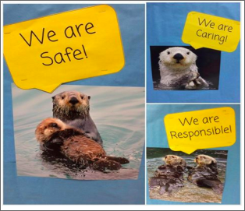
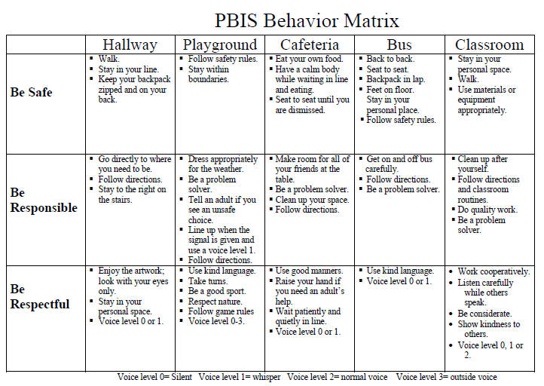
The Basics
Teaching (and re-teaching) clear, well-defined behavioral expectations

Slide 10
Going Beyond Simply Teaching Behavioral Expectations
What attitudes, knowledge, and skills do you want your students to have?
What attitudes, knowledge, and skills do they need to have in order to be successful in elementary, secondary, postsecondary, and career/life?

Slide 11
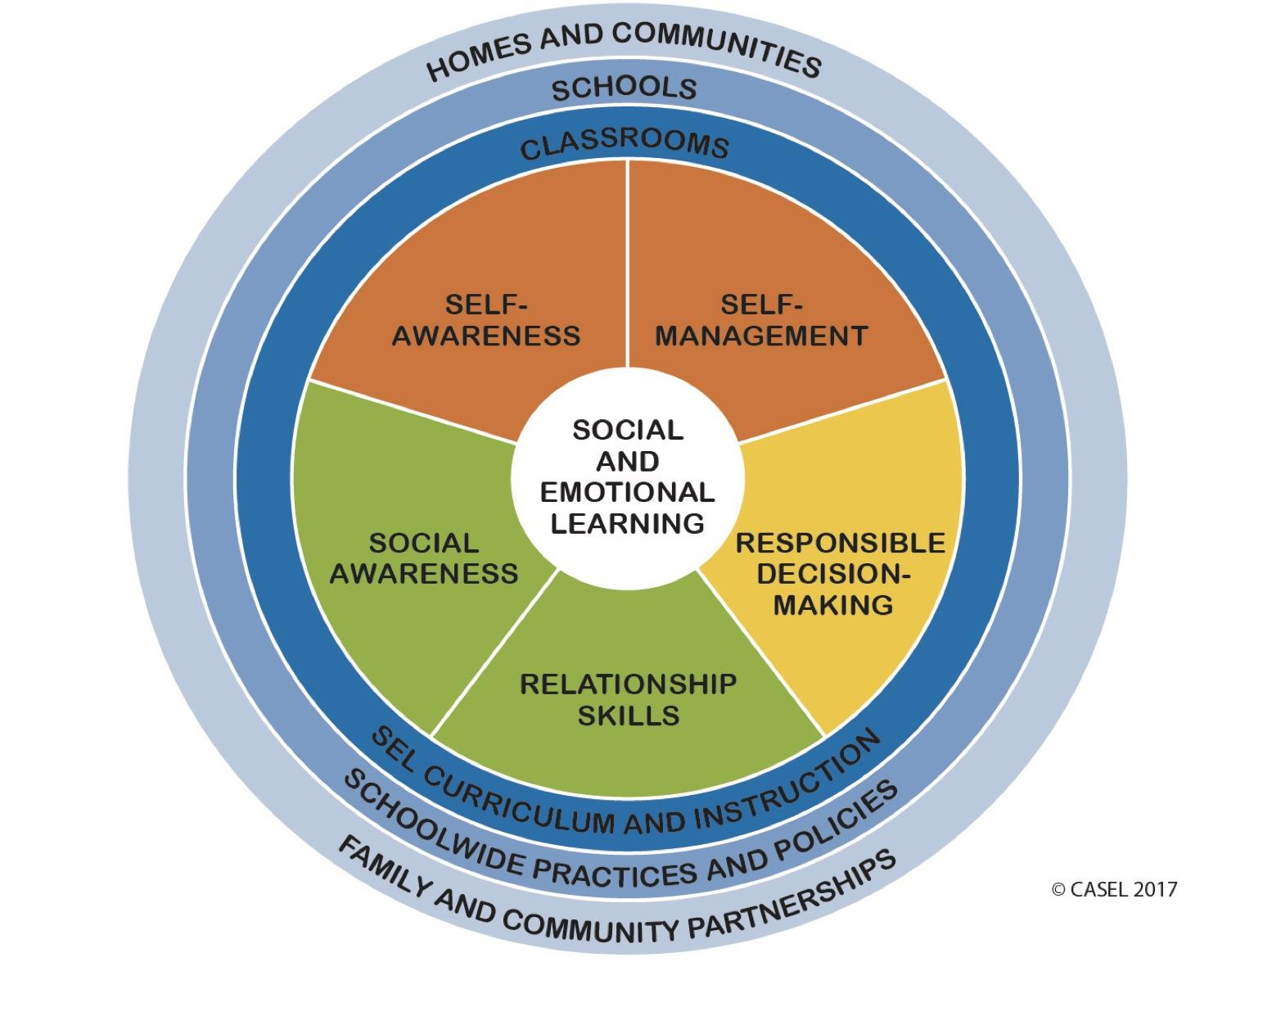
Social and Emotional Learning Competencies and Contexts
http://www.casel.org

Slide 12
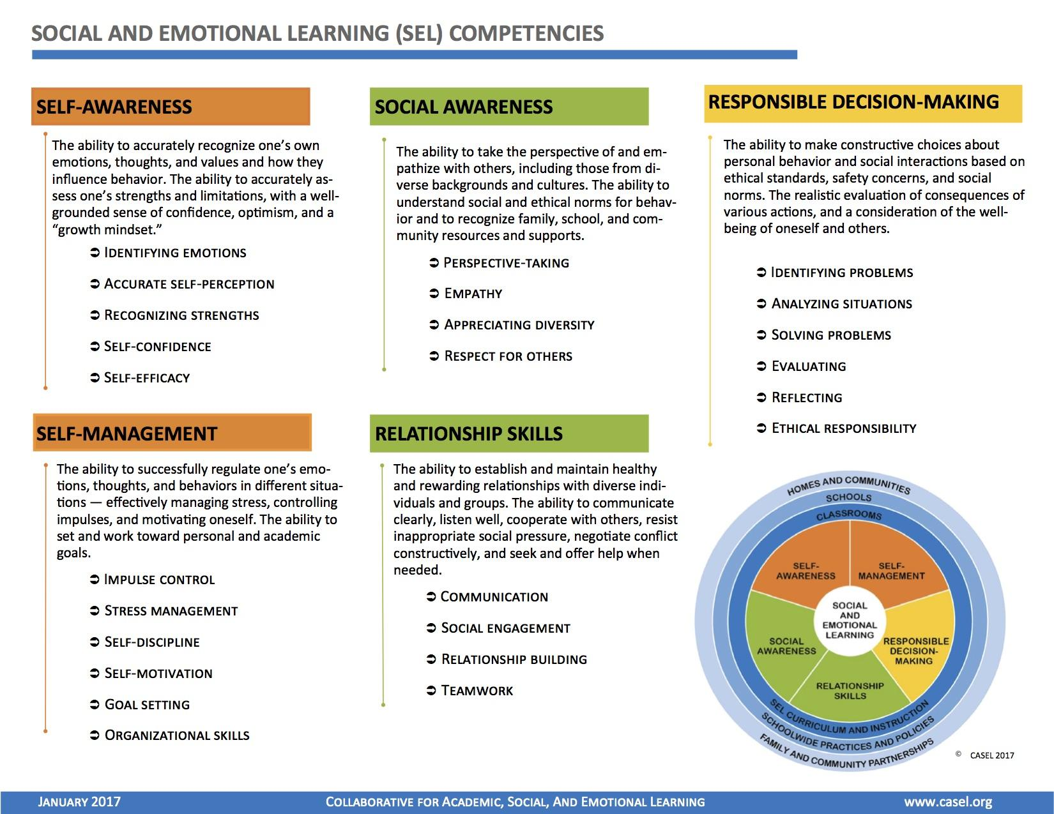
Notes:
Video: https://www.youtube.com/watch?v=DqNn9qWoO1M

Slide 13
Mindset Change
“What are the lagging skills?”
“That drives me crazy!”
Buy-in opportunity!
Notes:
Pop up activity. Put SEL competencies back up on the screen.

Slide 14
Notes:
How do the behaviors that drive us crazy fit into the lagging skills in these social and emotional learning competency areas?

Slide 15
Types of Social Skills Deficits
Acquisition Deficits
Absence of knowledge for executing skill or failure to discriminate which social behaviors are appropriate in specific situations
Performance Deficits
Skill is present in repertoire, but student fails to perform at acceptable levels
Fluency Deficits
Lack of exposure to sufficient or skilled models of social behavior, insufficient rehearsal/practice, or low rates/inconsistent delivery of reinforcement of skilled performances
Notes:
Amy

Slide 16
SEL Instructional Practices and Programming

Slide 17
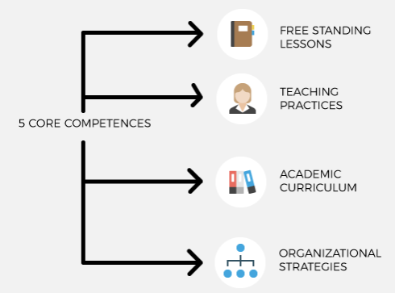
Self-
Awareness
Self-
Management
Social
Awareness
Relationship Skills
Responsible Decision-Making
http://www5.esc13.net/thescoop/behavior/2017/06/08/just-what-is-social-emotional-learning/

Slide 18
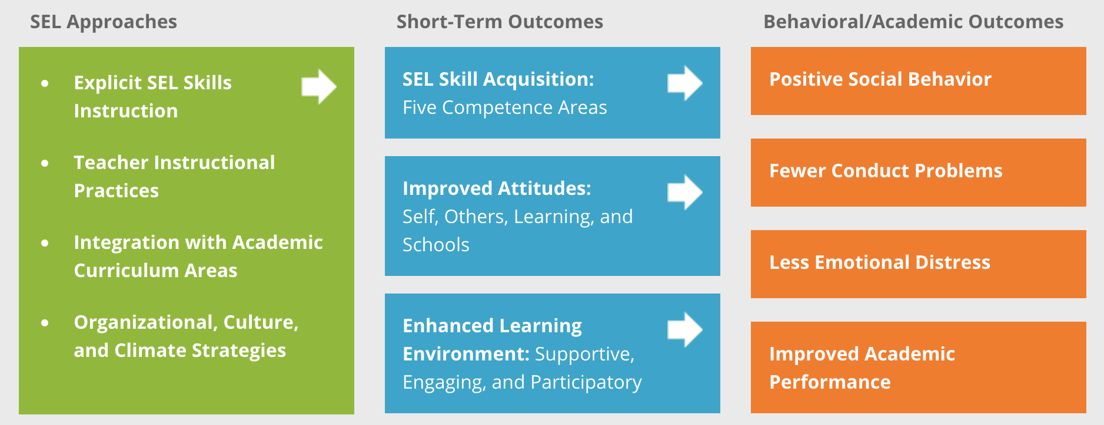
http://www.casel.org/what-is-sel/approaches/

Slide 19
Components of Schoolwide SEL Programming
Instruction in and opportunities to practice and apply integrated set of cognitive, affective, and behavioral skills
Learning environments characterized by trust and respectful relationships
Coordinated, systematic, and sequential programming from Pre-K-12th grade
Developmentally- and culturally-appropriate behavioral supports
Ongoing monitoring and evaluation for continuous improvement
http://www.casel.org
Notes:
Coordinated implementation that reinforces classroom, schoolwide, out-of-school, and at-home learning activities

Slide 20
Preferred Teaching Practices
Generalize
Monitor Progress
(apply in multiple settings)
(feedback)
Practice
(behavioral rehearsal)
Do
(role play)
Show
(modeling)
Tell
(coaching)
Notes:
Amy

Slide 21
Social Teaching Practices that Promote SEL
Student-centered discipline and proactive classroom management
Use observation and data to assess lagging social skills of your students
Ask your PBIS team for your class’ data
Teacher language:
Specific positive praise/feedback
Cueing to use strategies from social skills lessons (pre-corrections)
Use common language
Model use of skills (i.e. “I’m feeling in the yellow zone. I need to take a few deep breaths.”)
Student choice (norms and academic content)
Student responsibility (peer helping, community service, etc.)
Warmth and support from teacher and peers

Slide 22
Instructional Teaching Practices that Promote SEL
Cooperative learning
Classroom discussions around content
Self-reflection and self-assessment
Balanced instruction:
Active and direct instruction
Individual learning
Collaborative learning
Meaningful and challenging work and high expectations
Competence-building: modeling, practicing, feedback, coaching

Slide 23
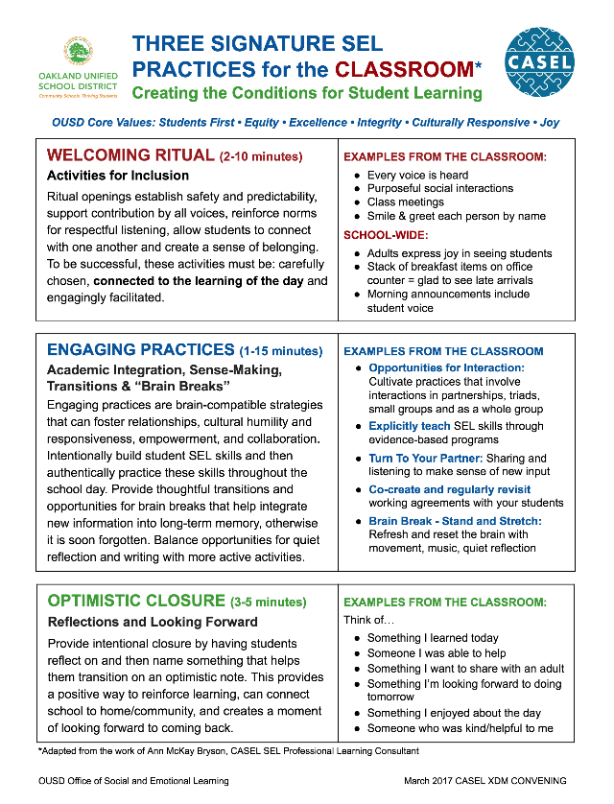
Welcoming Ritual
Activities for inclusion
Engaging Practices
Academic integration
Sense-making
Transitions
Brain breaks
Optimistic Closure
Reflections
Addresses all 5 SEL competencies
Creates collaborative classrooms
Builds upon/aligned to CCSS, Restorative Justice, & trauma-informed practices
https://www.ousd.org/Page/15473

Slide 24
Strategies that Promote SEL
Morning Meeting
Advisory
Project-based learning
Think-Pair-Share
Turn and Talk
Cooperative learning
Student self-assessment
Student-led instruction
Peer tutoring

Slide 25
SEL/Academic Content Area Integration
Incorporate SEL competency-building into academic curriculum:
Which skills will lend themselves most naturally to integration with the content?
Which SEL-related skills have we noticed our students are lacking?

Slide 26
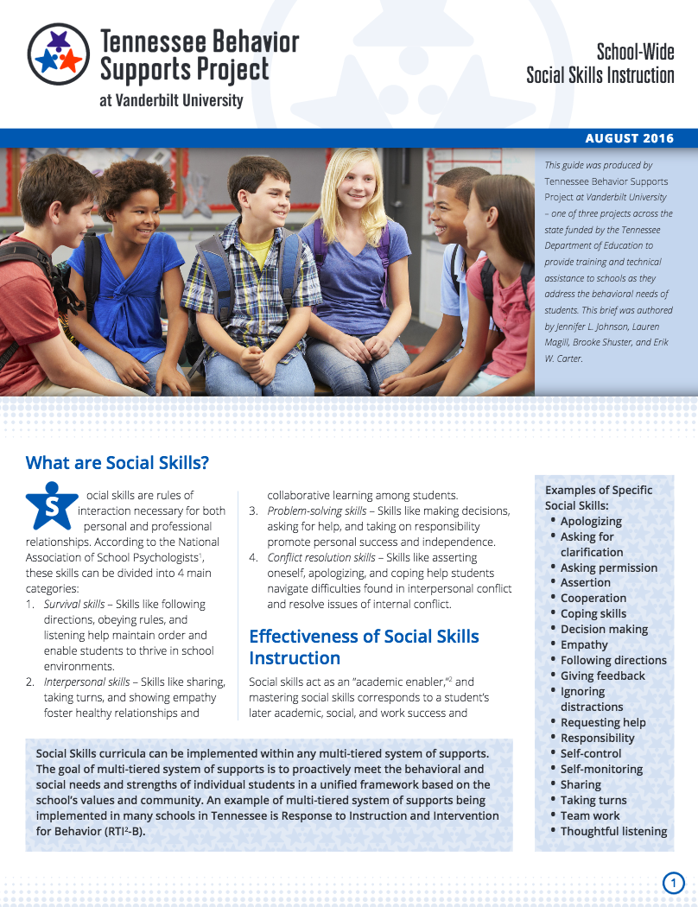
School-Wide Social Skills Curriculum
Identify need
Select curriculum
Prep for implementation
Kickoff
Provide instruction
Acknowledge students
Assess progress
https://vkc.mc.vanderbilt.edu/assets/files/resources/psisocialskills.pdf
Notes:
Amy

Slide 27
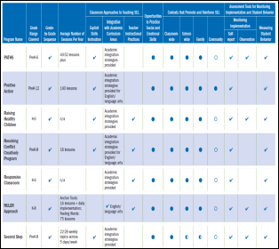
Effective Social and Emotional Learning Programs
CASEL
Ratings of evidence-based SEL programs
Guidelines for selection and implementation
LOTS of resources on SEL!
Programs for Preschool and Elementary (2013)
Programs for Middle & High School (2015)
Edutopia
Edutopia SEL Research Review
http://www.casel.org
Notes:
Second Step
MindUp
RULER Approach
PATHS
Steps to Respect

Slide 28
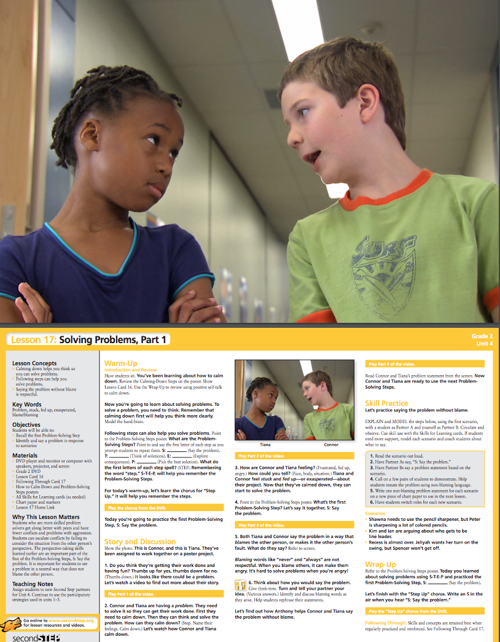
Second Step
Sample Lesson Plan
CASEL SELect Program for Early Learning-Grade 8
SEL stand-alone lessons
Units:
Skills for Learning
Empathy
Emotion Management
Problem-Solving
http://www.cfchildren.org/second-step/elementary/grade-2

Slide 29
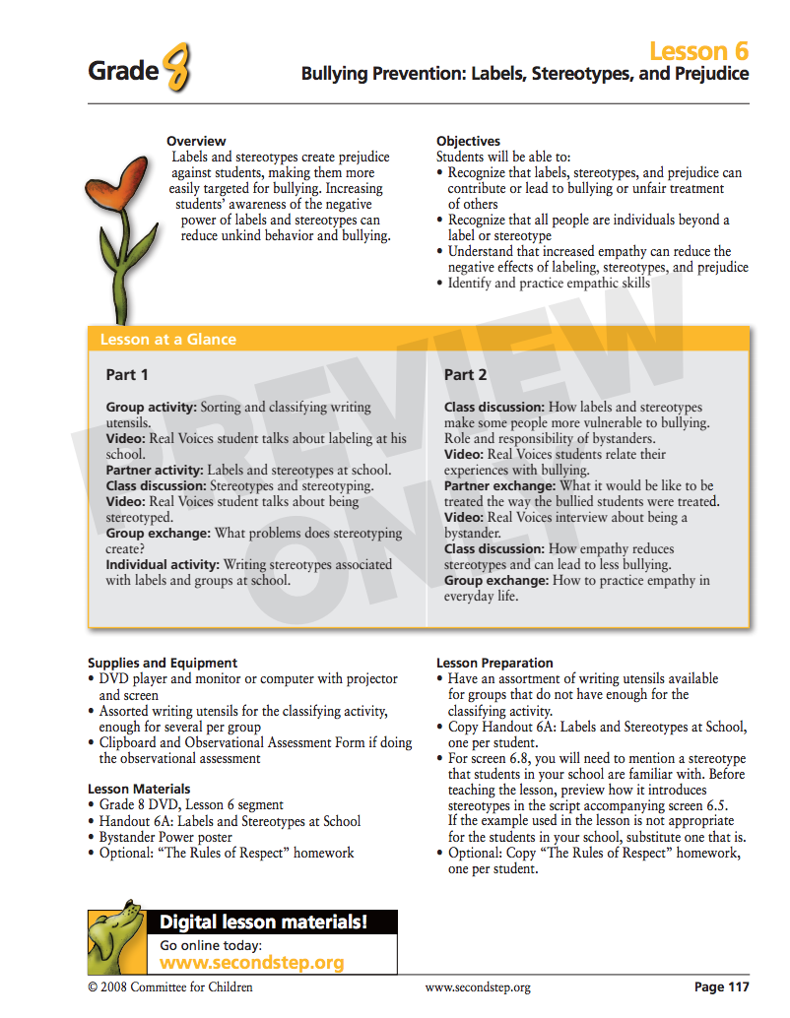
Second Step
Sample Lesson Plan
CASEL SELect Program for Middle School
SEL stand-alone classroom and/or advisory lessons
Units
Empathy and Communication
Emotion Management
Problem Solving
Substance Abuse Prevention
http://www.cfchildren.org/second-step/middle-school/grade-8

Slide 30
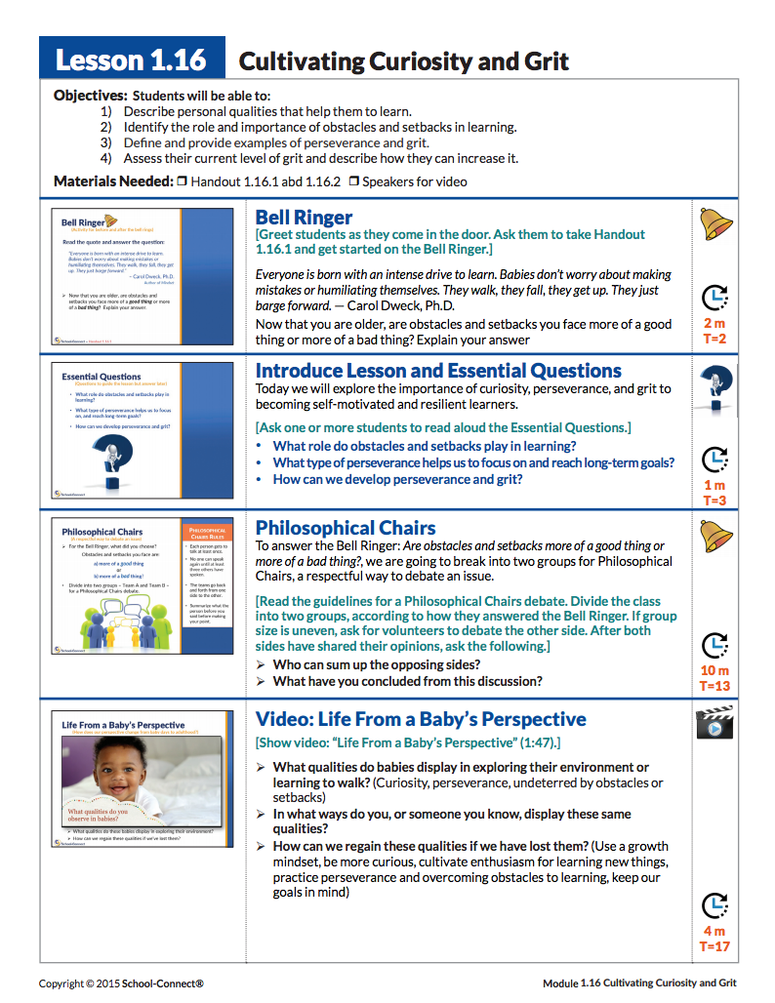
School-Connect
Sample Lesson Plan
CASEL Promising Program for Grades 9-12
SEL stand-alone classroom and/or advisory lessons
Modules:
Creating a Supportive Learning Community
Developing Self-Awareness and Self-Management
Building Relationships and Solving Conflicts
Preparing for College and the Workforce
http://www.school-connect.net/index.html

Slide 31
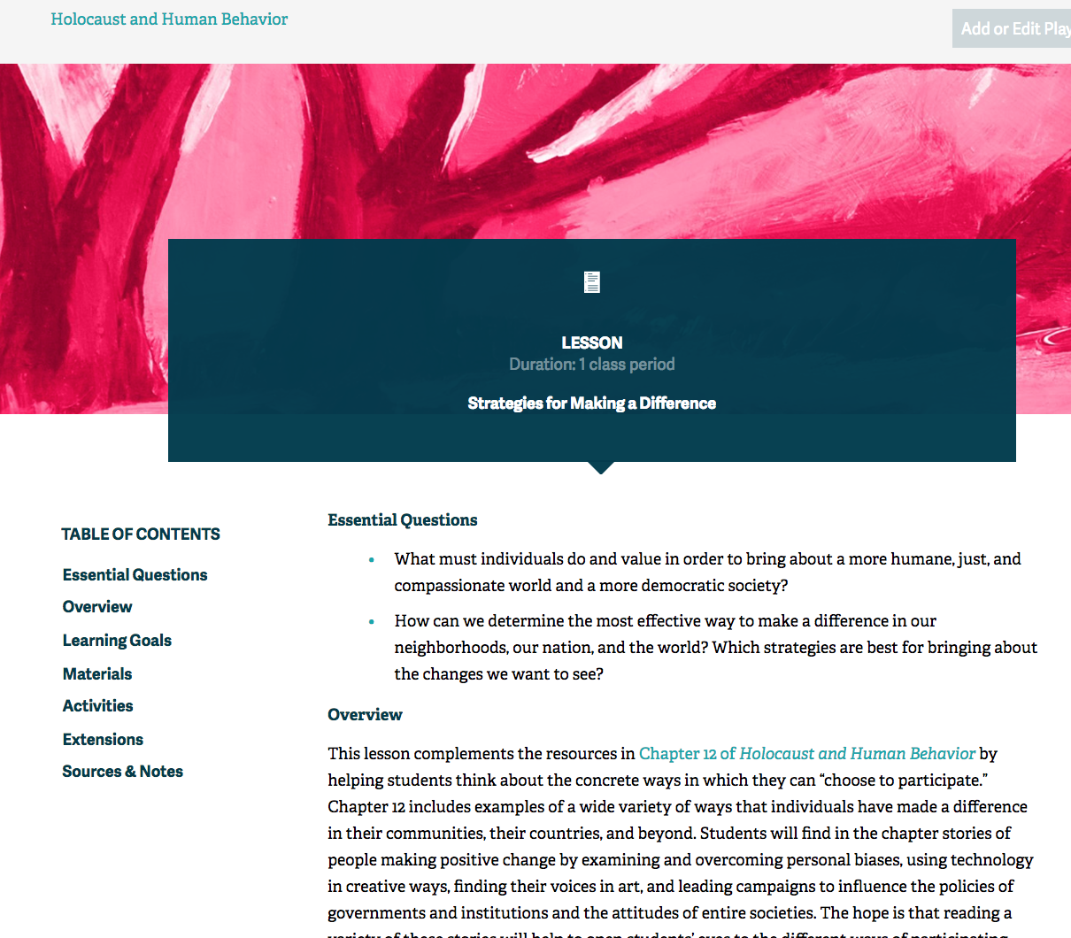
Facing History and Ourselves
Sample Lesson Plans
CASEL SELect Program
Integrated SEL/Social Studies for grades 6-12
Sample Lessons:
Teaching Mockingbird http://info.facinghistory.org/mockingbird-excerpt-homepage
Strategies for Making a Difference https://www.facinghistory.org/holocaust-and-human-behavior/strategies-making-difference

Slide 32
Vermont Early Learning Standards (VELS)
Age 0 - Grade 3
SEL-related standards fall under these domains:
Social and Emotional Learning and Development
Approaches to Learning
Social Studies

Slide 33
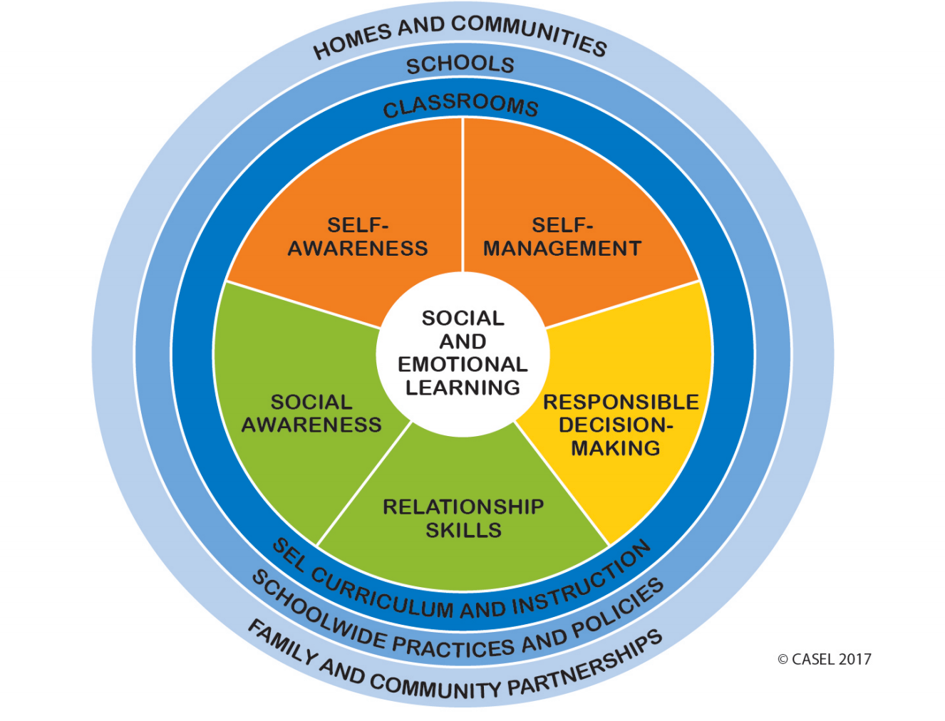
VELS: Social & Emotional Learning & Development
Emotion & Self-Regulation
Children express a range of emotions, and regulate their emotional and social responses
Self-Awareness
Children demonstrate awareness of their personal characteristics, skills, and abilities
Relationships with Adults and Peers
Children develop healthy positive relationships with adults and peers

Slide 34
VELS: Approaches to Learning
3. Problem Solving
Children display an interest in novel situations, and demonstrate flexibility, creativity, and innovation in solving challenging tasks

Slide 35
VELS: Social Studies
2. Family and Community; Civics, Government, & Society
Children identify themselves initially as belonging to a family, a group, and a community; eventually they develop awareness of themselves as members of increasingly wider circles of society and learn the skills needed to be a contributing member of society

Slide 36
Illinois SEL Standards
Goal 1: Develop self-awareness and self-management skills to achieve school and life success
Goal 2: Use social-awareness and interpersonal skills to establish and maintain positive relationships
Goal 3: Demonstrate decision-making skills and responsible behaviors in personal, school, and community contexts
Early Elementary, Late Elementary, Middle/Jr. High, Early HS, Late HS
Performance Descriptors available

Slide 37
ASCA Mindsets & Behaviors: Mindsets
Belief in development of whole self, including a healthy balance of mental, social/emotional and physical well-being
Self-confidence in ability to succeed
Sense of belonging in the school environment
Understanding that postsecondary education and life-long learning are necessary for long-term career success
Belief in using abilities to their fullest to achieve high-quality results and outcomes
Positive attitude toward work and learning

Slide 38
ASCA Mindsets & Behaviors: Behaviors
Learning Strategies
Self-Management Skills
Social Skills
Based on resources including CASEL, Framework for 21st Century Learning
Competencies align with Common Core

Slide 39
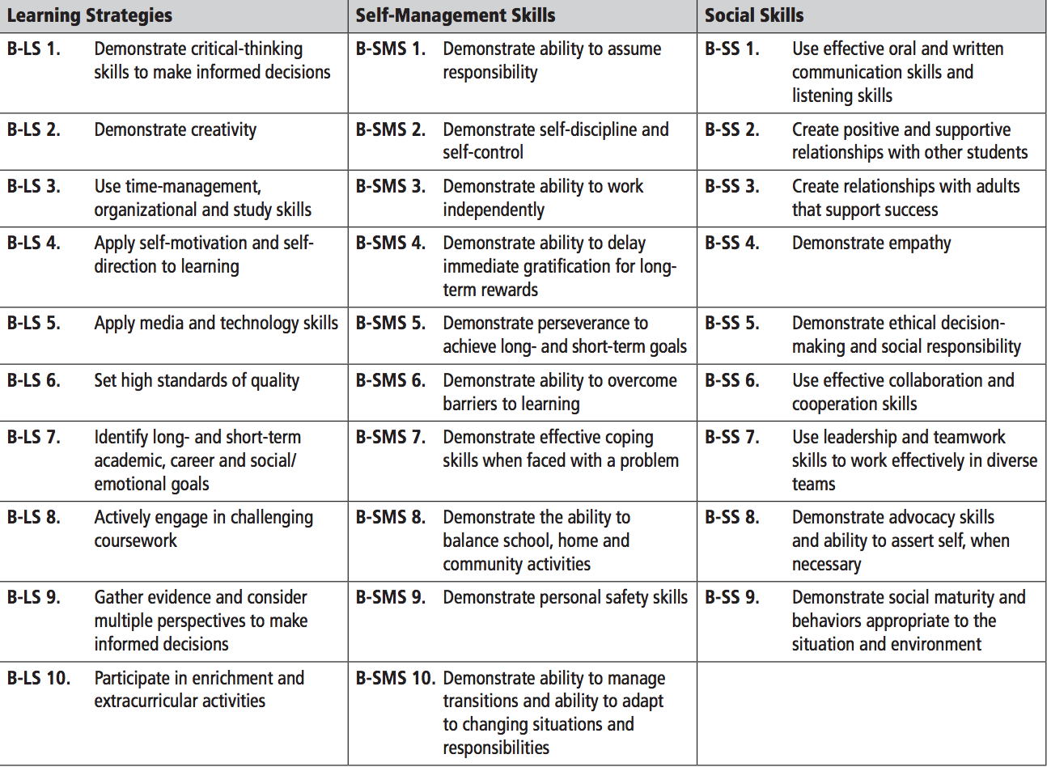

Slide 40
SEL: Universal
Developing a common skill set, language, and framework for staff and students
Universal Supports
universal expectations (in all settings)
re-teaching based on behavioral data
shared language & concepts
school counseling curriculum
school-wide social skills curriculum
Notes:
Rebecca

Slide 41
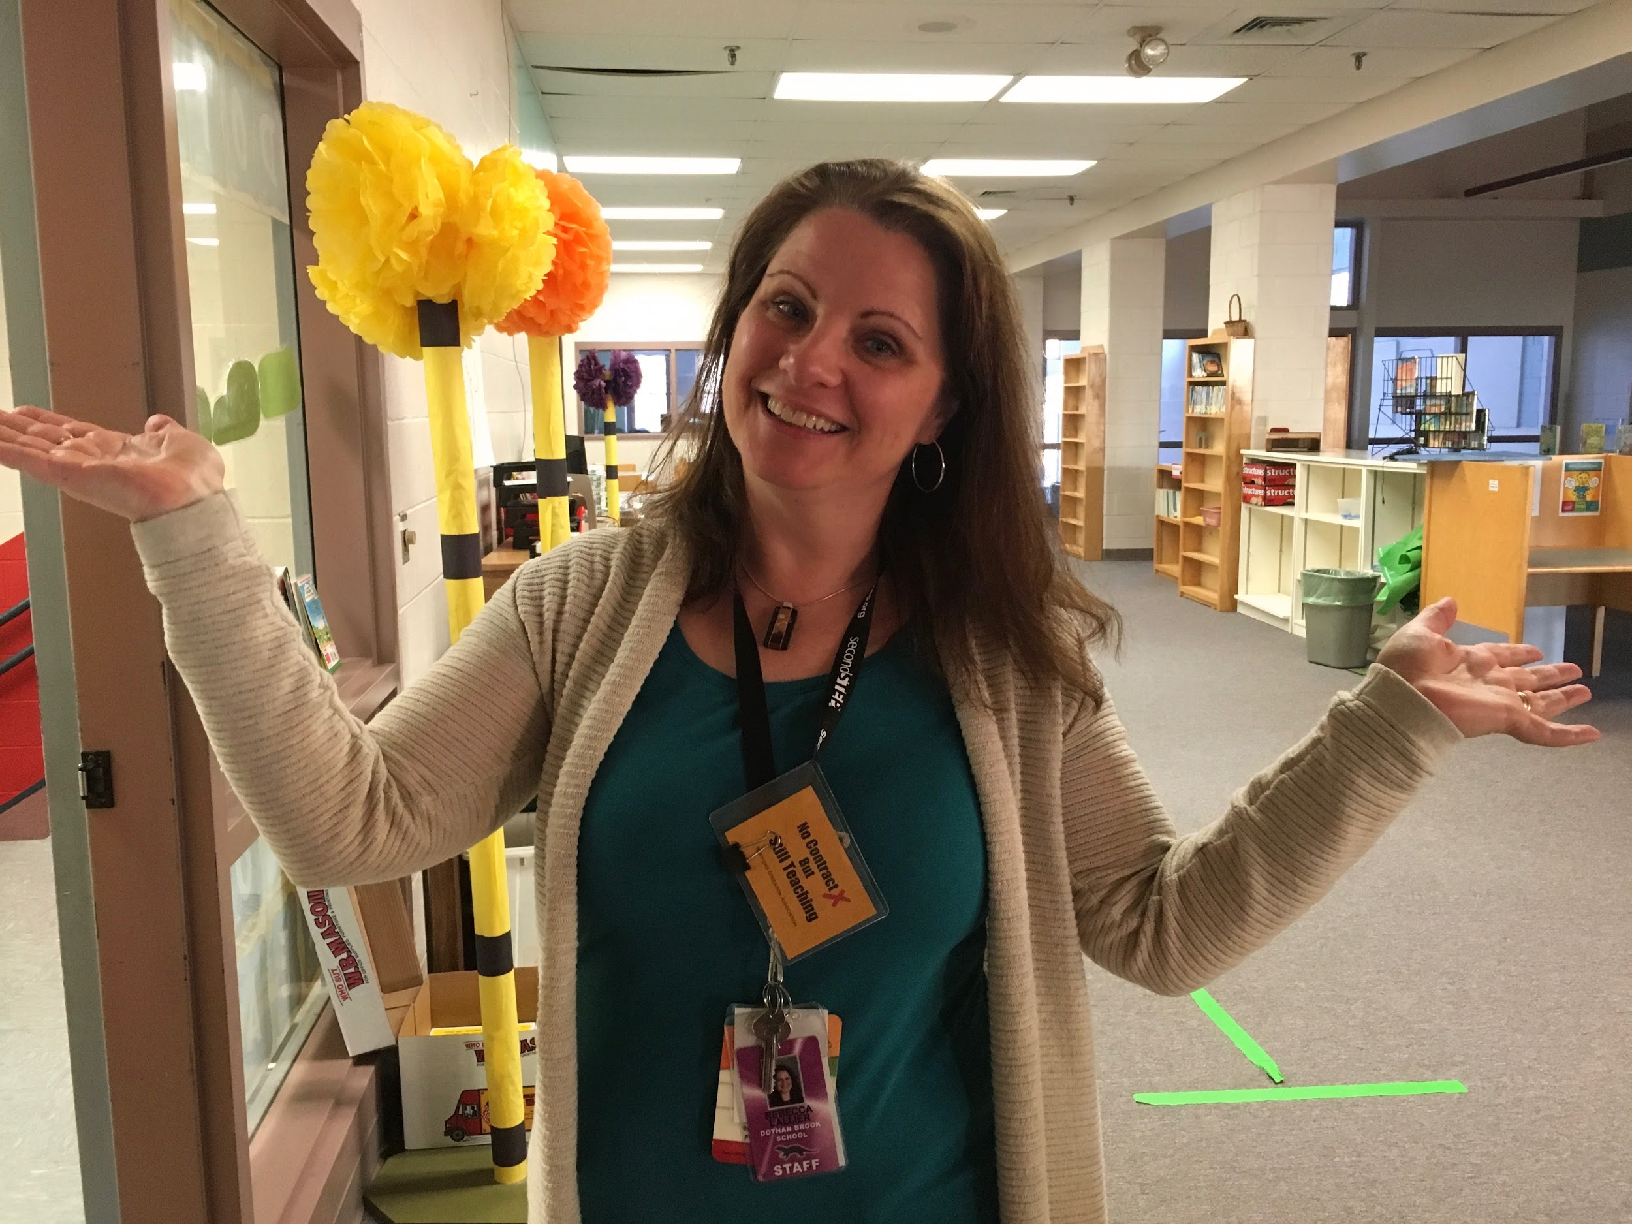
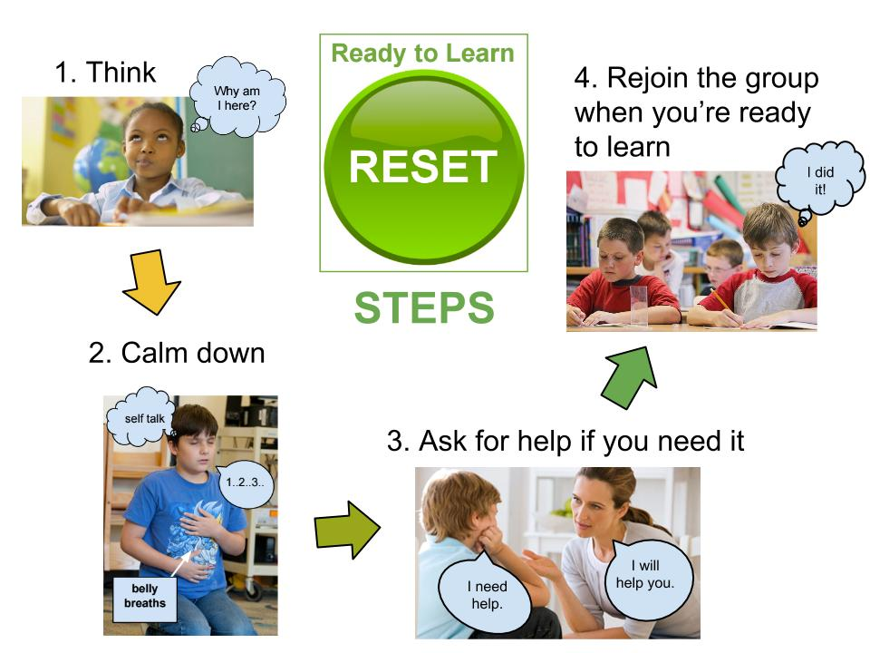
Shared Language and Concepts
Oh well!
“Eye of the tiger . . .”
“READY TO LEARN!”
Notes:
Rebecca

Slide 42
Second Step
All staff and teachers in the building assigned to a classroom to co-teach
Taught schoolwide simultaneously from 1:35-2:10 on Tuesdays
Built into the master schedule
Use curriculum at all three tiers
Notes:
Amy

Slide 43
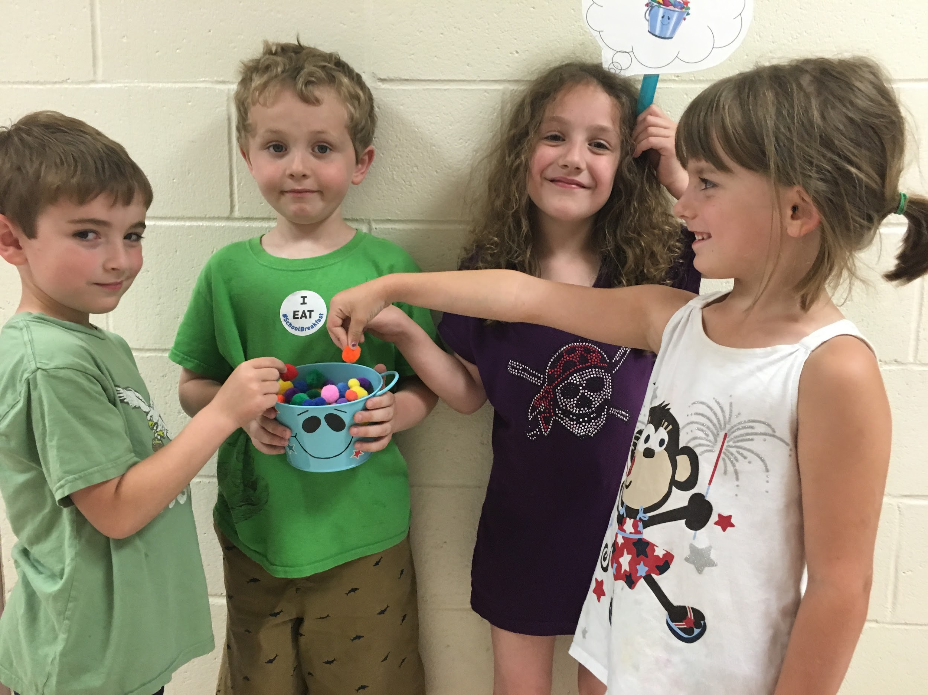
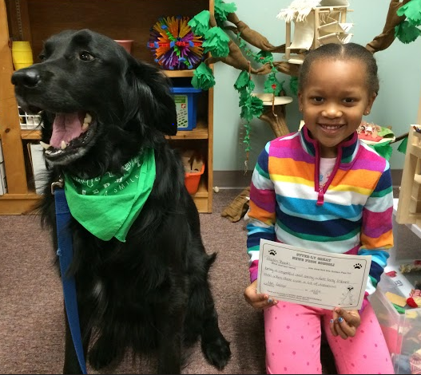
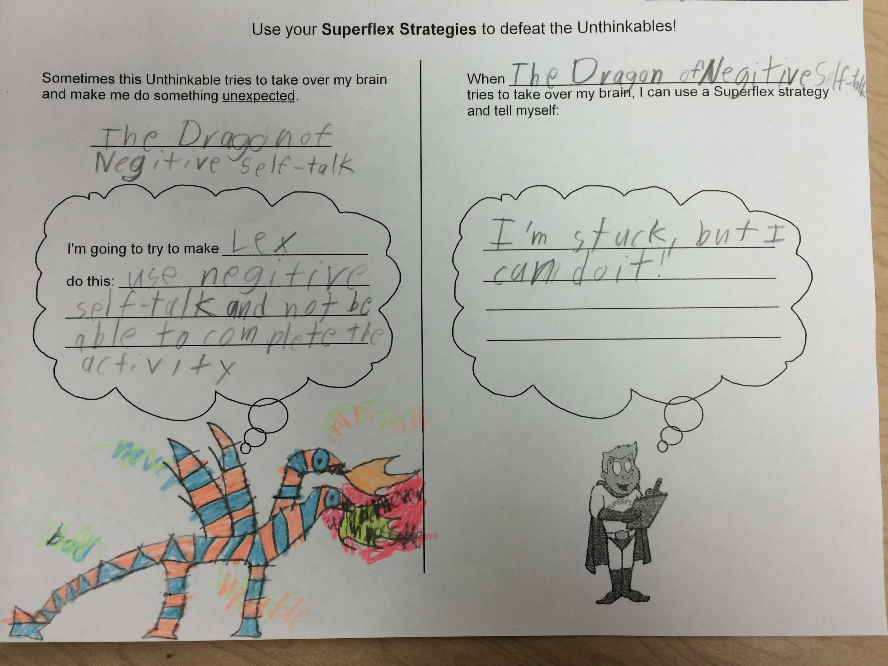
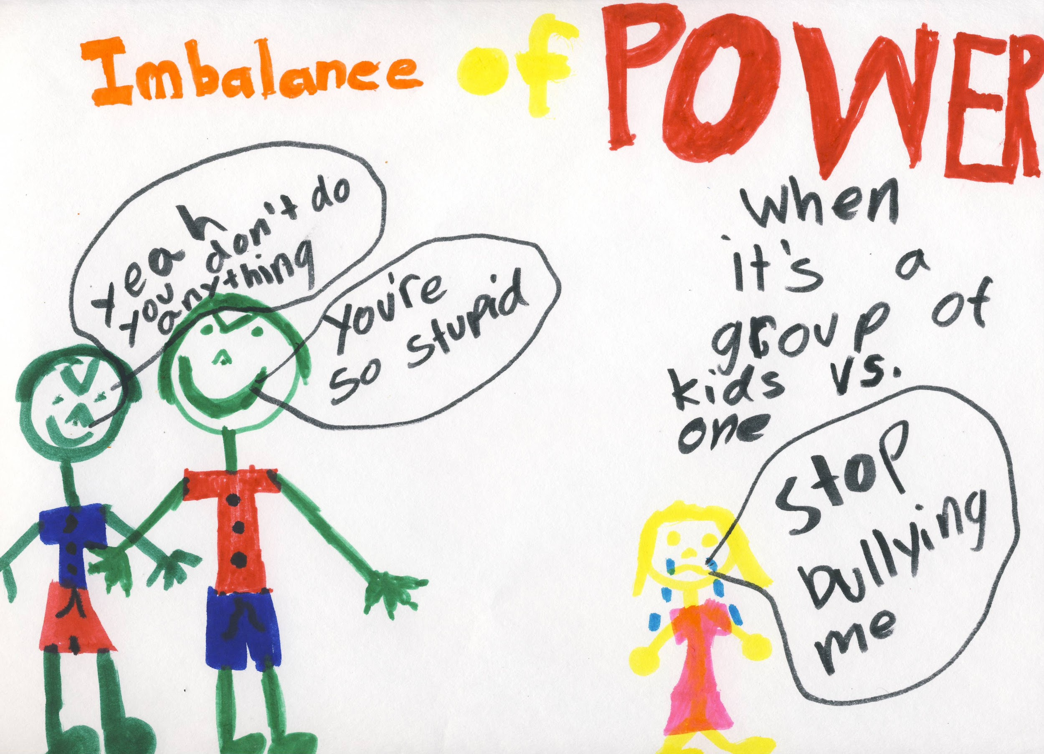
School Counseling Curriculum
Bear, the DBS Therapy Dog!
Bucket Filling
Bullying Prevention
Superflex
Notes:
Rebecca

Slide 44
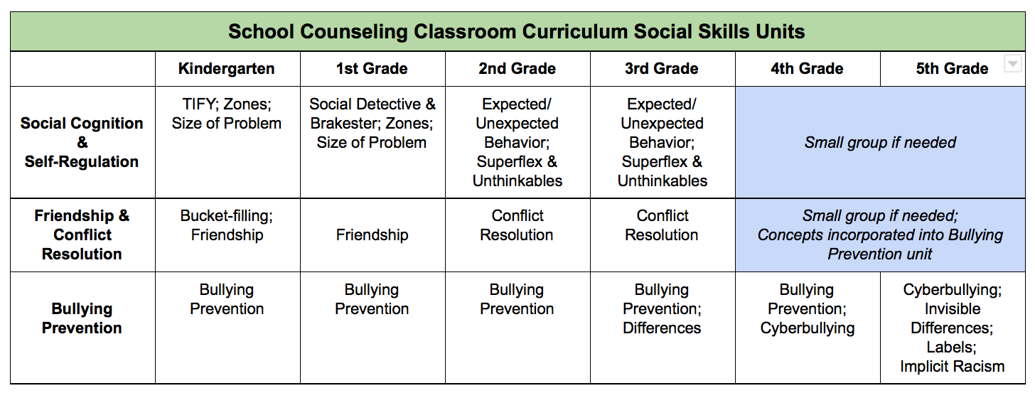
School Counseling Curriculum
Notes:
Rebecca

Slide 45
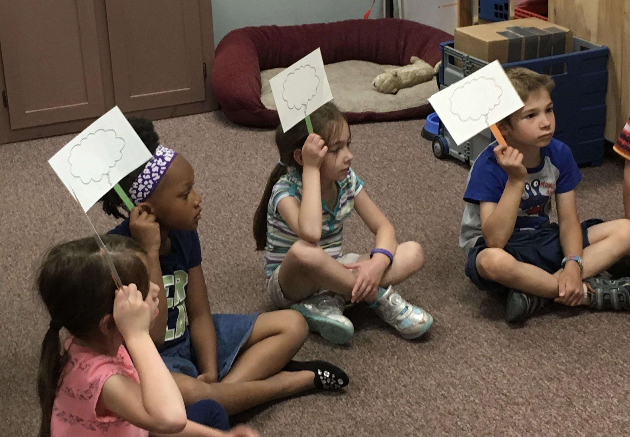
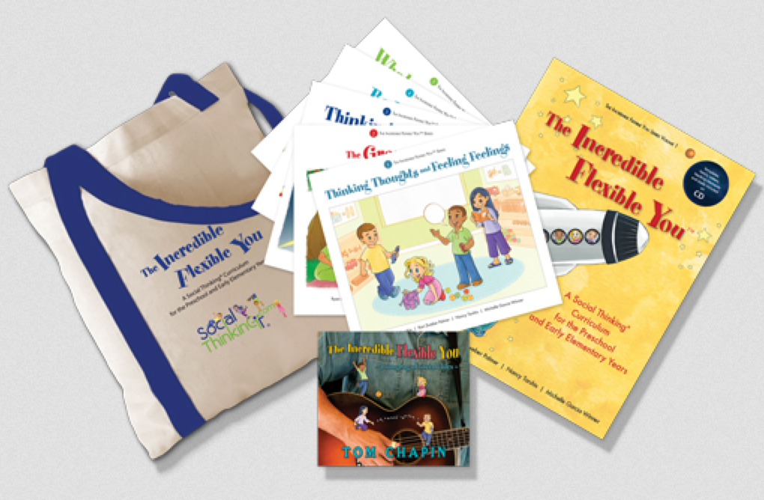
We Thinkers
Early learners
5 Story Books
Thinking Thoughts & Feeling Feelings
The Group Plan
Thinking With Your Eyes
Body in the Group
Whole Body Listening
Music
Dramatic Play

Slide 46
Zones of Regulation
Common language
Students identify specific feelings
Students use strategies to regulate emotions
Developmentally appropriate
Notes:
Rebecca

Slide 47
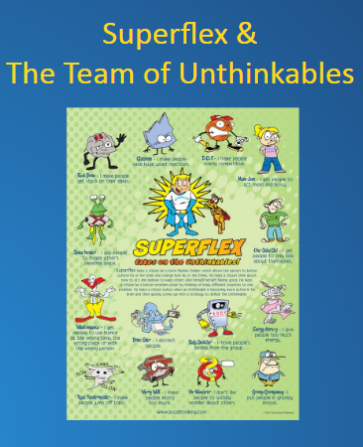
Superflex
Non-shaming way for students to understand behavior
Support a separation of self from behavior
Common language
Engaging
Developmentally appropriate
Notes:
Rebecca

Slide 48
SEL: Targeted
Reinforcing the common skill set, language, and framework for students
Targeted
Supports
Build upon universal social skills instruction
Brief instruction during CICO & breaks
Zones of Regulation
Goal and plan review
Strategies
Small groups to target specific skills
Notes:
Rebecca

Slide 49
Intensive
Supports
SEL: Intensive
Teaching and reinforcing specific social skills
through an individualized approach
Social Thinking & hidden rules
Social stories
Problem solving models
Guided social skills practice
Generalization is the goal!
Notes:
Amy

Slide 50
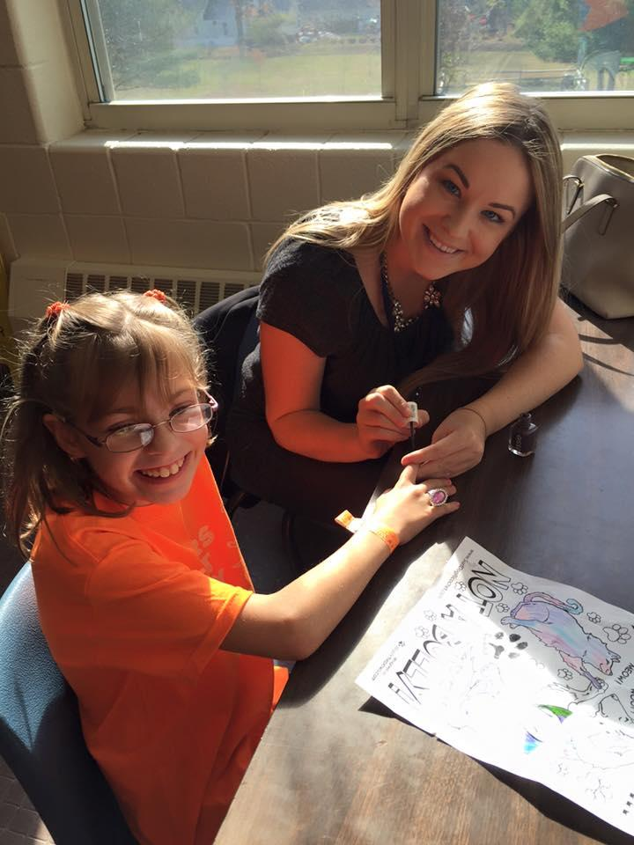
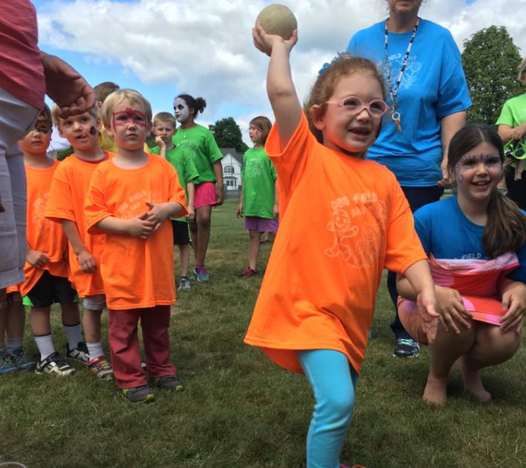
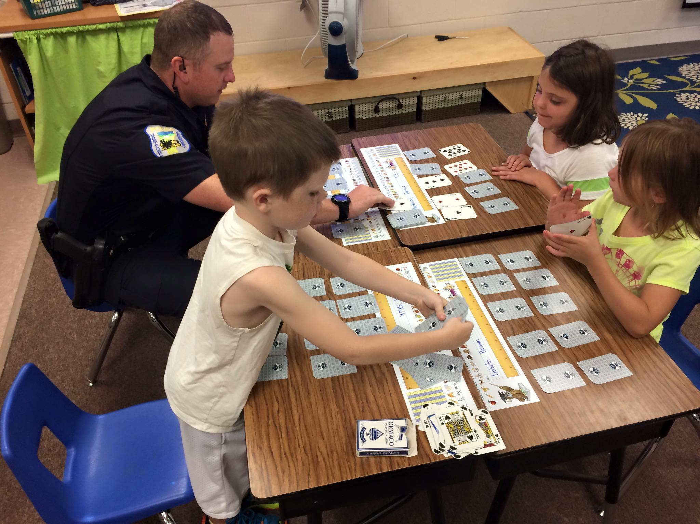
Social Skills Instruction Works!
Notes:
Amy

Slide 51
School/District-Wide Framework
Communicate SEL as a priority to stakeholders
District-wide vision & plan for SEL
Financial and human resources
SEL expertise & competence - central office & schools
SEL needs assessment
Professional development
SEL integration with district initiatives
Implement evidence-based programs
SEL Standards
Systems for continuous improvement

Slide 52
Addressing Barriers
Barriers:
Lack of teacher and/or administrators support/buy-in
Don’t see link between academics and SEL
Fixed mindsets
Staffing
Staff capacity
Scheduling/time - for planning & teaching
Funding
Lack of SEL resources
Strategies:
Turn complaining into needs assessment and problem-solving
Show admins/teachers research behind SEL and impact on academics
Pilot with ally teachers and natural leaders
Consider what duties/responsibilities can be reassigned to free up staff to teach social skills
Build staff capacity through PD
Build Universal and Targeted group times into master schedule
Apply for grant funding/access free resources

Slide 53
Action Planning
Review data
What are your school’s primary SEL needs?
What are your desired outcomes?
Outline realistic action steps that will help you meet the outcomes

Slide 54
Data Sources for SEL Needs Assessment
Behavioral data
Universal screening
Attendance
Report card (effort, work habits, social skills, etc.)
School climate survey
Nurse visits
Not data, but . . .
What are the behaviors that “drive people crazy?”
What do students, parents, and staff complain about?

Slide 55
Determining Desired Outcomes
SEL/PBIS/Leadership team
Analyze and discuss data
Review SEL standards samples and CASEL Competencies
VELS PreK-3
Samples from Illinois, ASCA, others available at CASEL.org
Connect to resources (online, coaching) and other schools using SEL
Create S.M.A.R.T. goals for implementation

Slide 56
Resources and Needs Assessment
What SEL-promoting programs, activities, practices, strategies, and resources are already in place and working to address the desired outcomes? What are our strengths that we can build upon?
School counseling curriculum?
PBIS lesson plans?
Responsive Classroom?
Mindfulness?
Instructional practices (such as PBL, cooperative learning)?
Where are the gaps where new programs, activities, practices, strategies, resources, and professional development may be needed?

Slide 57
Next Steps
What am I going to do to integrate SEL into my work at the start of the school year?
What am I going to do to promote SEL within the systems in my school/SU?
What resources do we need:
Right away?
During 2017-18?
Next 3 years?

Slide 58
What Does It Look Like When It’s Fully Implemented?
Teachers promoting SEL in the classroom
Classroom concepts reinforced outside classroom
Adults modeling SEL
Administrators manage school in a way that fosters adult SEL (e.g., how meetings are run, the way decisions are made)
Implemented and aligned at all three tiers
All policies and practices at the school level support student SEL (e.g., discipline guidelines)
School regularly communicates with and engages families/community partners around SEL
http://www.casel.org/integration/

Slide 59
References
Cook, C. R., Frye, M., Slemrod, T., Lyon, A. R., Renshaw, T. L., & Zhang, Y. (2015). An integrated approach to universal prevention: Independent and combined effects of PBIS and SEL on youths’ mental health. School Psychology Quarterly,30(2), 166-183. doi:10.1037/spq0000102
Collaborative for Academic, Social, and Emotional Learning (CASEL)
Vermont Early Learning Standards (VELS)
Illinois SEL Standards
American School Counselor Association (ASCA) Mindsets & Behavior Standards

