Slide 1
Sept 21, 2009
How Markets Work (part 2)
Supply and the Law of Supply
Market Equilibrium
Changes in Price and Quantity

Slide 2
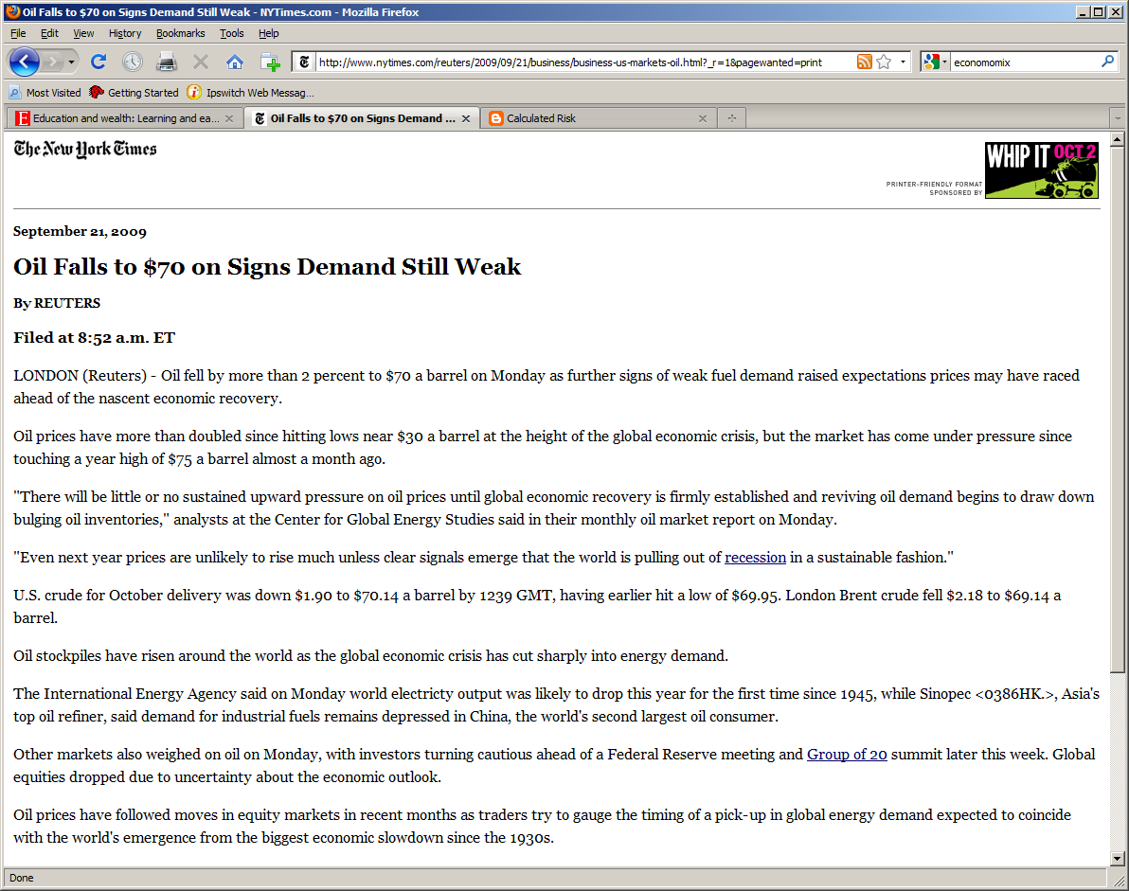

Slide 3
Interest Rates and Payments on a $200,000 Mortgage
 | Mortgage Rate | Monthly Payment
2000 | 7.4% | $1,385
2004 | 3.5% | $900
2006 | 0% | $600
Question: Do lower mortgage rates affect demand or supply?
Which direction will the curve shift?
What happens to price and quantity of houses sold?

Slide 4
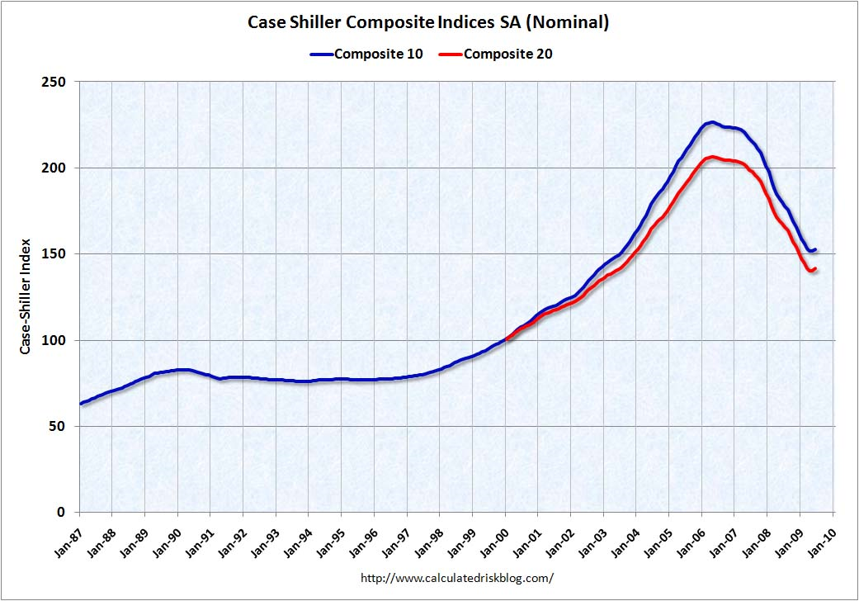

Slide 5
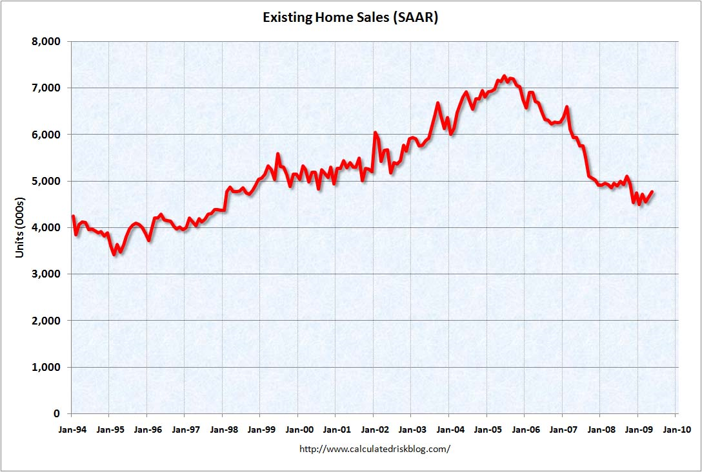

Slide 6
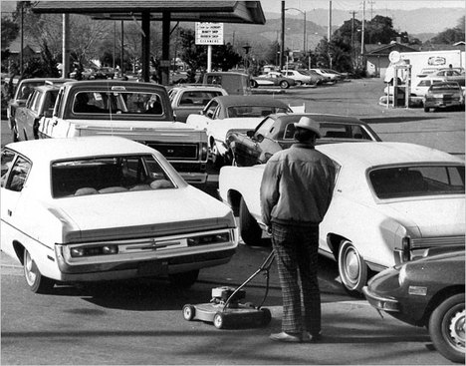
Gas Lines in 1974

Slide 7
