Slide 1
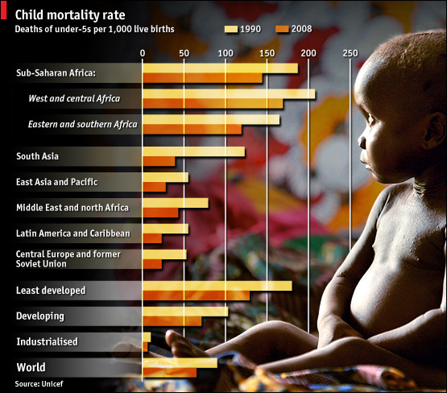
Sept 18, 2009
Good Economic News
How Markets Work
Demand and the Law of Demand
Supply and the Law of Supply
Market Equilibrium
U.S. : 8 per 1,000 live births
Sierra Leone: 262/1,000
Sweden, Iceland, Singapore: 3/1,000
Source: http://www.unicef.org/sowc09/statistics/tables.php
Notes:
Child mortality
Progress made
Sep 10th 2009 From Economist.com
More children are reaching their fifth birthday than ever before
MORE children are surviving beyond their fifth birthday, according to a new report from the United Nations Children's Fund (Unicef). The child mortality rate—the number of under-fives dying per thousand live births—declined from 90 in 1990 to 65 in 2008, a drop of over a quarter. The number of deaths has fallen from 12.5m in 1990 to 8.8m last year, the lowest since records began in 1960. The biggest improvements are in Latin America and the former Soviet Union, where mortality rates have fallen by more than half. Progress in sub-Saharan Africa, which now accounts for half of all deaths, has been slower, but Niger, Malawi, Mozambique and Ethiopia have seen reductions of more than 100 per 1,000 livebirths since 1990. The report notes that despite big improvements in preventing malaria, one of the three main causes of deaths, much more needs to be done to treat the other two causes, pneumonia and diarrhoea.

Slide 3
