Slide 1
Sept 14, 2009
Production Possibility Frontier (conclusion)
Trade and Comparative Advantage

Slide 2
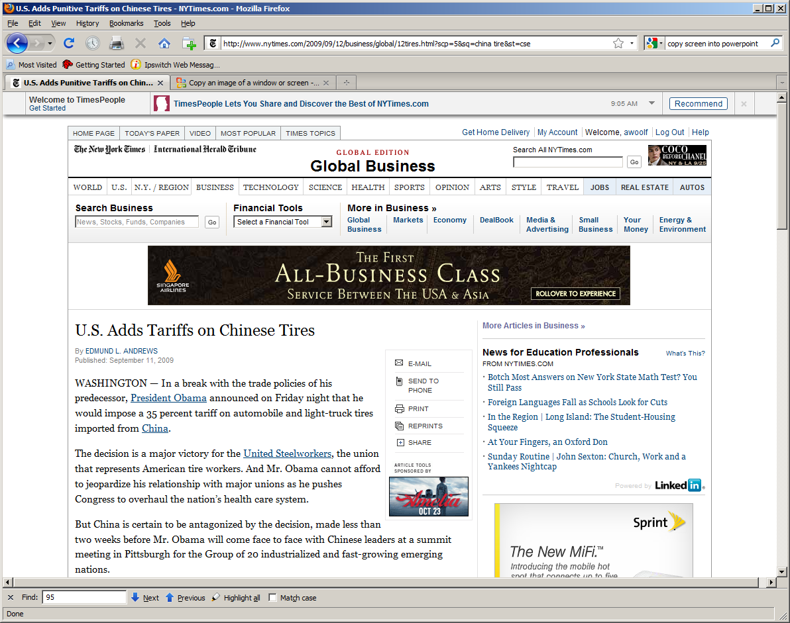

Slide 3
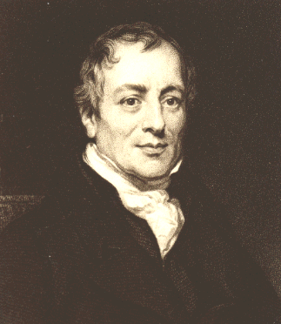
David Ricardo 1772-1823

Slide 4
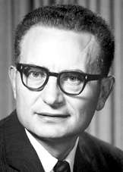
Paul Samuelson 1970 Nobel Prize in Economics
b 1915-

Slide 6
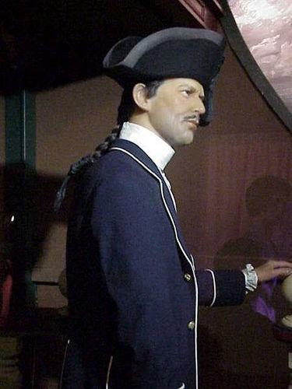
Fletcher Christian (aka Clark Gable)

