Slide 1
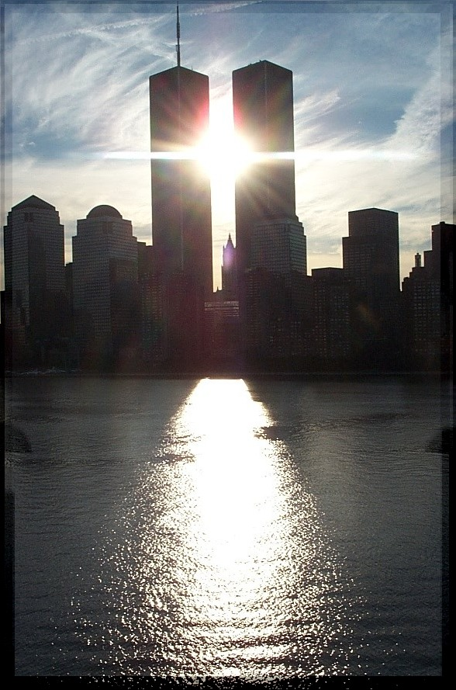
In Memoriam
UVM alumni lost on September 11, 2001
Carlton W. Bartels G’85
Brandon Buchanan ’99
Paul Cascio ’94
Robert Lawrence, Jr. ’82
Rajesh Mirpuri
Cesar Murillo ’91
Martin Niederer ’99
Joshua Piver ’00
Eric Rropiteau ’00
Matthew Sellitto ’00
John W. Wright, Jr. ’89
(http://www.uvm.edu/~uvmpr/vq/VQWINTER02/memorium.html)

Slide 2
Sept 11, 2009
Property Rights
Models in Economics
A. Circular Flow
B. Production Possibility Frontier
Supplemental Instructor (Information on Aplia and class site):
Justin KD Jdeigman@uvm.edu
410-952-1897
SI Sessions will be held in Living/Learning A161 Tues/Thursday from 8:30 - 9:45pm
Open office hours (no appointment necessary) on Tues/Thursday from 10-11am and Sunday from 7-8pm.

Slide 3
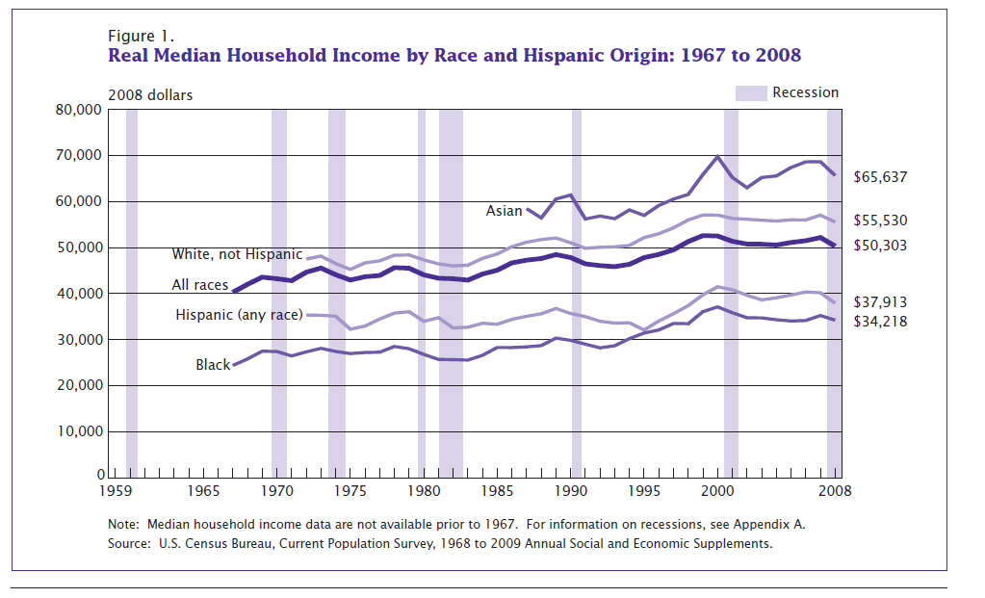
In the News…Income Fell in 2008…
Notes:
52,163 in 2007
Family income

Slide 4
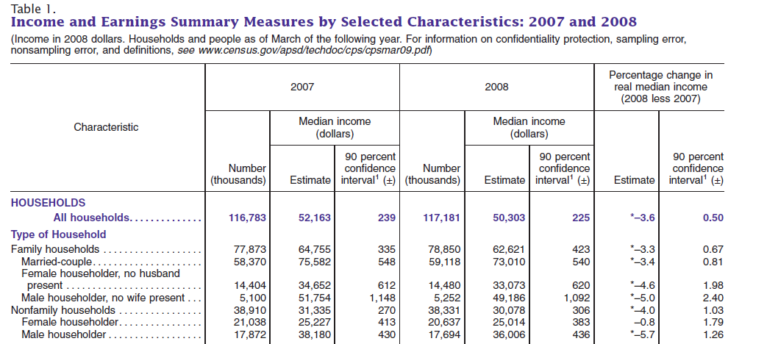

Slide 5
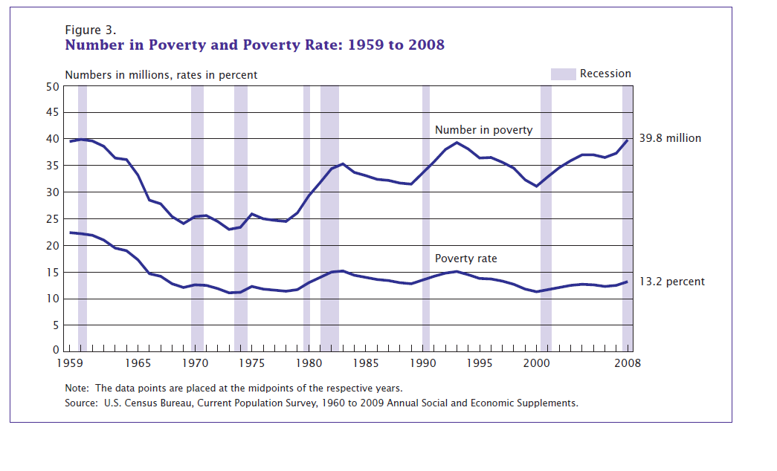
…and Poverty Rose

Slide 6
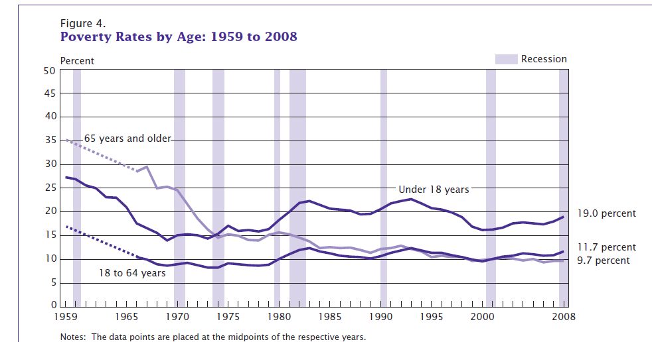
Notes:
Poverty used to be elderly; now it is young

Slide 7
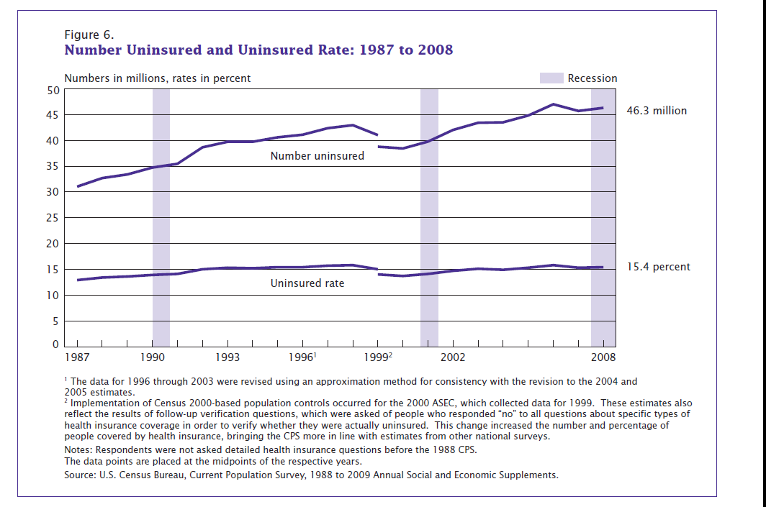
But the Number and Percent Uninsured Remain Unchanged

Slide 8
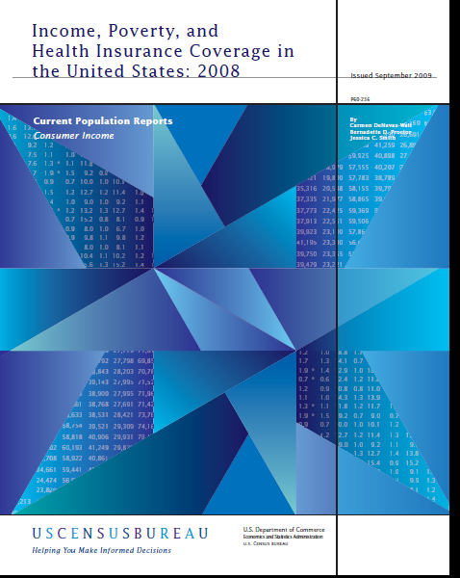
Much More Data Available
http://www.census.gov/prod/2009pubs/p60-236.pdf

Slide 9
Application of Property Rights: Poverty in Africa
Hernando deSoto The Mystery of Capital
The Commanding Heights Episode 3, Ch 19
<http://www.pbs.org/wgbh/commandingheights/shared/video/qt/mini_p03_19_300.html>
Main site for Commanding Heights: http://www.pbs.org/wgbh/commandingheights/lo/index.html
Hernando deSoto PBS special on property rights and poverty Oct 8
Notes:
Need overhead 2 transparencies; goldfish, prizes

Slide 10
The Tragedy of the Commons
Property held in common tends to be overused.
  Each user gains the full benefit of use, but does not bear the full cost of its use. Costs are shared by all the “owners.”
  No one has a strong incentive to conserve the property because someone else will use it if it is left idle.

Slide 11
Private Property Rights Must Be
Clearly Defined: What is it; where it is located; what are privileges and limitations of use?
Defendable: Is ownership protected by law and community consent? Are property rights enforceable?
Divestible: May owners choose whether to sell or hold property so that future gains and losses influence current value?

Slide 12
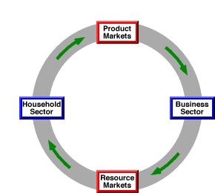
Circular Flow Model

Slide 13
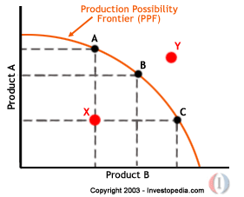
Production Possibility Frontier Model

