Slide 1
Sept 4, 2009
Readings posted on Aplia and class site
Mankiw’s 10 basic principles of economics (continued)

Slide 2
10 Principles of Economics
5. Trade Can Make Everyone Better Off By Increasing Wealth

Slide 3
10 Principles of Economics
Markets Are Usually a Good Way to Organize Economic Activity

Slide 4
Thinking about economics and markets:
I was in discussion with a senior Russian official whose job it was to direct the production of bread in St. Petersburg. “Please understand that we are keen to move towards a market system,” he told me. “But we need to understand the fundamental details of how such a system works. Tell me, for example, who is in charge of the supply of bread to the population of London? There is nothing naive about his question, because the answer, nobody is in charge, is astonishingly hard to believe. Only in the industrialized West, have we forgotten just how strange it is.
--Paul Seabright: The Company of Strangers

Slide 5
Markets are Everywhere, and for Everything

Slide 6
Markets Everywhere—Prison Edition
The Shawshank Redemption

Slide 7
10 Principles of Economics
Governments Can Sometimes Improve Market Outcomes
Property Rights
Externalities
Public Goods

Slide 8
10 Principles of Economics
A Country’s Standard of Living Depends on Its Ability to Produce Goods and Services

Slide 9
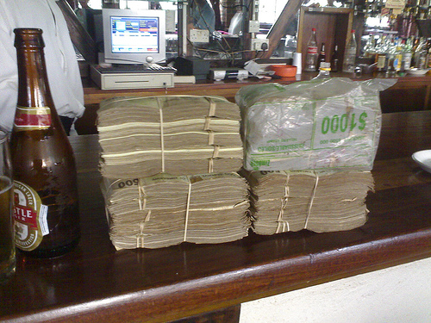
10 Principles of Economics
Prices Rise When the Government Prints Too Much Money

Slide 10
Who is this man?

Slide 11
10 Principles of Economics
Society Faces a Short-Run Tradeoff Between Inflation and Unemployment

