Slide 1
Dec 7
Using Monetary and Fiscal Policy
Active Policy
Pro
Con
Automatic Stabilizers

Slide 2
Schedule:
12/7 Ch 16
12/9 1. Econ Dept Assessment—20 multiple choice questions (counts as 1 30 point Aplia assignment)
2. Course Evaluation
3. Course Conclusion
Exam information:
Ch 1-13, 15, 16 2/3 of questions since last exam, 1/3 on first 2/3 of course; 60 questions
Office hours Friday and Monday
Exam is Tuesday 12/15 3:30 – 5:00 301 Williams

Slide 3
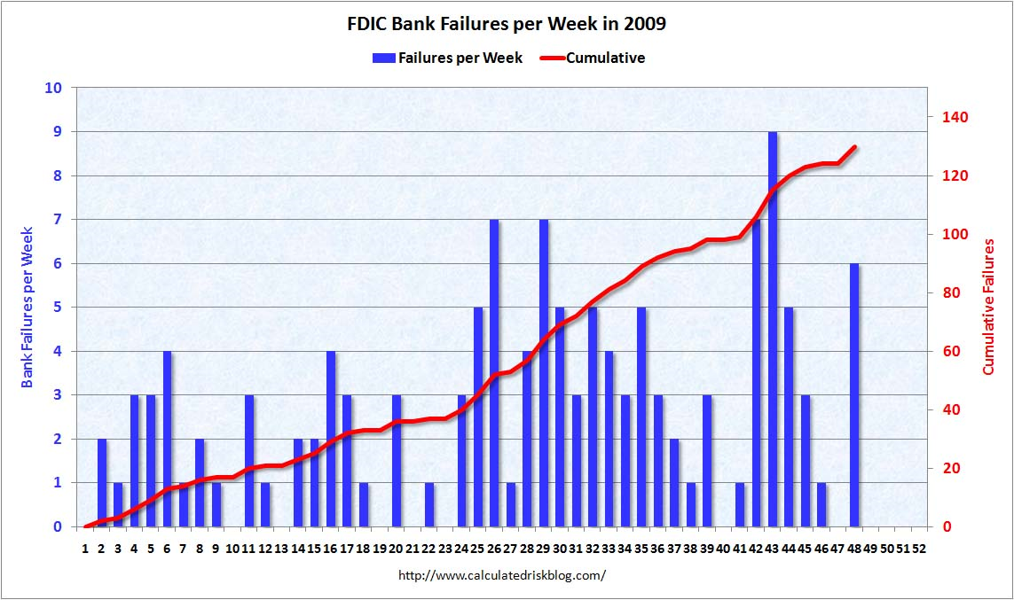

Slide 4
It’s Hard to Spend $787 Billion: Federal Stimulus Spending as of Nov 1 (note: stimulus bill was passed in February)
$141 b spent
$158 b committed, not spent
$281 b remaining
$84 b in tax cuts paid
$128 b in tax cuts to be paid

Slide 5
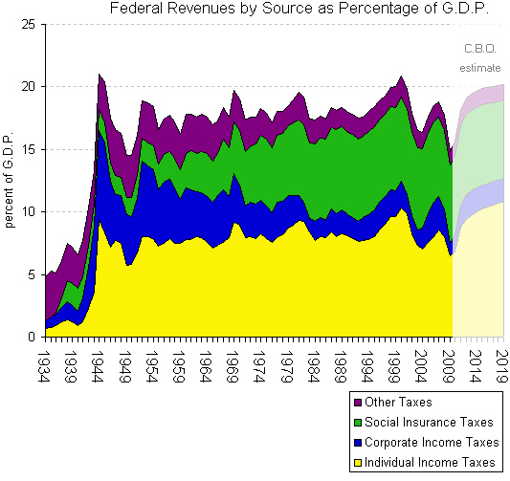
Taxes as Automatic Stabilizers

Slide 6
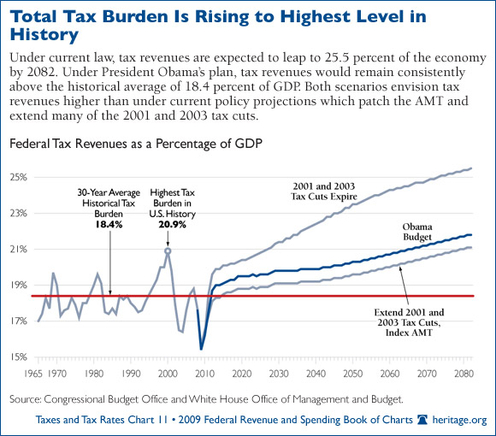

Slide 7
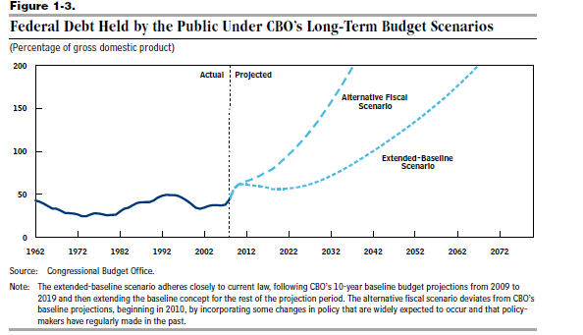
Long Run Problems

