Slide 1
Dec 4
  Business Cycles
  Liquidity Preference
  Using Monetary and Fiscal Policy
November Employment Report
Unemployment rate 10.0%
Jobs -11,000
http://www.nytimes.com/2009/12/05/business/economy/05jobs.html?hp

Slide 2
  Schedule:
  12/2 Ch 15
  12/4, 12/7 Ch 16
  12/9 1. Econ Dept Assessment—20 multiple choice questions (counts as 1 30 point Aplia assignment)
  2. Course Evaluation
  3. Course Conclusion
  Exam information:
  Ch 1-13, 15, 16 2/3 of questions since last exam, 1/3 on first 2/3 of course; 60 questions
  Exam is Tuesday 12/15 3:30 – 5:00 301 Williams

Slide 3
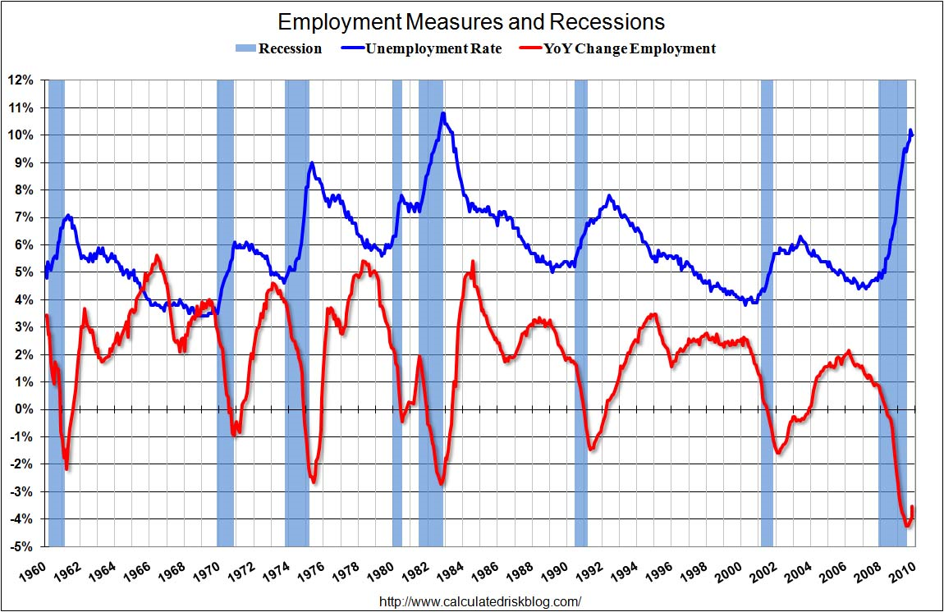

Slide 4
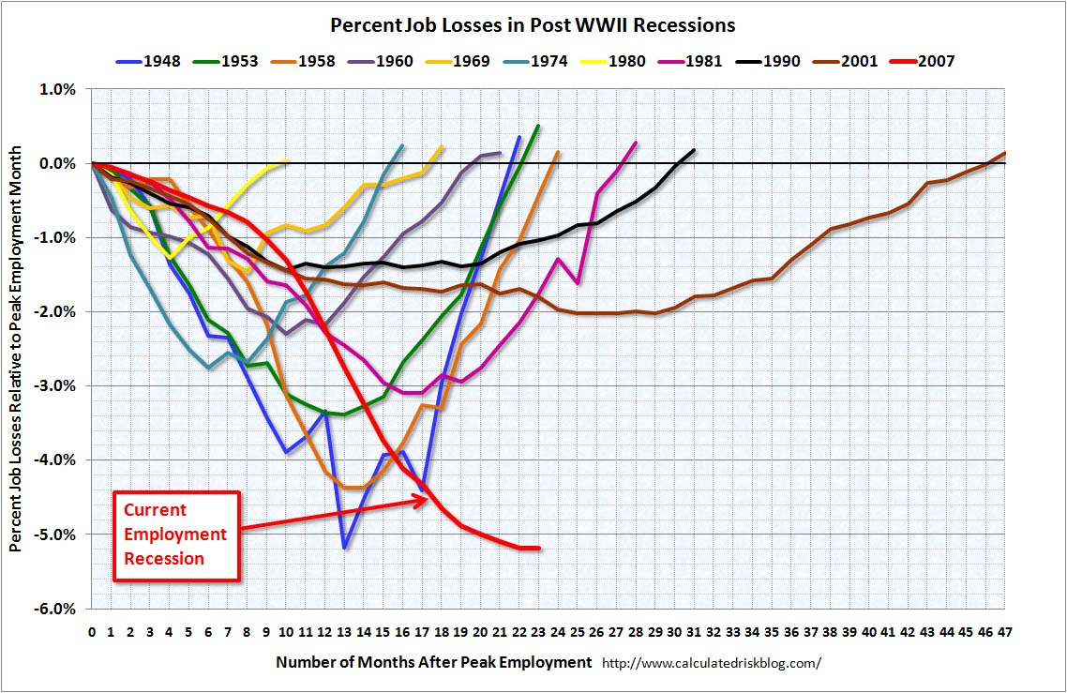

Slide 5
US Price Level 1774-1900

