Slide 1
Nov 30
Purchasing Power Parity
Aggregate Supply
Long Run
Short Run
Aggregate Demand

Slide 2
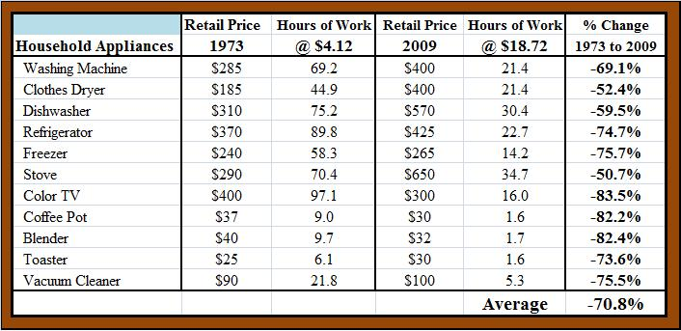
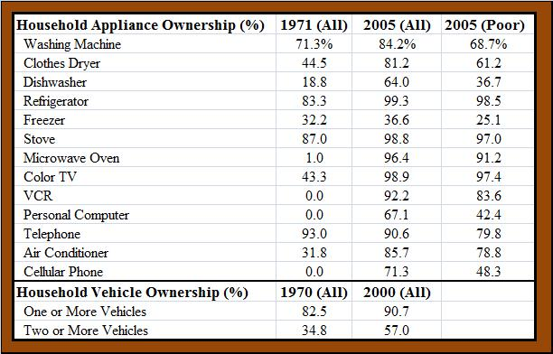
Appliances are
cheaper today
measured by hours
of work needed to
buy them…
…and poor Americans’
ownership rates today are
similar to average
ownership rates 30 years
ago
Conclusion: The rich get
richer, and so do the poor.

Slide 3
