Slide 1
Nov 18
Open Economy Macro I:
International Flow of Goods and Services and Financial Capital
Exchange Rates
We will be skipping Ch 14 and going directly to Ch 15

Slide 2
Supply and Demand? Rationing? Doesn’t Kellogg’s Understand Economics?
http://www.npr.org/templates/player/mediaPlayer.html?action=1&t=1&islist=false&id=120527483&m=120527502

Slide 3
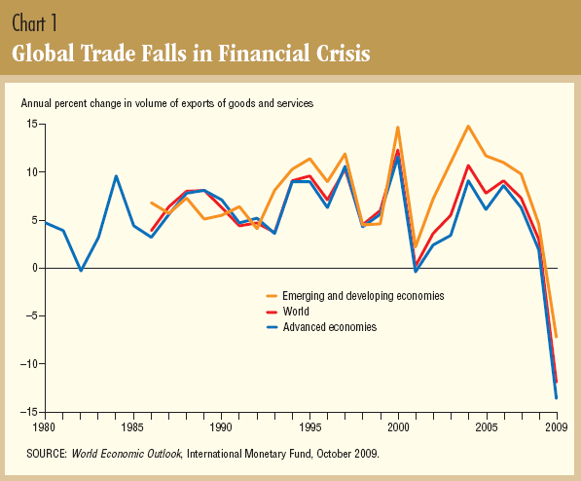

Slide 4
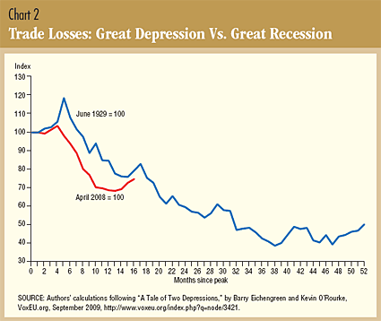

Slide 5
Exports 2008

Slide 6
Imports 2008

Slide 7
What do we export?

Slide 8
What do we import?

Slide 9
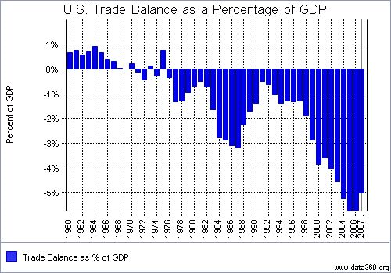

Slide 10
Exchange Rates

Slide 12
