Slide 1
Nov 13
Money and Inflation (continued)
  Costs of Inflation
Eurozone returns to growth
http://online.wsj.com/article/SB125809667186946819.html#project%3DEuroGDP0905%26articleTabs%3Dinteractive

Slide 2
US Price Level 1774-1900

Slide 3
Inflation 1775-1900

Slide 4
US Inflation Rate 1900 - 2008

Slide 5
Inflation 1960-2008

Slide 6
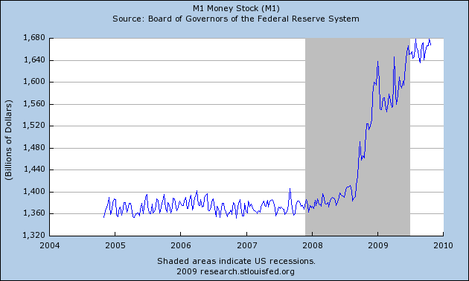

Slide 7
Effects of Inflation
http://www.pbs.org/wgbh/commandingheights/shared/video/qt/mini_p01_04_300.html

Slide 9
Exam 2
(40 Points)
Distribution
A 34-40 18%
B 30-33 22%
C 25-29 29%
D 20-24 22%
F <19 8%
100%

