Slide 1
Nov 11
Money and Inflation
Quantity Theory of Money
Costs of Inflation

Slide 3
US Price Level 1774-1900

Slide 4
Inflation 1775-1900

Slide 5
US Inflation Rate 1900 - 2008

Slide 6
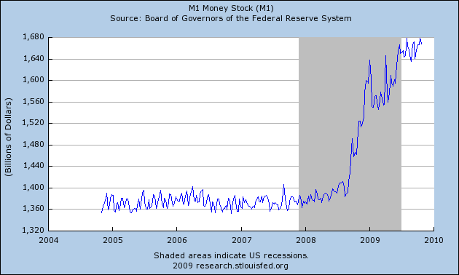

Slide 7
The Fed’s Balance Sheet (graphic)
http://blogs.wsj.com/economics/2009/10/22/a-look-inside-the-feds-balance-sheet-102109-update/

Slide 8
Inflation 1960-2008

