Slide 1
Nov 9, 2009
Money and Inflation
Hyperinflations
Quantity Theory of Money
Costs of Inflation
Today in history: 1989 The fall of the Berlin Wall
--Political freedom
--Economic freedom
http://www.youtube.com/watch?v=wnYXbJ_bcLc

Slide 2
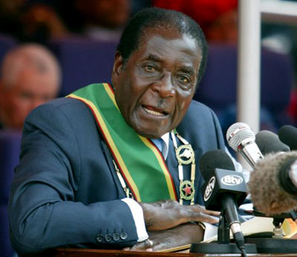
Robert Mugabe

Slide 3
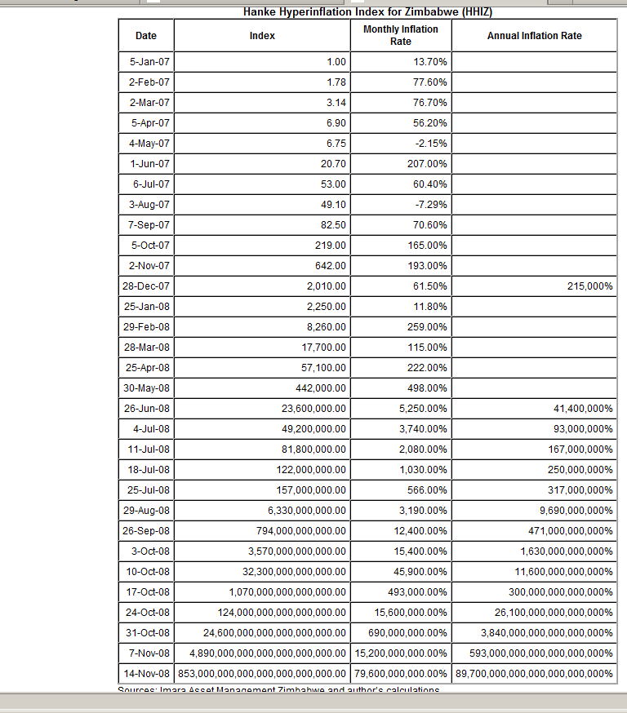

Slide 4
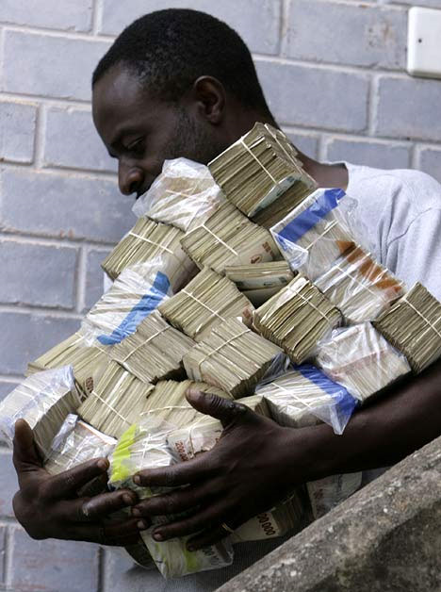
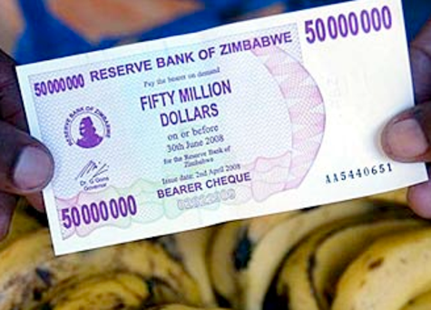
Zimbabwe Inflation

Slide 6
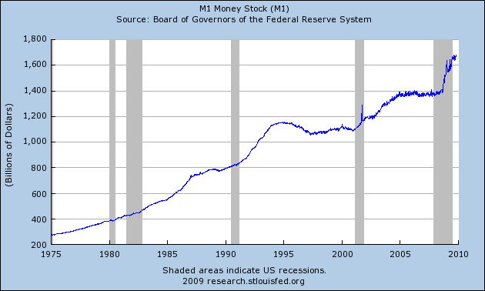

Slide 7
