Slide 1
Nov 4, 2009
Federal Reserve
History and Structure
Tools
Money Creation
Exam Friday: Ch 6-11, readings, Aplia, class lectures (not Janus forum lecture)
No office hours this afternoon. I will respond to emails and will call you if you need to talk.
Economics Advising Session for spring courses Monday Nov 9 4:15-5:15 A207 Old Mill Annex ---free pizza and beer soft drinks

Slide 2
How Long Did it Take and When did Fertility Fall by 50%? Selected Nations:
Europe: 1800-1930
South Korea 1965-85
Bangladesh 1980-2000
Mauritius 1963-74
Iran 1984-2006 falls by 75%

Slide 3
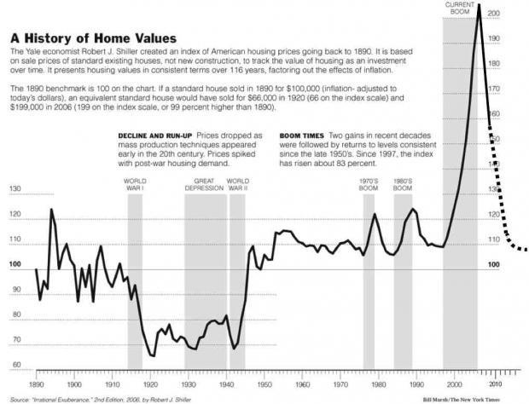

Slide 4
Ben Bernanke

Slide 5
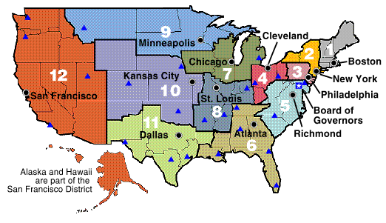
Federal Reserve Regional Banks

Slide 7
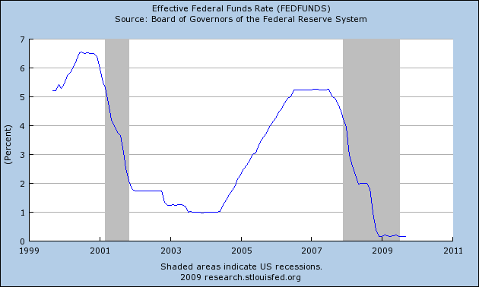

Slide 8
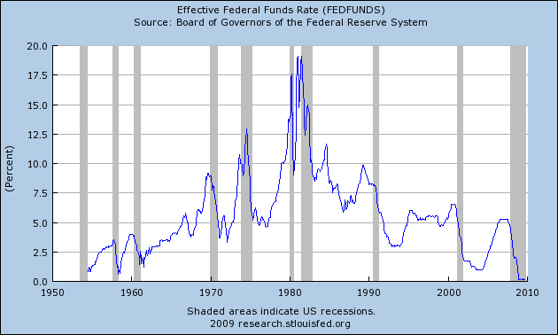

Slide 9
Fed Balance Sheet
http://blogs.wsj.com/economics/2009/10/22/a-look-inside-the-feds-balance-sheet-102109-update/
(interactive graphic)

Slide 10
Federal Reserve Balance Sheet
(Billions of dollars)
 | 9/30/09 | 6/27/07
Total assets | 2,144 | 869
Short-term lending programs for financial institutions | 264 | 0
Targeted lending programs | 84 | 0
Securities holdings | 1,593 | 791
Treasury securities | 769 | 791
GSE-related securities | 824 | 0
Emergency lending | 101 | 0
Other assets (such as foreign exchange, bank premises) | 102 | 78
Total liabilities | 2,093 | 836
Federal Reserve notes | 874 | 775
Reserve balances | 848 | 16
Treasury deposits | 273 | 4
Other (such as foreign official deposits) | 98 | 41

