Slide 1
Nov 2, 2009
The Financial Crisis
The Federal Reserve
Exam Friday: Ch 6-11, readings, Aplia, class lectures (not Janus forum lecture)

Slide 2
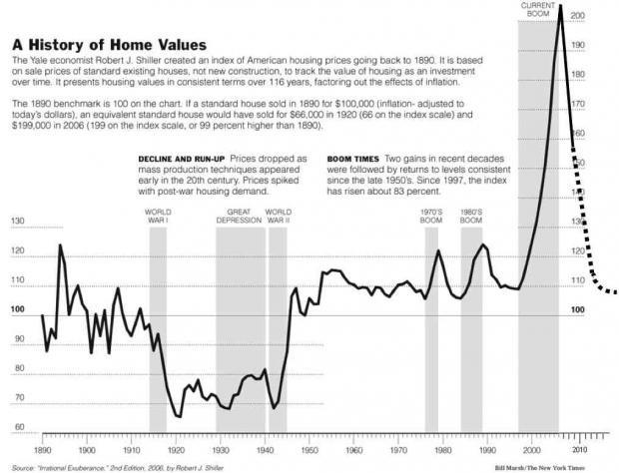

Slide 3
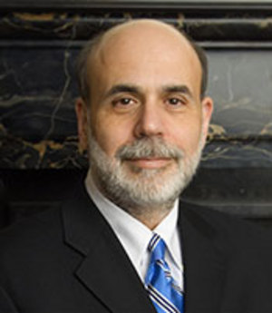
Ben Bernanke

Slide 4
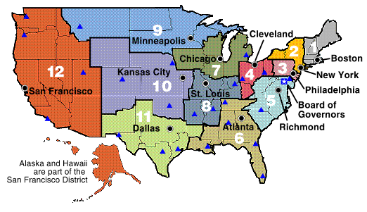
Federal Reserve Regional Banks

