Slide 1
Oct 30, 2009
Money (con’t)
Banks
Money Creation Process
Understanding the Causes of the Financial Crisis

Slide 2
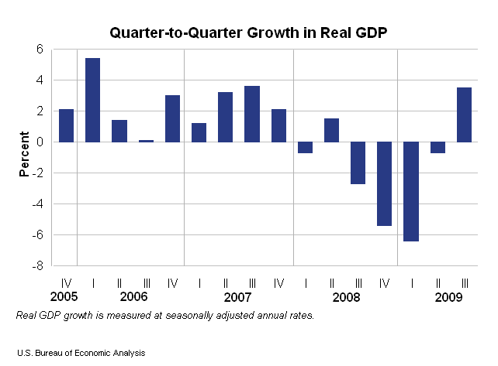

Slide 3
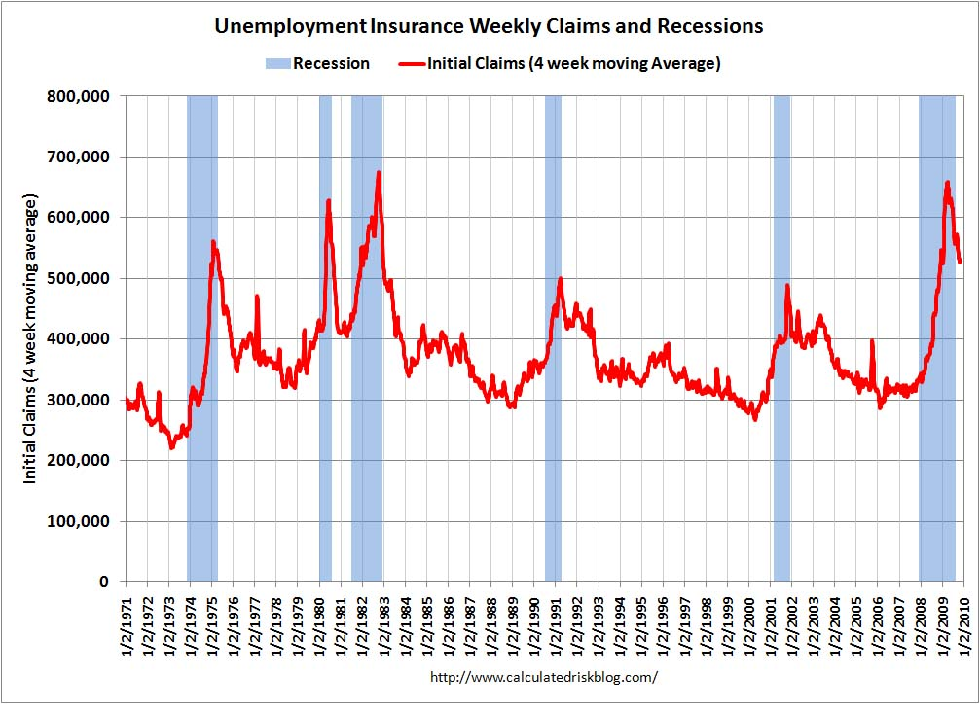

Slide 4
Banks and Money Creation
The process by which banks create money is so simple the mind is repelled.
--John Kenneth Galbraith

Slide 5
Basic Accounting: T Account
Assets
Liabilities
Something of value the bank owns
Currency
Loans (student, car, mortgage)
Bonds
Something of value the bank owes to someone—a claim on the bank
Checking accts (demand deposit)
Savings account
Debt or loans from someone
equity
Assets = Liabilities + New Worth

Slide 6
FDIC

Slide 7
