Slide 1
Oct 28, 2009
I. Unemployment
Causes
Policies
II. Money
What it is
How much is there
III. Banks

Slide 3
Union Membership

Slide 4
Functions of Money
Medium of Exchange
Store of Value
Unit of Account

Slide 5
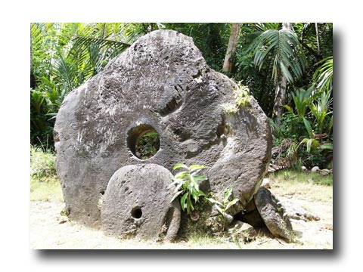
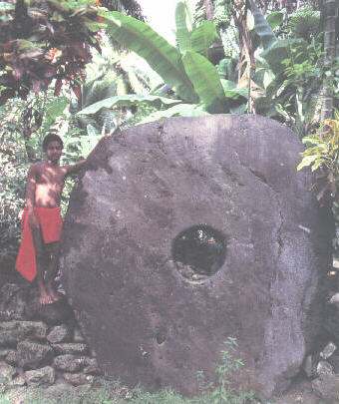
Stone Money of Yap Island

Slide 6
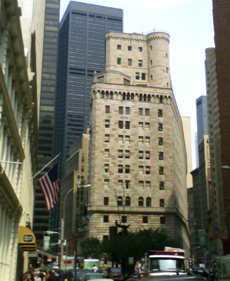
Federal Reserve Bank of NY

Slide 7
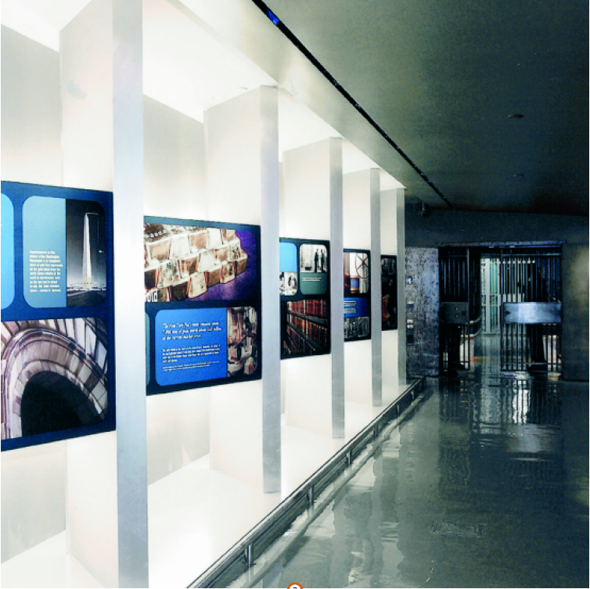
Gold Vault at NY Fed
80 feet below ground, on Manhattan bedrock

Slide 8
Hard to break into (Bruce Willis notwithstanding)

Slide 9
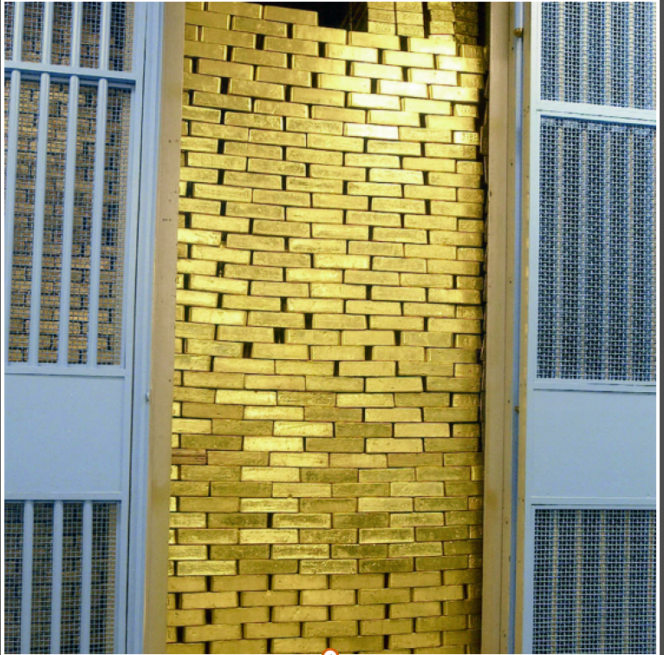
On the other side of the door is 266 million ounces of gold. Each bar is worth about $450,000 at current market rates.

Slide 10
A job worth having?

Slide 11
Resisting temptation

Slide 13
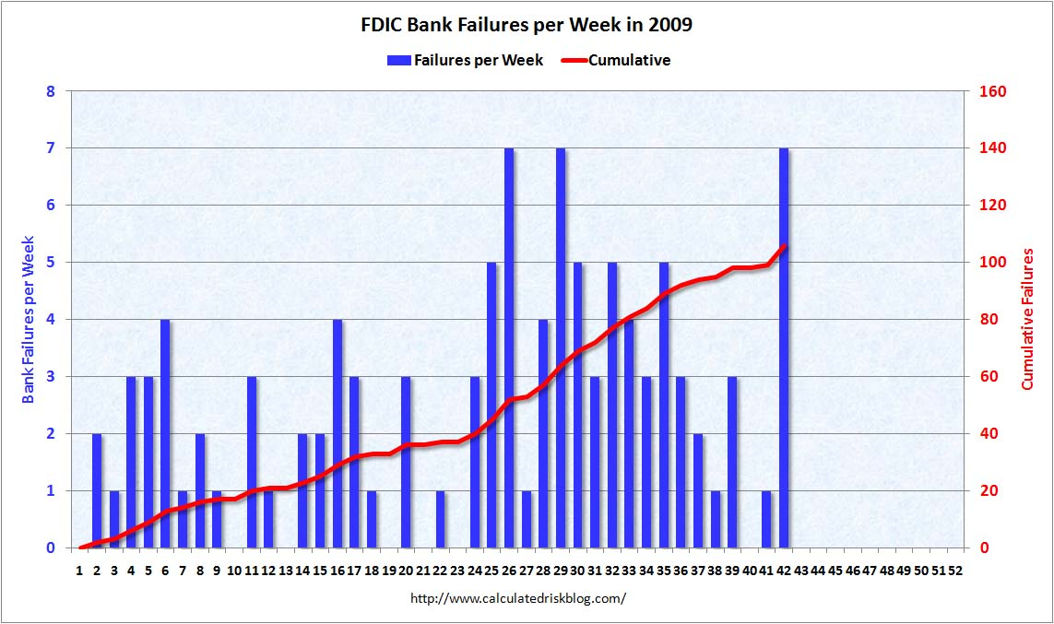

Slide 15
FDIC

