Slide 1
Oct 26, 2009
Unemployment
Definition and Measurement
Trends
Causes
Policies
Cool graphic here: http://www.mitacstrends.com/employment.html

Slide 2
Payroll Employment 1940-2009
Notes:
Note in 1970s US created 24 million jobs. 1980s 17 million 1990s 15 million 2000-07 7.4 million
2000 to 2009 100,000

Slide 3
How to Calculate Unemployment Rate
Ask 60,000 households: Are you working?
You are employed and in labor force
Have you looked for work in past 4 weeks?
You are unemployed and in labor force
You are not in labor force and are not unemployed
Yes
No
Yes
No

Slide 4
September 2009 Employment and Unemployment
Labor Force 154.0 million
Employed People 138.9 million
Unemployed People 15.1 million
15.1/(138.9+15.1)=15.1/(154) = 9.8%
Source: http://www.bls.gov/news.release/empsit.nr0.htm

Slide 5
Sept 09 Selected Unemployment Rates
All 9.8%
Adult Men 10.3%
Adult Women 7.8%
Black Male Teens 16-19 50.4%
White Male Teens 16-10 26.6%

Slide 6
Education, Unemployment, and Earnings

Slide 7
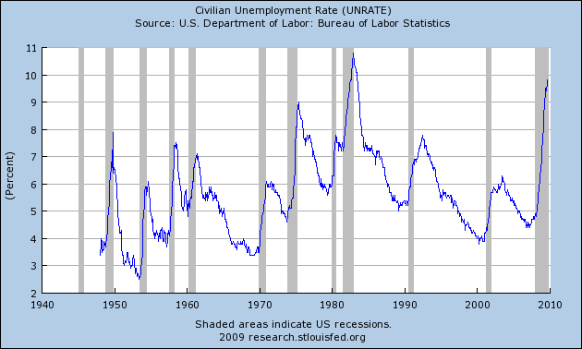
Unemployment Rate 1948-2009

Slide 8
Recent Unemployment Trends

Slide 9
In a Recession, Unemployment is Longer

Slide 10
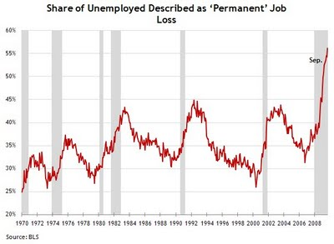

Slide 11
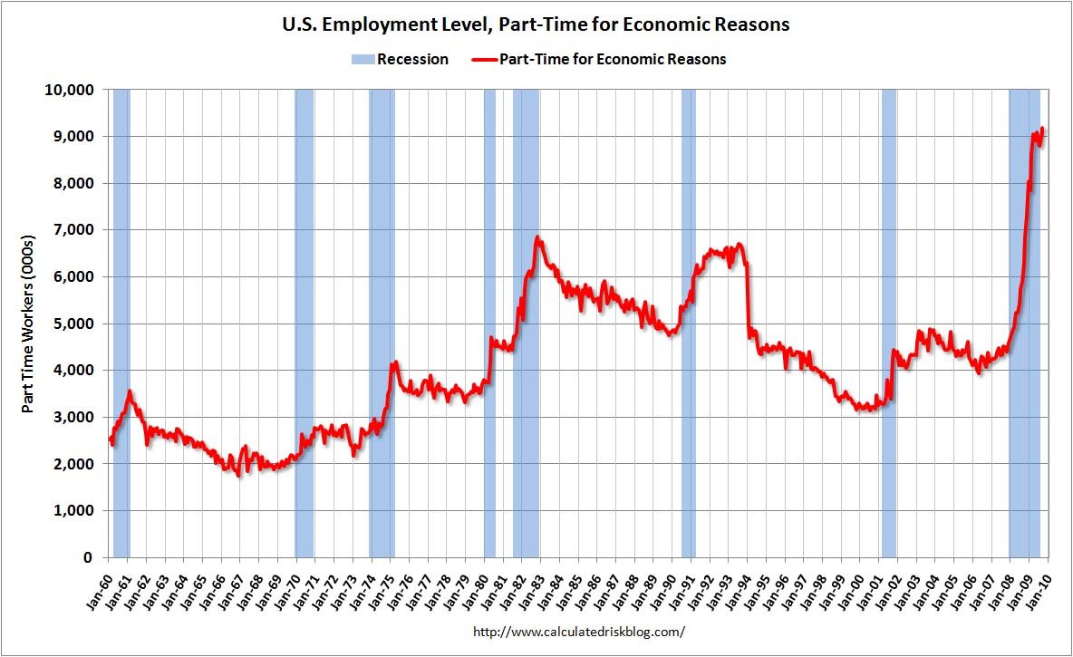

Slide 12
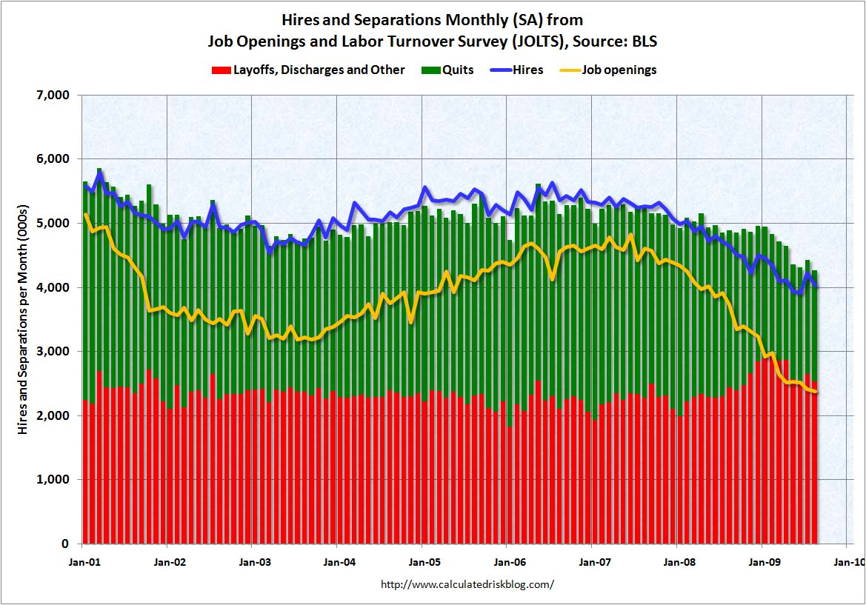

Slide 13
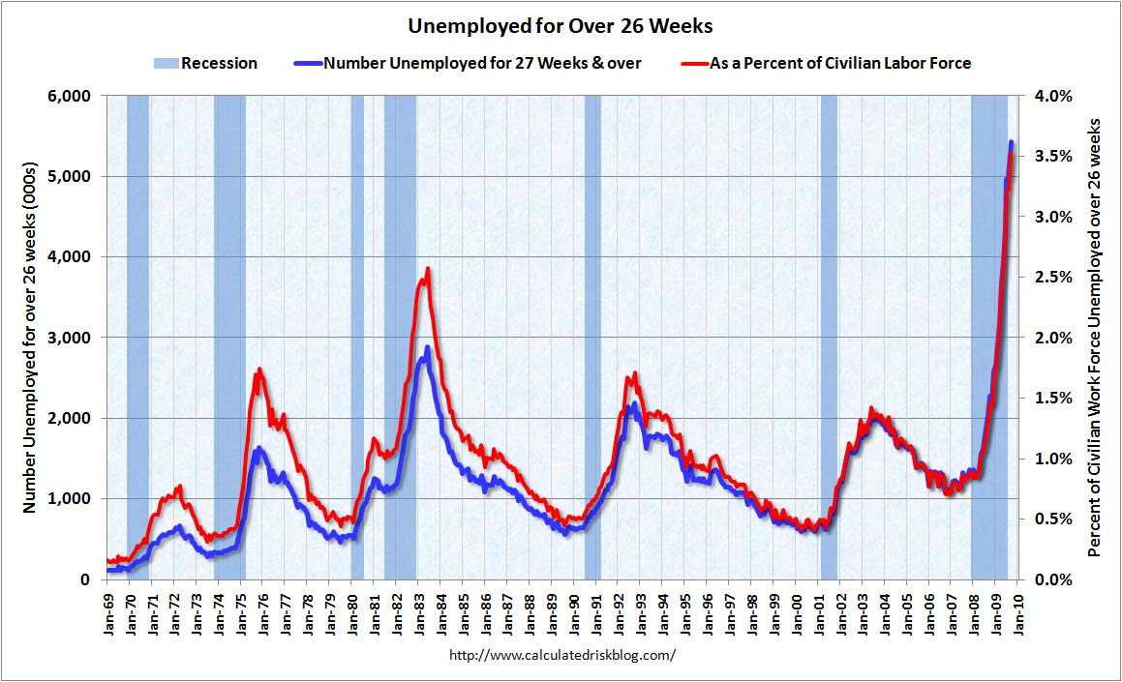

Slide 14
Payroll Employment 1940-2009
Notes:
Note in 1970s US created 24 million jobs. 1980s 17 million 1990s 15 million 2000-07 7.4 million
2000 to 2009 100,000

Slide 17
Participation Rate Rose 1965-2009

Slide 18
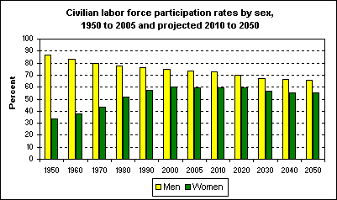

Slide 19
Union Membership

