Slide 1
Social Security and Personal Finance
October 21
How it Works
Problems
Solutions
Your Personal Financial Life

Slide 2
1. Suppose you had $100 in a savings account and the interest rate was 2 percent per year. After 5 years, how much do you think you would have in the account if you left the money to grow?
a. More than $102
b. Exactly $102
c. Less than $102
d. Do not know
2. Imagine that the interest rate on your savings account was 1 percent per year and inflation was 2 percent per year. After 1 year, would you be able to buy more than, exactly the same as, or less than today with the money in this account?
a. More than today
b. Exactly the same as today
c. Less than today
d. Do not know
3. Do you think that the following statement is true or false? “Buying a single company stock usually provides a safer return than a stock mutual fund.”
a. True
b. False
c. Do not know

Slide 3
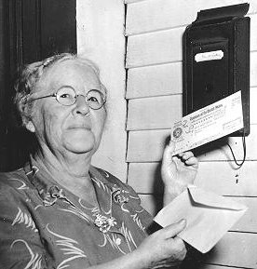
Ida Mae Fuller
Notes:
Ida May Fuller worked for three years under the Social Security program and retired in 1939 The accumulated taxes on her salary during those three years was a total of $24.75. Her initial monthly check on January 1, 1940 was $22.54. She died in 1975 at age 100. During her lifetime she collected a total of $22,888.92 in Social Security benefits.

Slide 4
How it works
FICA: Federal Insurance Contribution Act (1935)
Currently 6.2% on employer and employee up to $108,600 = 12.4%
Medicare tax is 1.45% on employer and employee = 2.9%
Total SS and Medicare Tax = 15.3%
Tax incidence issues--Who Pays?

Slide 5
PAYGO
# workers x tax rate x income = # retirees x benefits per retiree or income = outgo
W x t x Inc = R x SS$
10 x 10% x $30,000 =
Assume 3 retirees, how much does each get?
Now assume 5 retirees, what happens?

Slide 6
PAYGO (cont)
10 x 10% x $30,000 = $30,000 so if 3 retirees each gets $10,000
If 5 retirees, each gets $6,000
  Tax rate has to increase
  Have to have more workers
  Or income has to rise

Slide 7
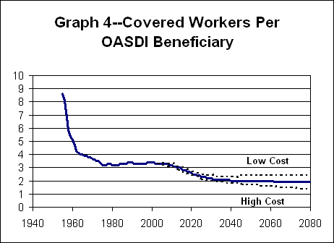

Slide 9
Social Security: Key Dates
 | Social Security | Medicare
First Year Outgo exceeds Income | 2025 | 2008
Year Trust Funds Are Exhausted | 2039 | 2017
Notes:
After SS exhausted, benefits shrink to 75% of promised level. Taxes not sufficient .
Trust funds were exhausted in 1982.

