Slide 1
Oct 19, 2009
National Debt
Problems with the debt
Social Security

Slide 2
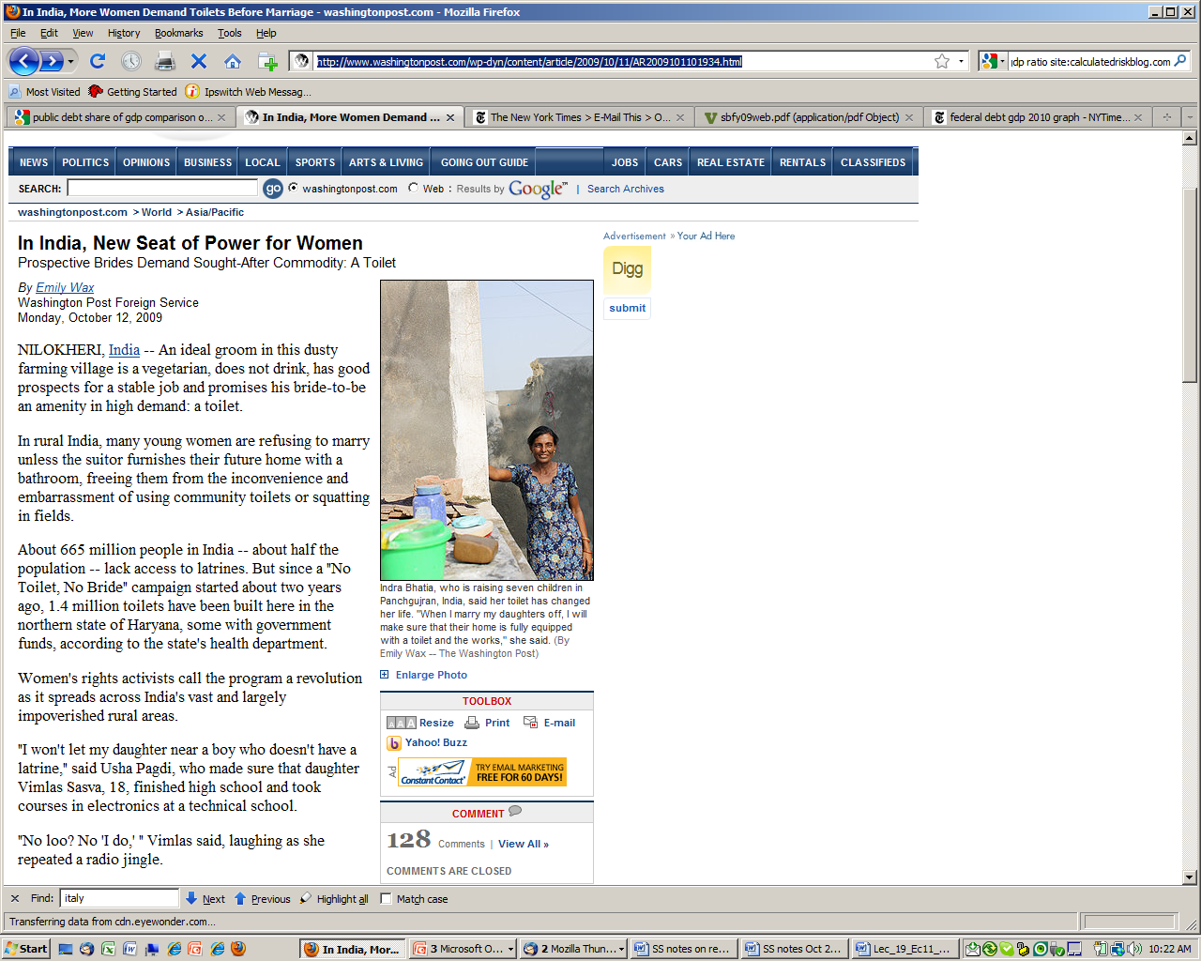

Slide 3
The price of a bride in India has increased….why?
(Washington Post Oct 12, 2009)
NILOKHERI, India -- An ideal groom in this dusty farming village is a vegetarian, does not drink, has good prospects for a stable job and promises his bride-to-be an amenity in high demand: a toilet.
In rural India, many young women are refusing to marry unless the suitor furnishes their future home with a bathroom, freeing them from the inconvenience and embarrassment of using community toilets or squatting in fields.
About 665 million people in India -- about half the population -- lack access to latrines. But since a "No Toilet, No Bride" campaign started about two years ago, 1.4 million toilets have been built here in the northern state of Haryana, some with government funds, according to the state's health department.
Women's rights activists call the program a revolution as it spreads across India's vast and largely impoverished rural areas.
"I won't let my daughter near a boy who doesn't have a latrine," said Usha Pagdi, who made sure that daughter Vimlas Sasva, 18, finished high school and took courses in electronics at a technical school.
"No loo? No 'I do,' " Vimlas said, laughing as she repeated a radio jingle.

Slide 4
Debt (not deficit)

Slide 6
Note: Does not include $4,785 billion held in U.S. government accounts

Slide 7
Foreign Debt Holdings in $bil

Slide 8
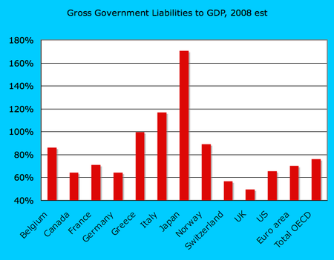
Debt/GDP of Major OECD Nations

Slide 9
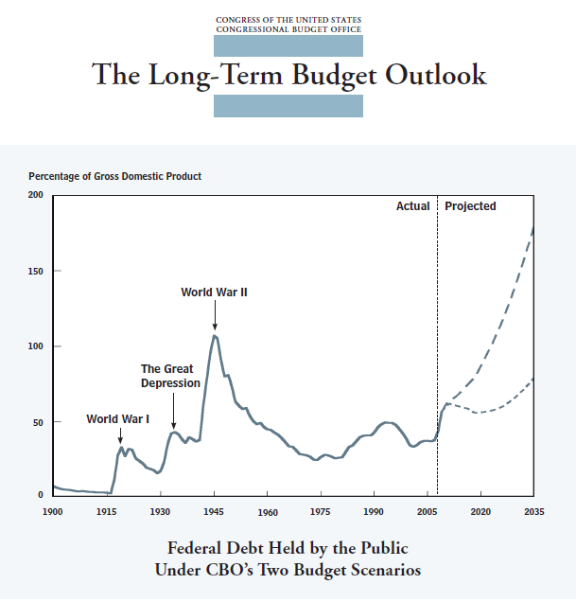
Long Run Problems…

Slide 10
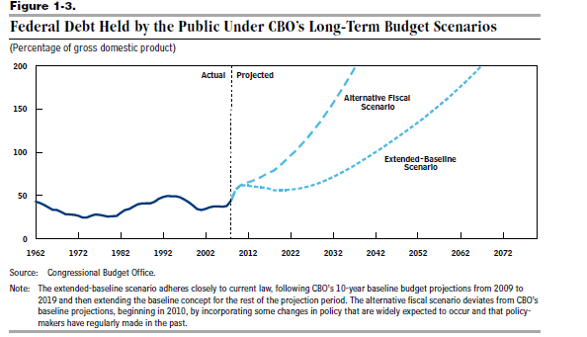
…And Longer Run Problems

Slide 11
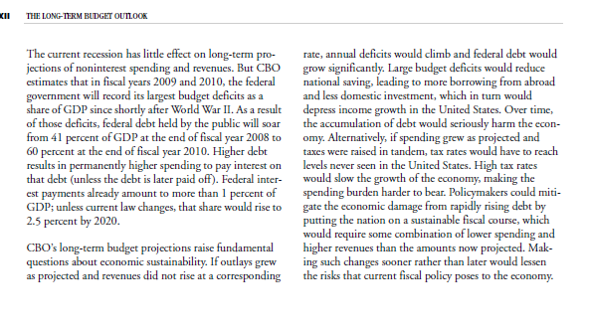

Slide 12
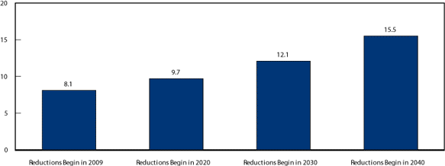
The Longer We Wait, the Harder it Gets
Reductions in Noninterest Spending Needed to Close the Fiscal Gap in Various Years Under CBO’s Alternative Fiscal Scenario
(Percentage of gross domestic product)
Source: CBO

