Slide 1
Oct 16, 2009
Deficits and Debt
Problems with the debt
Social Security

Slide 2
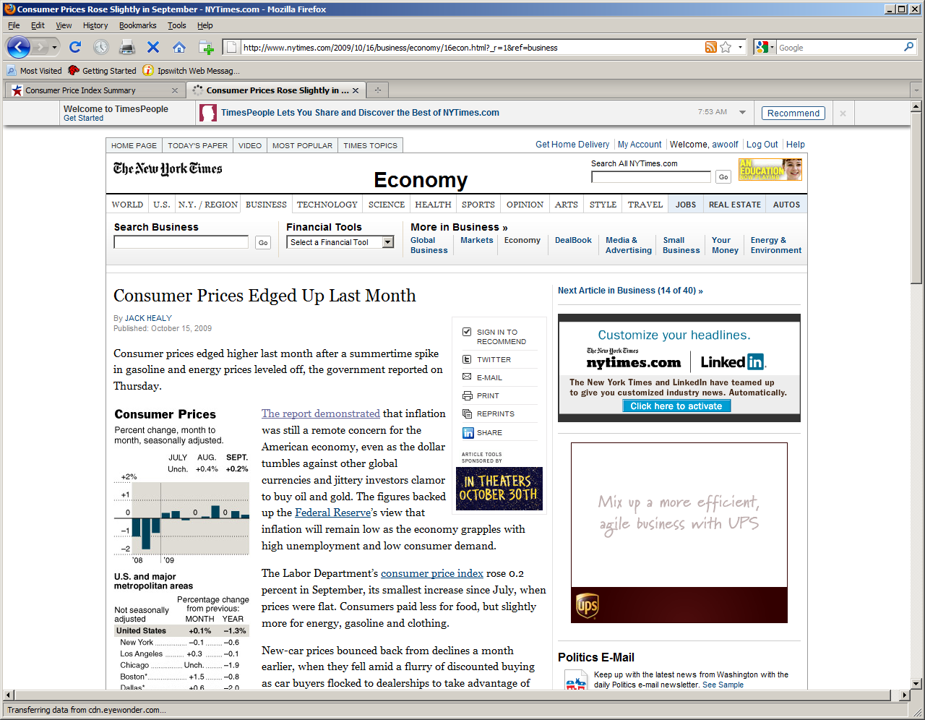

Slide 6
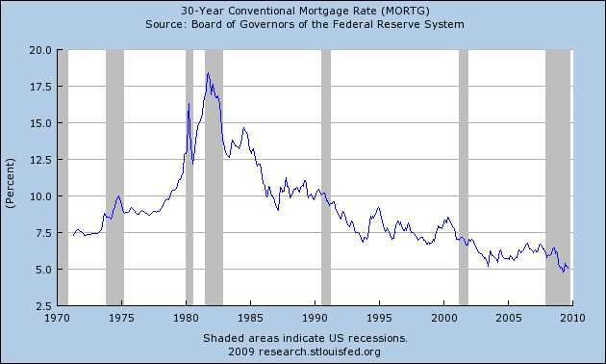
Mortgage Rates: Why so low?

Slide 7
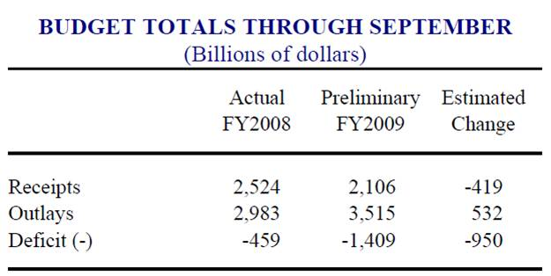

Slide 8
Federal Surplus/Deficit (G-T)

Slide 9
Recent Deficit/Surplus

Slide 10
Deficit/Surplus as Share of GDP

Slide 11
Recent History

Slide 12
Debt (not deficit)

