Slide 1
Oct 14, 2009
Savings and Investment
The Savings and Investment Identity
Deficits and Debt
Problems with the debt

Slide 2
Today’s News

Slide 3
The Algebra of Savings and Investment
GDP = C+I+G+NX expenditures = output= income
Ignore ROW, so Y = C+I+G
Y – C – G = I
Y – C – G = S
S = Y (– T + T) – C – G
S = (Y – T – C) + (T – G)
Total Savings = Private Savings + Public Savings

Slide 4
Where does the Federal government get its revenues?
Income Taxes ____%
Social Security Taxes ____%
Corporate Taxes ____%
Sales Taxes ____%
Property Taxes ____%
Excise Taxes (gas, tobacco, alcohol) ____%
Tariffs ____%
Estate Taxes ____%
9. How much tax revenue did the federal government collect in FY08? $ ____

Slide 5
Where does the Federal government get its revenues? (FY08)
Income Taxes ($1,146 b) 45%
Social Security Taxes ($900 b) 36%
Corporate Income Taxes ($304b) 12%
Sales Taxes ($0)
Property Taxes ($0)
Excise Taxes (gas, tobacco, alcohol) ($67b) 3%
Tariffs ($28b) 1%
Estate Taxes ($29b) 1%
Other ($50b) 2%
How much tax revenue did the federal government collect in FY08? ($2,524 billion)
(Source: http://www.gpoaccess.gov/usbudget/browse.html

Slide 7
Where does the Federal government spend its money?
 | $ Amount | Percent of Total
Defense
Social Security
Medicare
Medicaid
Interest
Income security
Other retirement
International
Other
Total |  | 100%

Slide 8
Where does the Federal government spend its money?
 | $ Amount ($bil) | Percent of Total
Defense | $616 | 21%
Social Security | $617 | 21%
Medicare | $456 | 15%
Medicaid | $201 | 7%
Interest | $254 | 9%
Income security | $260 | 9%
Other retirement | $129 | 4%
International | $29 | 1%
Other | $421 | 14%
Total | $2,983 | 100%

Slide 9
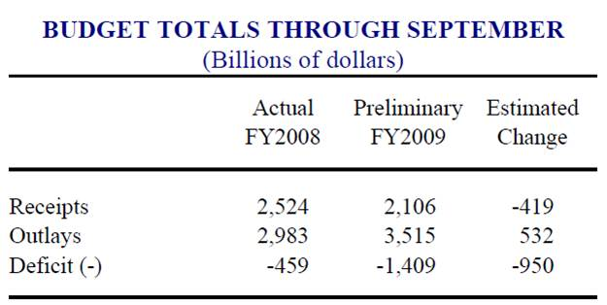

Slide 10
Federal Surplus/Deficit (G-T)

Slide 11
Recent Deficit/Surplus

Slide 12
Deficit/Surplus as Share of GDP

Slide 13
Recent History

Slide 14
Debt (not deficit)

Slide 17
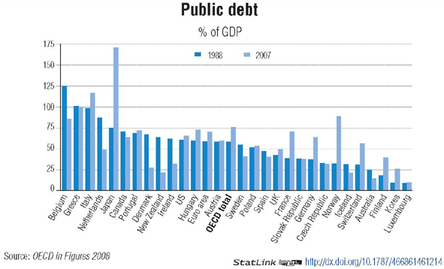
International Comparisons

Slide 19
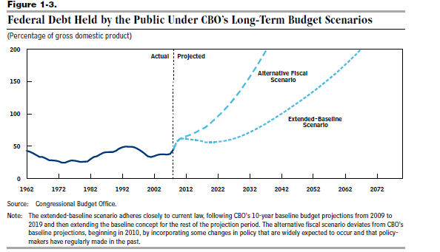

Slide 20
