Slide 1
Oct 12, 2009
Factors of Production (continued)
Human Capital
Physical Capital
Technology
Resources
Institutions
Savings and Investment
Savings
Bonds and Stocks
The Savings and Investment Identity

Slide 2
Exam 1
 | Minimum # Correct (40 Max) | Equivalent % | % of Class With This Grade
A | 34 | 85% | 16%
B | 30 | 75% | 28%
C | 26 | 65% | 26%
D | 20 | 50% | 20%
F | 19 | 49% | 9%
Average | 28

Slide 4
2009 Nobel Prize in Economics
Elinor Ostrom (Indiana)
Oliver Williamson (Berkeley)
"Elinor Ostrom has challenged the conventional wisdom that common property is poorly managed and should be either regulated by central authorities or privatized. Based on numerous studies of user-managed fish stocks, pastures, woods, lakes, and groundwater basins, Ostrom concludes that the outcomes are, more often than not, better than predicted by standard theories."
"[L]arge private corporations exist primarily because they are efficient. They are established because they make owners, workers, suppliers, and customers better off than they would be under alternative institutional arrangements.”

Slide 5
Resource Availability
http://www.nytimes.com/2009/10/10/business/energy-environment/10gas.html?th&emc=th

Slide 6
To understand how to alleviate poverty, we must understand growth and progress. Progress comes from new and better ideas. Ideas come in two flavors, technologies and rules. To foster growth and development, the world's poorest residents need an opportunity to copy existing technologies and existing rules that are known to work well.
--Paul Romer

Slide 7
Institutions and Economic Growth
Property Rights
Honest Government
Political Stability
Dependable Legal System
Free and Open Markets

Slide 8
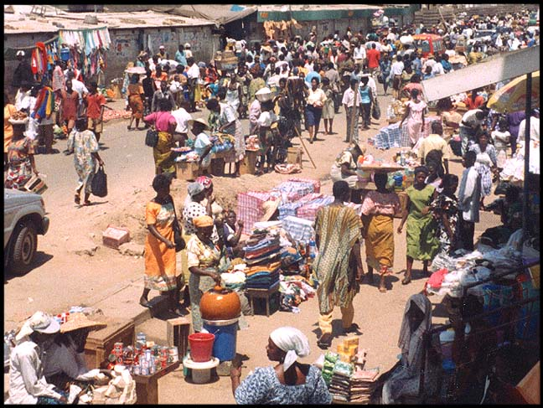
Street Market in Accra, Ghana

Slide 9
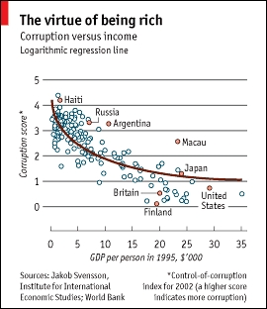

Slide 10
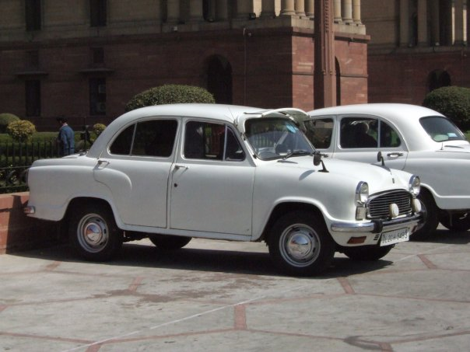
Indian Ambassador: Produced 1958 - Today
For the video go to http://www.pbs.org/wgbh/commandingheights/lo/index.html and
Click on Storyline, episode 2 chapter menu, chapter 4

Slide 11
The Algebra of Savings and Investment
GDP = C+I+G+NX expenditures = output= income
Ignore ROW, so Y = C+I+G
Y – C – G = I
Y – C – G = S
S = Y (– T + T) – C – G
S = (Y – T – C) + (T – G)
Total Savings = Private Savings + Public Savings

