Slide 1
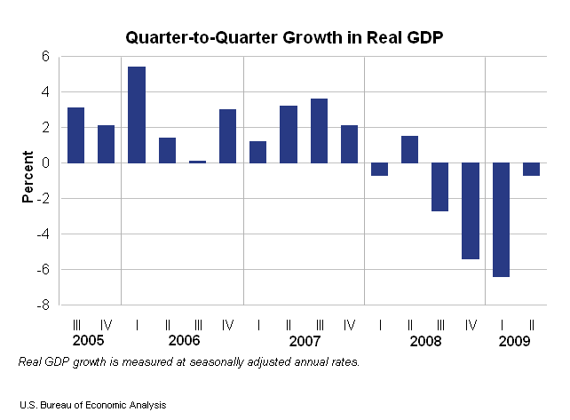
New GDP Estimate
Sept 30
Consumer Price Index
  Measurement
  Changes

Slide 2
The UNIVERSITY of VERMONT
JANUS FORUM
Monday October 5, 4-5:30pm
Grand Maple Ballroom, Davis Center, UVM Campus
$787 Billion:Stimulus orSedative
A Debate Featuring
Jeffrey Miron, Ph.D.
Senior Lecturer and Director of Undergraduate Studies
Harvard University
Senior Fellow, Cato Institute
and
Justin Wolfers, Ph.D.
Associate Professor of Business and Public Policy
University of Pennsylvania
Senior Fellow, Brooking Institution
Debate Moderator
Emerson Lynn
Editor and Publisher of the St. Albans Messenger
Reception Immediately Following in the Livak Fireplace Lounge 5:30–6:30p.m.

Slide 3
Exam 1
Friday October 2 in class
Multiple choice
Covers Ch 1-5, readings on syllabus, class materials, and emailed readings
Old exam is online
Justin does not have the exam questions or answers
NOTE: Syllabus says Fall recess is Oct 7—it is Oct 9
Aplia Assignment Sunday and Guest Lecture Monday—Prof Justin Wolfers
Janus Forum Debate Monday 4:00 Davis Center

Slide 4
http://www.bea.gov/newsreleases/national/gdp/2009/pdf/gdp2q09_3rd.pdf
http://www.npr.org/blogs/money/2009/09/halloween_holiday_sales_take_a.html

Slide 6
Consumer Price Index
50,000 households
87 urban areas
23,000 retail establishments
96,000 items

Slide 7
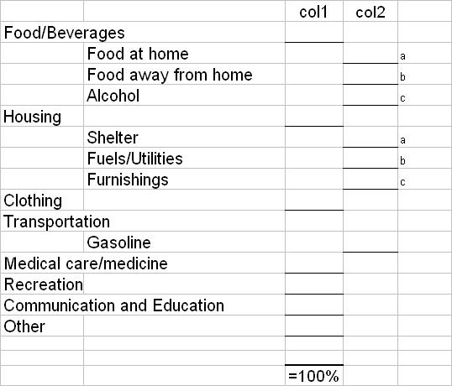
How Do People Spend? The CPI Basket

Slide 8
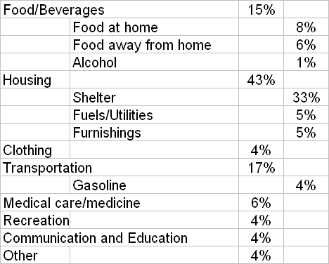
How Do People Spend? The CPI Basket

Slide 9
How is the CPI Calculated?
See handout

Slide 10
US Price Level 1774-1900

Slide 11
US Inflation Rate 1900 - 2008

Slide 12
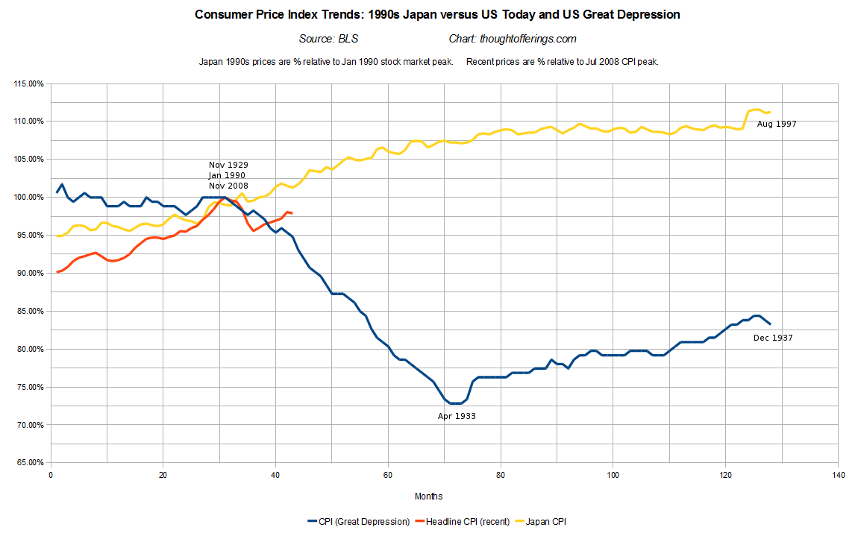
US Price Level 1900 - 2008

