Slide 1
Sept 28
Exam 1
Friday October 2 in class
Multiple choice: bring a pencil
Covers Ch 1-5, readings on syllabus, class materials, and emailed readings
No calculators, cell phones, or computers
Old exam is online
Justin does not have the exam questions or answers
Anyone who needs special accommodations should email me
NOTE: Syllabus says Fall recess is Oct 7—it is Oct 9
GDP
Measurement
Does GDP Measure Quality of Life?
NOTE: Oct 5 Janus Debate 4:00 in Davis Center

Slide 2
Exam 1
Friday October 2 in class
Multiple choice
Covers Ch 1-5, readings on syllabus, class materials, and emailed readings
Old exam is online
Justin does not have the exam questions or answers
NOTE: Syllabus says Fall recess is Oct 7—it is Oct 9

Slide 3
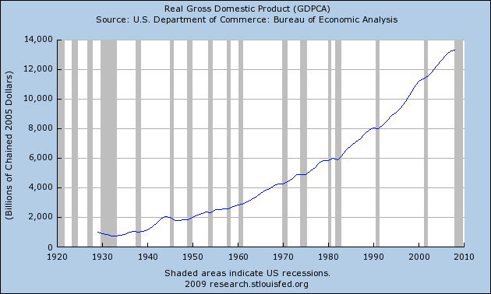

Slide 4
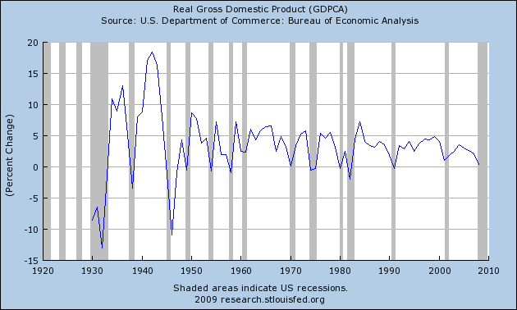
Notes:
Average growth rate is 3%

Slide 5
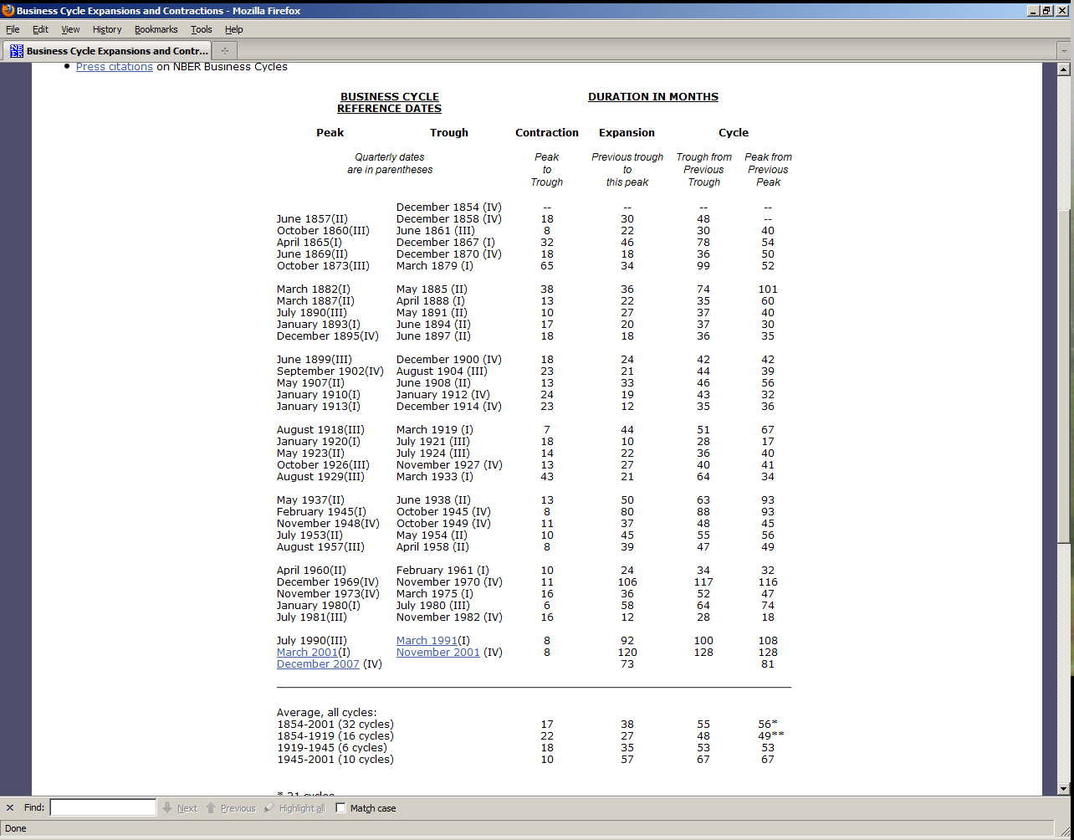

Slide 6
A recession is a significant decline in economic activity spread across the economy, lasting more than a few months, normally visible in real GDP, real income, employment, industrial production, and wholesale-retail sales. A recession begins just after the economy reaches a peak of activity and ends as the economy reaches its trough. Between trough and peak, the economy is in an expansion. Expansion is the normal state of the economy; most recessions are brief and they have been rare in recent decades.
---National Bureau of Economic Research

Slide 7
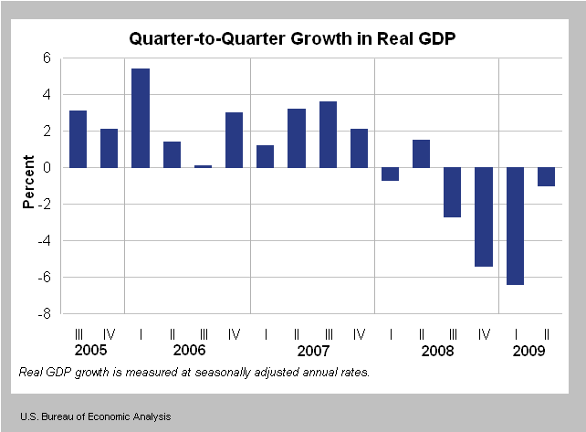
Recent GDP Trends
Notes:
Next GDP estimate: Sept 30 Final Estimate for Q2

Slide 8
GDP Growth in your lifetime
GDP in 1990 = $5,800 billion
GDP in 2008 = $14,441 billion
Growth = (14441-5800)/5800 = 148%

Slide 9
Adjust for inflation
We want 1990 quantities at 2008 prices
GDP in 1990 at 2008 prices = Real 1990 output x 2008 price of
each good produced = $8,034 billion
So real GDP growth is (14,441-8,034)/8,034 = 79.8%

Slide 10
Components of GDP ($billion)
GDP | $ 14,143.3
Consumption | $ 9,996.6 | 71%
Investment | $ 1,558.6 | 11%
Government Spending on Goods and Services | $ 2,926.8 | 21%
Net Exports (X-IM) | $ (338.7) | -2%

Slide 11
Gory Details
GDP | $ 14,143.3
Consumption | $ 9,996.6
Goods |  | $ 3,191.2
Services |  | $ 6,805.3
Investment | $ 1,492.2
Nonresidential |  | $ 1,387.3
Residential Housing |  | $ 346.2
Government Consumption | $ 2,926.8
Federal |  | $ 1,137.0
Defense |  |  | $ 775.0
Nondefense |  |  | $ 362.0
State and Local |  | $ 1,789.8
Net Exports | $ (338.7)
Exports |  | $ 1,492.2
Imports |  | $ 1,830.8

Slide 12
What GDP Does Not Measure
Non-Priced Services
Illegal Activity
Leisure
Bads
Poverty and inequality
Love, Satisfaction, Happiness

Slide 13
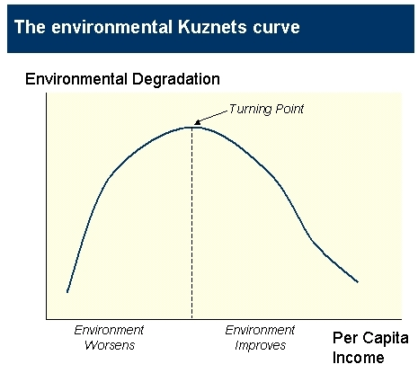
Environmental Quality and GDP

Slide 14
GDP Around The World
Rank | Nation | GDP in Billions | GDP/capita
1 | United States | $14,260 | $46,900
2 | China | $7,973 | $6,000
3 | Japan | $4,329 | $34,000
4 | India | $3,297 | $2,900
5 | Germany | $2,918 | $35,400
6 | Russia | $2,266 | $16,100
7 | United Kingdom | $2,226 | $36,500
8 | France | $2,128 | $33,200
9 | Brazil | $1,993 | $10,200
10 | Italy | $1,823 | $31,300
12 | Mexico | $1,563 | $14,200
15 | Canada | $1,300 | $39,100
202 | Haiti | $12 | $1,300
219 | Afghanistan | $22 | $700

Slide 15
G20’s GDP as a proportion of world total: 2008

Slide 16
GDP per capita in PPP terms of G20: 2008

Slide 17
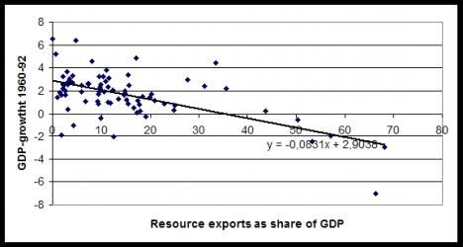
Are Natural Resources Key?

Slide 18
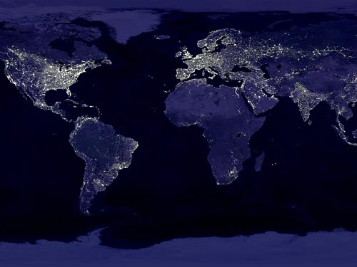
GDP and Light

Slide 19
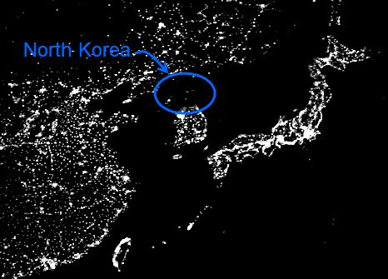
…And Where It’s Not Light

Slide 20
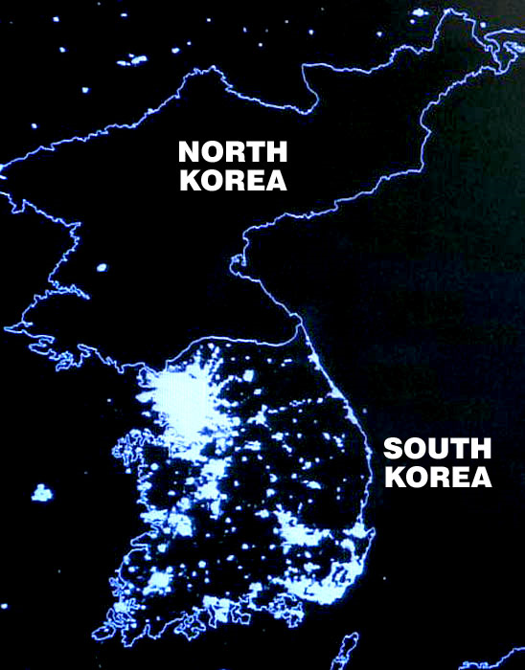

Slide 21
A Tale of Two Koreas
 | North Korea | South Korea
GDP | $40 billion | $1,335 billion
GDP/capita | $1,800 | $27,600
Electricity Production | 22 billion kwh | 440 billion kwh
Telephone land lines | 1.2 million | 23.9 million
Cellular phones | 0 | 43 million
Population | 23 million | 48 million
Note that in 1955 the two Koreas had approximately equal GDPs per capita and they were
both lower than Argentina’s. Today Argentina’s GDP per capita is $14,200.

Slide 22
GDP and Quality of Life: Food Supply

Slide 23
GDP and Quality of Life: Safe Water

Slide 24
Access to Goods in the US: Growth and Poverty
Pct of HHS with | All U.S. HHs 1971 | Poor U.S. HHs 1994
Washing Machine | 71% | 72%
Dryer | 44% | 50%
Dishwasher | 19% | 20%
Refrigerator | 83% | 98%
Color TV | 43% | 93%
Telephone | 93% | 77%
Air Conditioner | 32% | 50%
One or more cars | 80% | 72%
Source: U.S. Census Bureau

