Slide 1
Sept 23, 2009
How Markets Work (part 3)
Changes in Price and Quantity
Price Floors and Ceilings
GDP
Definition
Measurement
When this Ford vehicle is imported into the U.S. from Turkey by Ford, the first thing Ford does is rip out the rear seats, remove the windows and send them to a recycling center. Then it covers the holes in the floor and plugs the window spaces with metal. All at a cost of hundreds of dollars per vehicle. Ford does this to save money. Why?

Slide 2
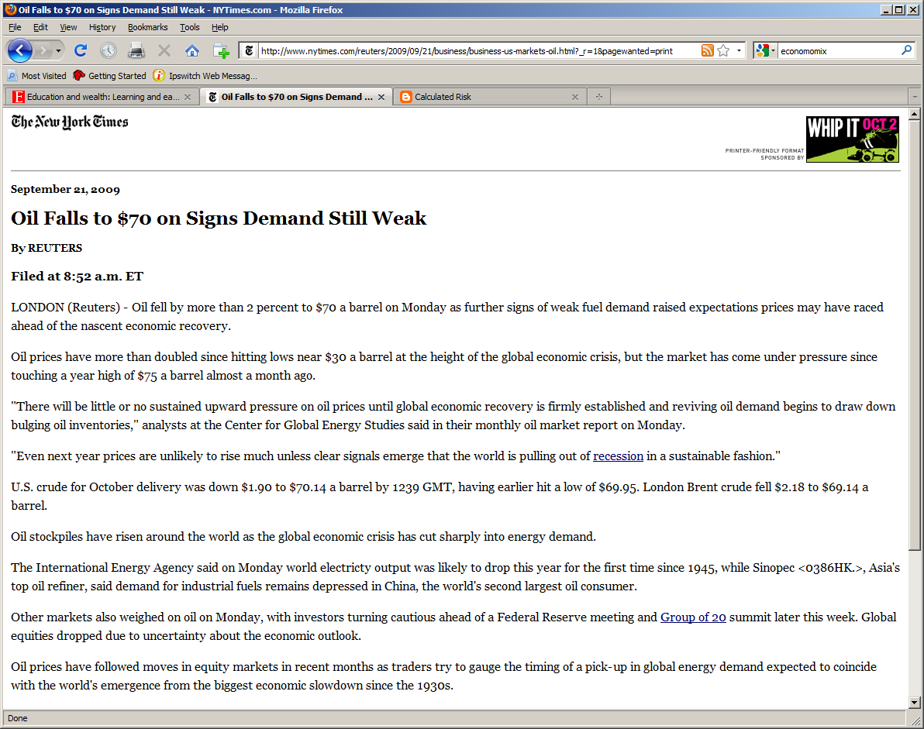

Slide 3
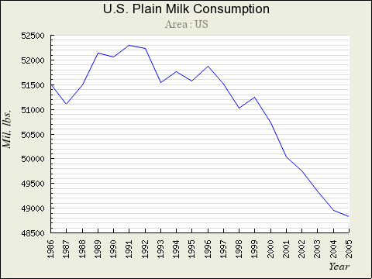
Supply and Demand and Dairy Problem

Slide 4
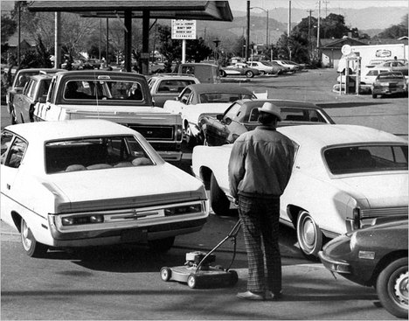
Gas Lines in 1974: Why

